Slide 1
Proving Right Triangles Congruent

Slide 2
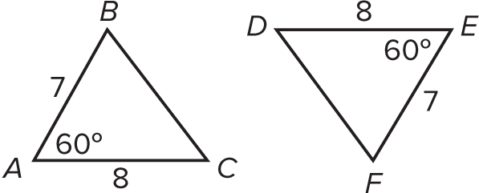
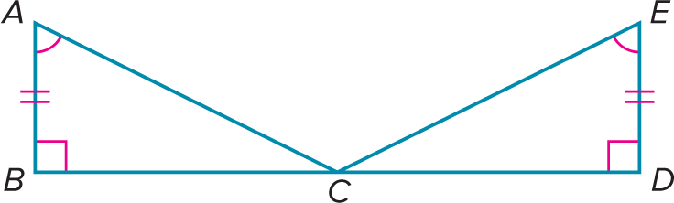
Warm Up
Write SSS, SAS, ASA, or none to indicate which congruence postulate you would use to prove the two triangles congruent.
1. 2.

Slide 3
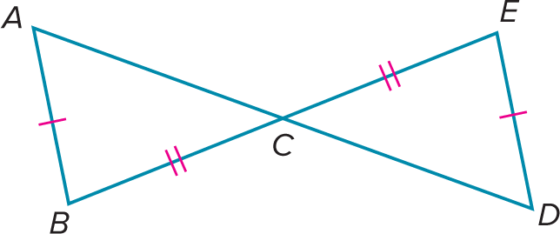
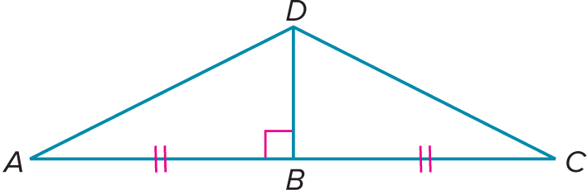
Warm Up
Write SSS, SAS, ASA, or none to indicate which congruence postulate you would use to prove the two triangles congruent.
3. 4.

Slide 4
Warm Up
Write SSS, SAS, ASA, or none to indicate which congruence postulate you would use to prove the two triangles congruent.
1. 2.
SAS
ASA
Notes:
SAS
ASA

Slide 5
Warm Up
Write SSS, SAS, ASA, or none to indicate which congruence postulate you would use to prove the two triangles congruent.
3. 4.
none
SAS
Notes:
none
SAS

Slide 6
Florida’s B.E.S.T. Standards for Mathematics
MA.912.GR.1.2 Prove triangle congruence or similarity using Side-Side-Side, Side-Angle-Side, Angle-Side-Angle, Angle-Angle-Side, Angle-Angle and Hypotenuse-Leg.
MA.912.GR.1.3 Prove relationships and theorems about triangles. Solve mathematical and real-world problems involving postulates, relationships and theorems of triangles.
MA.912.GR.1.6 Solve mathematical and real-world problems involving congruence or similarity in two-dimensional figures.

Slide 7
Florida’s Mathematical Thinking and Reasoning Standards
MA.K12.MTR.2.1
Demonstrate understanding by representing problems in multiple ways.
MA.K12.MTR.7.1
Apply mathematics to real-world contexts.

Slide 8
Lesson Objectives
Content Objective
Students will use right triangle congruence theorems to solve problems.
Language Objectives
Students solve problems and then make statements of explanation using because.
To optimize output, students participate in MLR7: Compare and Connect.

Slide 9
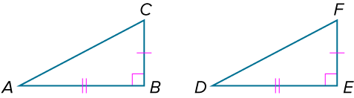
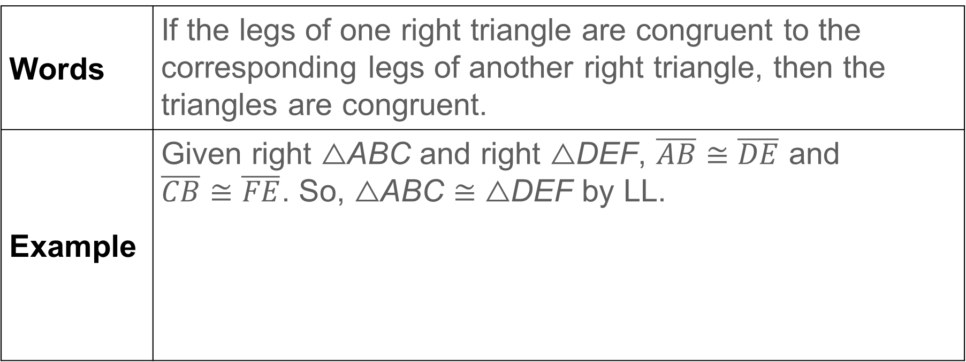
Learn
Right Triangle Congruence
Theorem 5.6: Leg-Leg (LL) Congruence
Words | If the legs of one right triangle are congruent to the corresponding legs of another right triangle, then the triangles are congruent.
Example | Given right △ABC and right △DEF, $\overline{AB}≅\overline{DE}$ and $\overline{CB}≅\overline{FE}$. So, △ABC ≅ △DEF by LL.

Slide 10
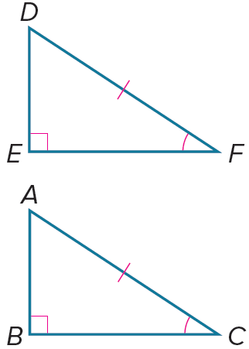
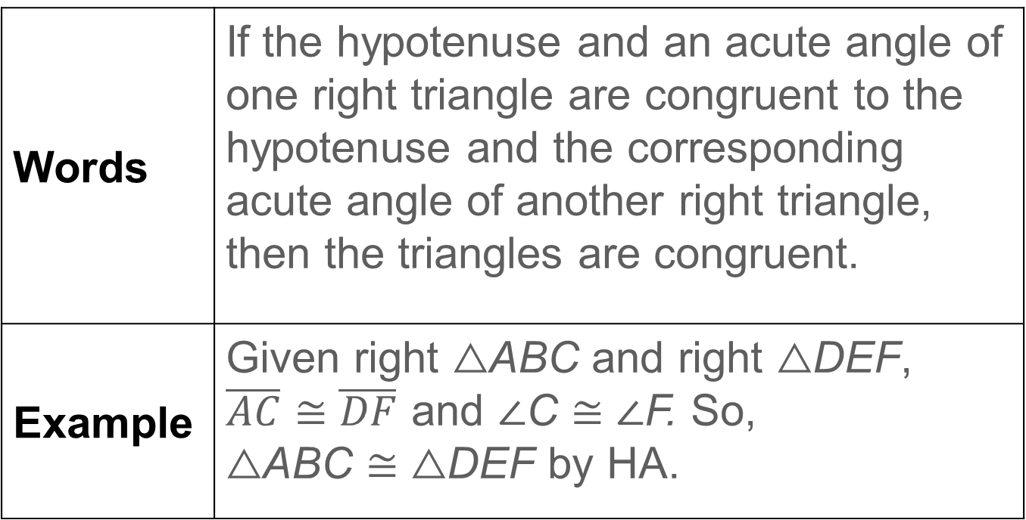
Learn
Right Triangle Congruence
Theorem 5.7: Hypotenuse-Angle (HA) Congruence
Words | If the hypotenuse and an acute angle of one right triangle are congruent to the hypotenuse and the corresponding acute angle of another right triangle, then the triangles are congruent.
Example | Given right △ABC and right △DEF, $\overline{AC}≅\overline{DF}$ and ∠C ≅ ∠F. So, △ABC ≅ △DEF by HA.

Slide 11
Learn
Right Triangle Congruence
Theorem 5.8: Leg-Angle (LA) Congruence
If one leg and an acute angle of one right triangle are congruent to the corresponding leg and acute angle of another right triangle, then the triangles are congruent.
Theorem 5.9: Hypotenuse-Leg (HL) Congruence
If the hypotenuse and a leg of one right triangle are congruent to the hypotenuse and the corresponding leg of another right triangle, then the triangles are congruent.

Slide 12
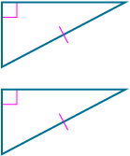
Learn
Right Triangle Congruence
Talk About It!
Can you declare that the given triangles are congruent by HA? Justify your argument.

Slide 13
Example 1
Problem Solving with Right Triangles
HOME IMPROVEMENT Craig and his brother are painting a house. The brothers use ladders that are the same length. If they place their ladders an equal distance from the house, will each ladder reach the same height on the house? Construct a narrative proof.

Slide 14
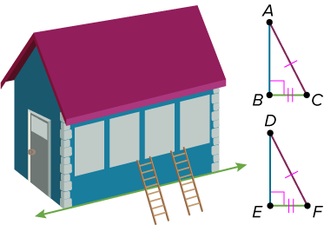
Example 1
Problem Solving with Right Triangles
Draw a diagram to model this situation. It is given that the lengths of the ladders are the same and that they are placed the same distance from the house.

Slide 15
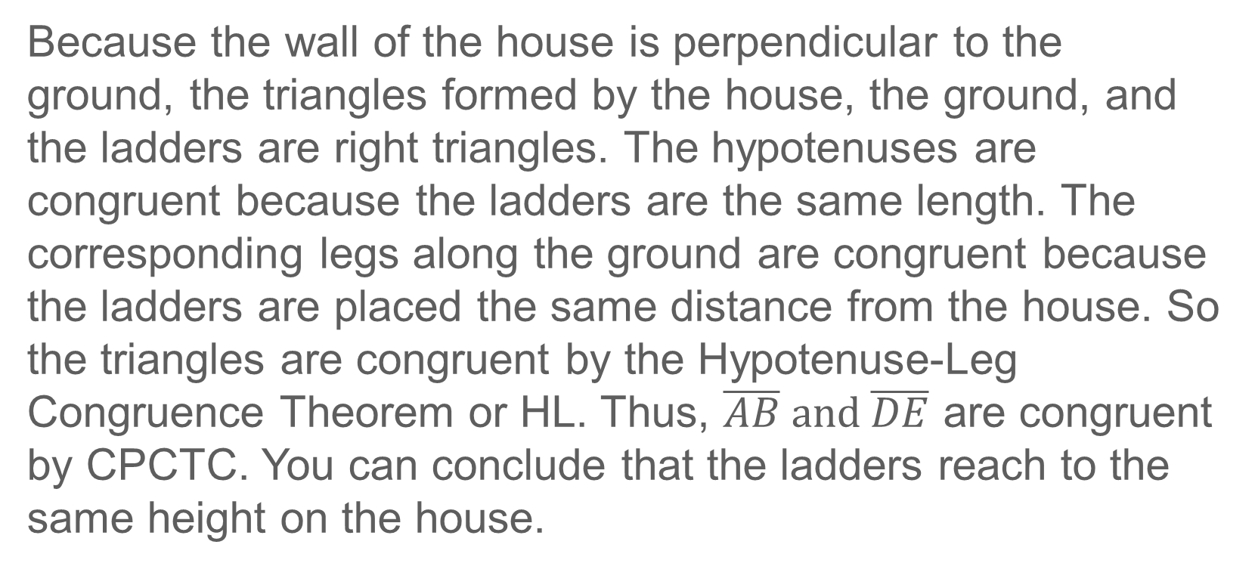
Example 1
Problem Solving with Right Triangles
Because the wall of the house is perpendicular to the ground, the triangles formed by the house, the ground, and the ladders are right triangles. The hypotenuses are congruent because the ladders are the same length. The corresponding legs along the ground are congruent because the ladders are placed the same distance from the house. So the triangles are congruent by the Hypotenuse-Leg Congruence Theorem or HL. Thus, $\overline{AB} and \overline{DE}$ are congruent by CPCTC. You can conclude that the ladders reach to the same height on the house.

Slide 16
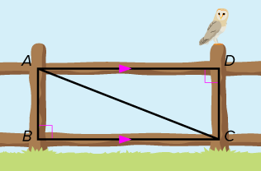
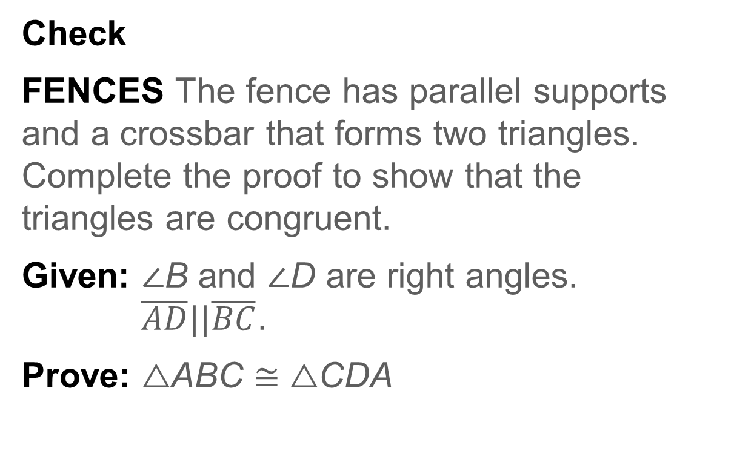
Example 1
Problem Solving with Right Triangles
Check
FENCES The fence has parallel supports and a crossbar that forms two triangles. Complete the proof to show that the triangles are congruent.
Given: ∠B and ∠D are right angles.
$\overline{AD}||\overline{BC}$.
Prove: △ABC ≅ △CDA

Slide 17
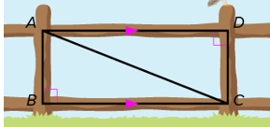
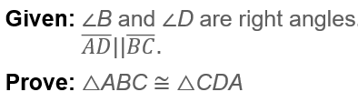
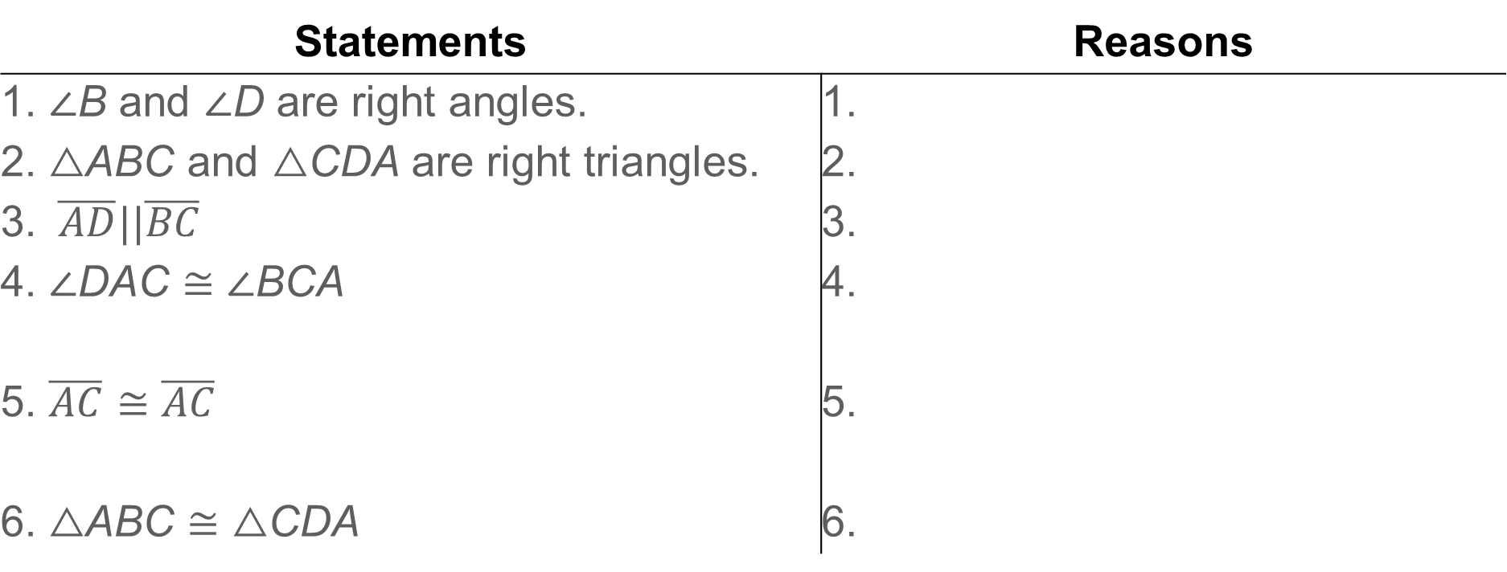
Example 1
Proof:
Statements | Reasons
1. ∠B and ∠D are right angles. | 1.
2. △ABC and △CDA are right triangles. | 2.
3. $\overline{AD}||\overline{BC}$ | 3.
4. ∠DAC ≅ ∠BCA | 4.
5. $\overline{AC}≅\overline{AC}$ | 5.
6. △ABC ≅ △CDA | 6.

Slide 18
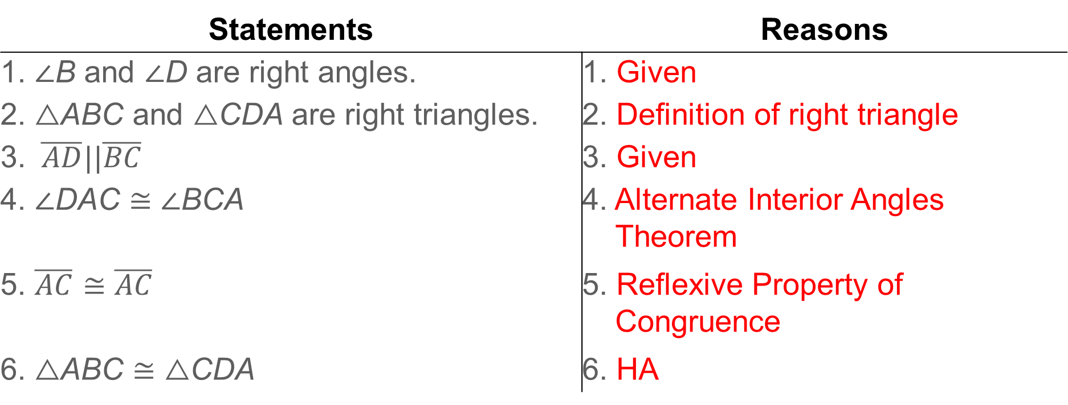
Example 1
Problem Solving with Right Triangles
Proof:
Statements | Reasons
1. ∠B and ∠D are right angles. | 1. Given
2. △ABC and △CDA are right triangles. | 2. Definition of right triangle
3. $\overline{AD}||\overline{BC}$ | 3. Given
4. ∠DAC ≅ ∠BCA | 4. Alternate Interior Angles Theorem
5. $\overline{AC}≅\overline{AC}$ | 5. Reflexive Property of Congruence
6. △ABC ≅ △CDA | 6. HA
Notes:
Reasons
1. Given
2. Definition of right triangle
3. Given
4. Alternate Interior Angles Theorem
5. Reflexive Property of Congruence
6. HA

Slide 19
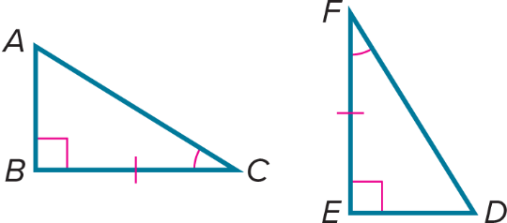

Exit Ticket
Write a proof.
Given: ∠B and ∠E are right angles.
$\overline{BC}≅\overline{EF}$; ∠C ≅ ∠F
Prove: △ABC ≅ △DEF

Slide 20
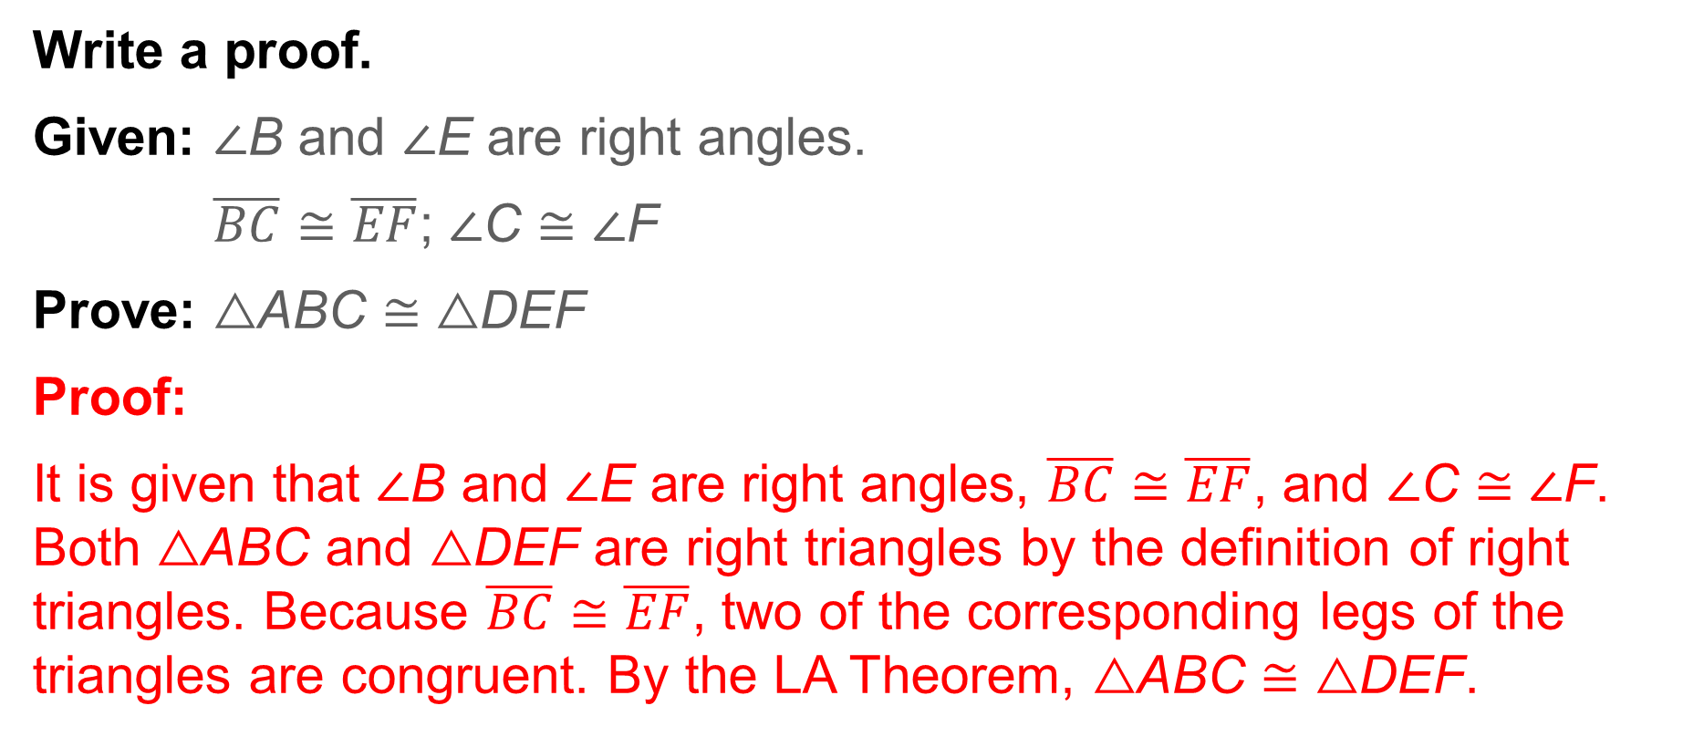
Exit Ticket
Write a proof.
Given: ∠B and ∠E are right angles.
$\overline{BC}≅\overline{EF}$; ∠C ≅ ∠F
Prove: △ABC ≅ △DEF
Proof:
It is given that ∠B and ∠E are right angles, $\overline{BC}≅\overline{EF}$, and ∠C ≅ ∠F. Both △ABC and △DEF are right triangles by the definition of right triangles. Because $\overline{BC}≅\overline{EF}$, two of the corresponding legs of the triangles are congruent. By the LA Theorem, △ABC ≅ △DEF.
Notes:
Proof:
It is given that ∠B and ∠E are right angles, $\overline{BC}≅\overline{EF}$, and ∠C ≅ ∠F. Both △ABC and △DEF are right triangles by the definition of right triangles. Because $\overline{BC}≅\overline{EF}$, two of the corresponding legs of the triangles are congruent. By the LA Theorem, △ABC ≅ △DEF.

