Slide 1
Areas of Quadrilaterals
Parallelogram
Trapezoid
Rhombus
Kite

Slide 2
Warm Up
Write true or false for each statement.
1. All trapezoids are quadrilaterals.
2. All trapezoids are parallelograms.
3. If a polygon is a trapezoid, it cannot be a parallelogram.
4. The two nonparallel sides of a trapezoid must be congruent.
5. A trapezoid cannot contain a right angle.

Slide 3
Warm Up
Write true or false for each statement.
1. All trapezoids are quadrilaterals.
2. All trapezoids are parallelograms.
3. If a polygon is a trapezoid, it cannot be a parallelogram.
4. Two nonparallel sides of a trapezoid must be congruent.
5. A trapezoid cannot contain a right angle.
true
false
false
false
false
Notes:
true
false
true
false
false

Slide 4
Florida’s B.E.S.T. Standards for Mathematics
MA.912.GR.4.4
Solve mathematical and real-world problems involving the area of two-dimensional figures.

Slide 5
Florida’s Mathematical Thinking and Reasoning Standards
MA.K12.MTR.4.1
Engage in discussions that reflect on the mathematical thinking of self and others.

Slide 6
Lesson Objectives
Content Objective
Students find areas of quadrilaterals.
Language Objectives
Students use same and different to explain how to find areas of quadrilaterals.
To cultivate conversation, students participate in MLR8: Discussion Supports.

Slide 7
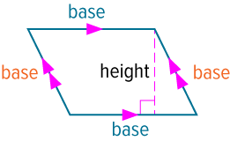
Learn
Areas of Parallelograms
A parallelogram is a quadrilateral with both pairs of opposite sides parallel.
The base of a parallelogram is any side of the parallelogram.
An altitude of a parallelogram is defined as a perpendicular segment between any two parallel bases.

Slide 8
Learn
Areas of Parallelograms
The height of a parallelogram is the length of an altitude of the parallelogram.
You can use the Area Addition Postulate and decomposition to develop the formula for the area of a parallelogram. Decomposition is the process of separating a figure into two or more nonoverlapping parts.

Slide 9
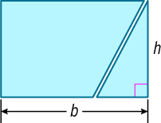
Learn
Areas of Parallelograms
Postulate 11.1: Area Addition Postulate
The area of a region is the sum of the areas of its nonoverlapping parts.
To find the area of a parallelogram, imagine cutting off a right triangle from one side of a parallelogram and translating the triangle to the other side to form a rectangle with the same base and height.

Slide 10
Learn
Areas of Parallelograms
Key Concept: Area of a Parallelogram
The area A of a parallelogram is the product of the base b and its corresponding height h.

Slide 11
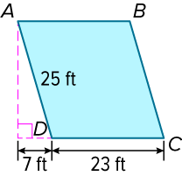
Example 1
Area of a Parallelogram
Find the area of the parallelogram.

Slide 12
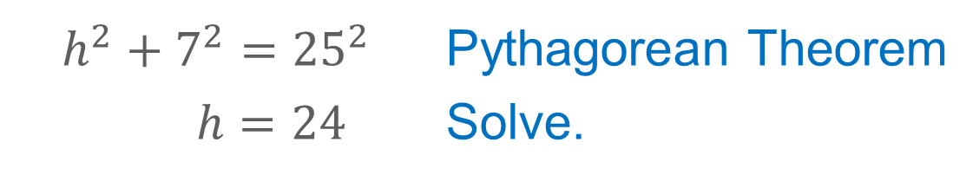
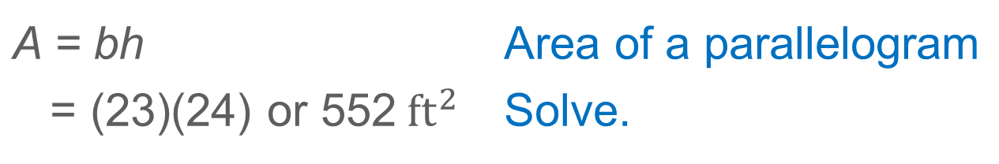
Example 1
Area of a Parallelogram
$$h^{2}+7^{2}={25}^{2}$$ | Pythagorean Theorem
$h=24$ | Solve.
$\overline{DC}$ is one base of ▱ABCD, and DC = 23 feet.
A = bh | Area of a parallelogram
= (23)(24) or 552${ft}^{2}$ | Solve.

Slide 13
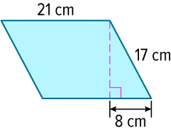
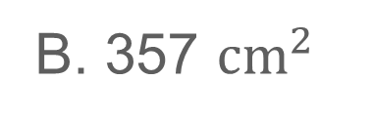
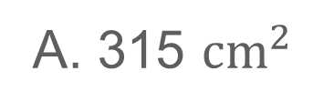
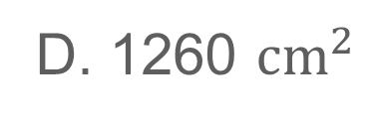
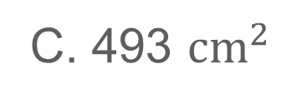
Example 1
Area of a Parallelogram
Check
Find the area of the parallelogram.
A. 315 ${cm}^{2}$
B. 357 ${cm}^{2}$
C. 493 ${cm}^{2}$
D. 1260 ${cm}^{2}$

Slide 14
Example 1
Area of a Parallelogram
Check
Find the area of the parallelogram.
A. 315 ${cm}^{2}$
B. 357 ${cm}^{2}$
C. 493 ${cm}^{2}$
D. 1260 ${cm}^{2}$
A
Notes:
A

Slide 15
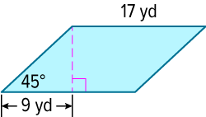
Example 2
Use Trigonometry to Find the Area of a Parallelogram
Find the area of the parallelogram.

Slide 16
Example 2
Use Trigonometry to Find the Area of a Parallelogram
Step 1 Use special right triangles.
Use a 45°-45°-90° triangle to find the height h of the parallelogram. Recall that if the measure of the leg opposite the 45° angle is h, then the measure of the leg adjacent the 45° angle is also h.
h = 9 yd

Slide 17
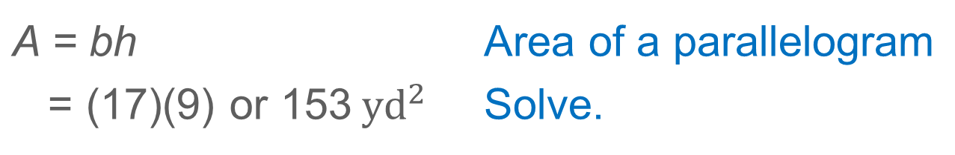
Example 2
Use Trigonometry to Find the Area of a Parallelogram
Step 2 Find the area.
A = bh | Area of a parallelogram
= (17)(9) or 153${ yd}^{2}$ | Solve.

Slide 18
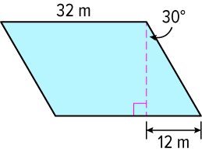
Example 2
Use Trigonometry to Find the Area of a Parallelogram
Check
Find the area of the parallelogram to the nearest tenth.

Slide 19
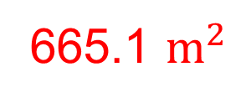
Example 2
Use Trigonometry to Find the Area of a Parallelogram
Check
Find the area of the parallelogram to the nearest tenth.
665.1 $m^{2}$
Notes:
665.1 $m^{2}$

Slide 20
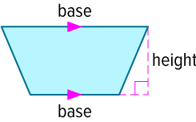
Learn
Areas of Trapezoids
The parallel sides of a trapezoid that is not a parallelogram are called bases.
The height of a trapezoid is the perpendicular distance between the bases of a trapezoid.
You can use rigid transformations and the Area Addition Postulate to develop the formula for the area of a trapezoid.

Slide 21
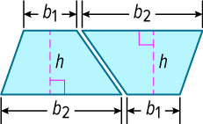
Learn
Areas of Trapezoids
Imagine performing a composition of transformations on a trapezoid. A translation followed by a rotation of the first trapezoid results in two congruent trapezoids that fit together to form a parallelogram.

Slide 22
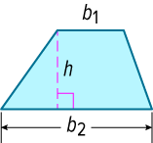
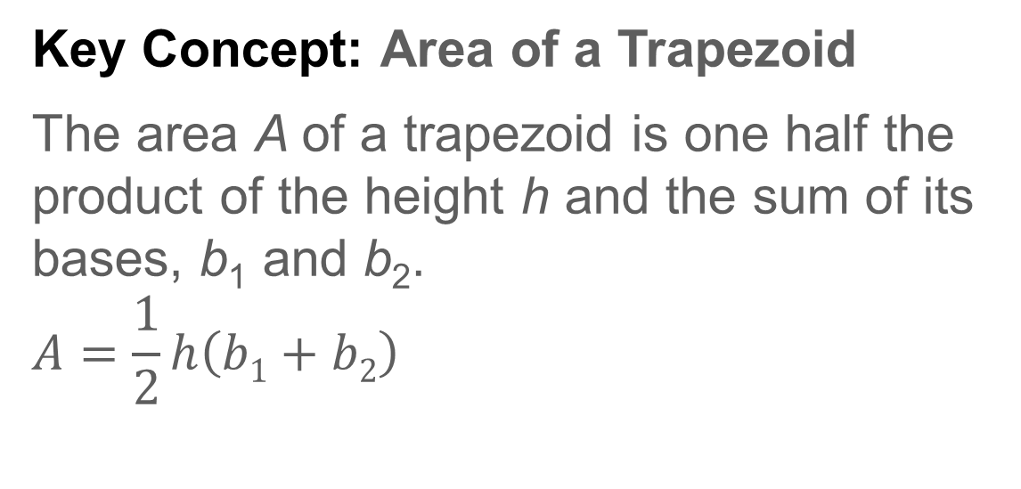
Learn
Areas of Trapezoids
Key Concept: Area of a Trapezoid
The area A of a trapezoid is one half the product of the height h and the sum of its bases, b₁ and b₂.
$$A=\frac{1}{2}h\left(b1+b2\right)$$

Slide 23
Learn
Areas of Trapezoids
Talk About It!
What is the relationship between the area of a parallelogram and the area of a trapezoid? Justify your answer.

Slide 24
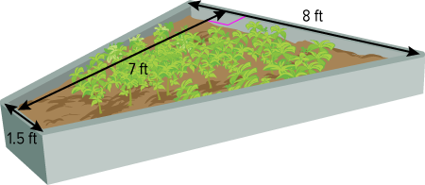
Example 3
Area of a Trapezoid
GARDENS Andrea needs enough mulch to cover the garden she planted in a raised bed constructed in the shape of a trapezoid. If one bag of mulch covers 12 square feet at the desired depth, how many bags of mulch does she need to buy?

Slide 25
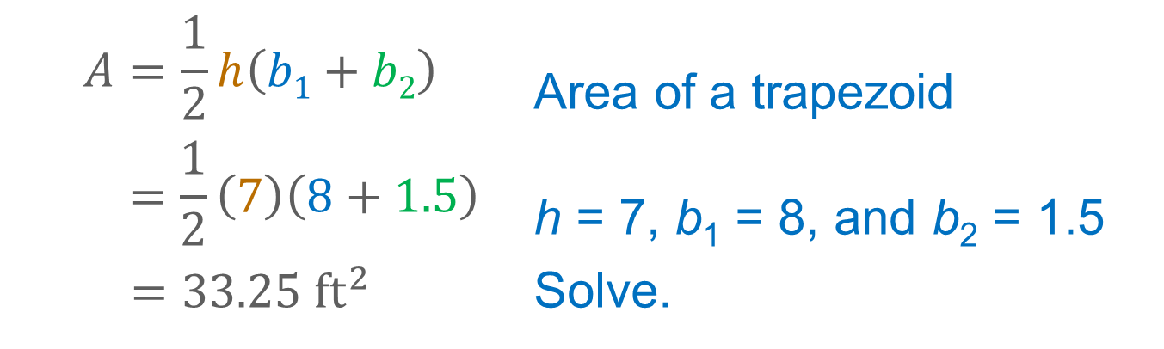
Example 3
Area of a Trapezoid
Step 1 Find the area of the garden.
$$A=\frac{1}{2}h\left(b1+b2\right)$$ | Area of a trapezoid
$$=\frac{1}{2}\left(7\right)\left(8+1.5\right)$$ | h = 7, b₁ = 8, and b₂ = 1.5
${ =33.25 ft}^{2}$ | Solve.
The area of the garden is 33.25 square feet.

Slide 26
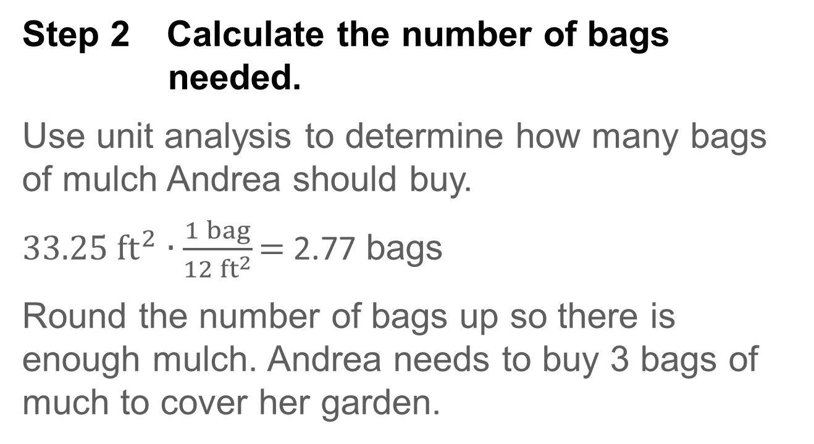
Example 3
Area of a Trapezoid
Step 2 Calculate the number of bags needed.
Use unit analysis to determine how many bags of mulch Andrea should buy.
33.25${ft}^{2}$ ∙ $\frac{1 bag}{12{ ft}^{2}}$ = 2.77 bags
Round the number of bags up so there is enough mulch. Andrea needs to buy 3 bags of much to cover her garden.

Slide 27
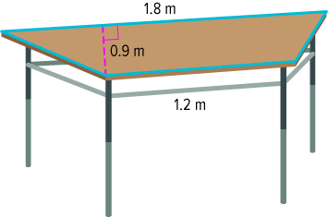
Example 3
Area of a Trapezoid
Check
ART Miguel wants to cover the top of his desk with butcher paper before working on a project for his art class. If one sheet of butcher paper covers a square meter of workspace, how many sheets will Miguel need?

Slide 28
Example 3
Area of a Trapezoid
Check
ART Miguel wants to cover the top of his desk with butcher paper before working on a project for his art class. If one sheet of butcher paper covers a square meter of workspace, how many sheets will Miguel need?
The top of the table has an area of 1.35 square meters.
Miguel will need 2 sheets of butcher paper.
Notes:
The top of the table has an area of 1.35 square meters.
Miguel will need 2 sheets of butcher paper

Slide 29
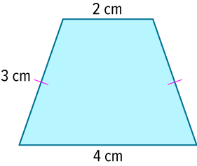
Example 4
Use Right Triangles to Find the Area of a Trapezoid
Find the area of the trapezoid.

Slide 30
Example 4
Use Right Triangles to Find the Area of a Trapezoid
Step 1 Draw right triangles.
To calculate the height of the trapezoid, draw vertical lines to separate the figure into two right triangles and a rectangle.

Slide 31
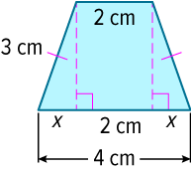
Example 4
Use Right Triangles to Find the Area of a Trapezoid
Step 2 Find the height.
x + x + 2 = 4 | Length of b₂
x = 1 | Solve.
The length of the base of each right triangle is 1 centimeter.

Slide 32
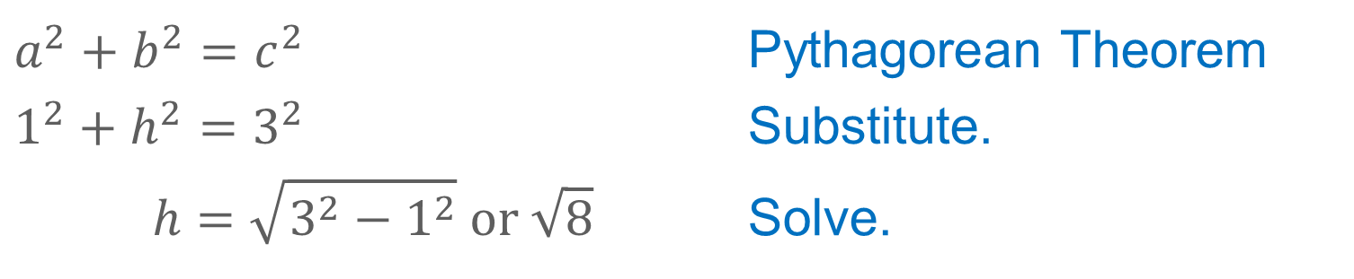
Example 4
Use Right Triangles to Find the Area of a Trapezoid
Use the Pythagorean Theorem to calculate the height of the trapezoid.
$$a^{2}+b^{2}=c^{2}$$ | Pythagorean Theorem
$$1^{2}+h^{2}=3^{2}$$ | Substitute.
$$h=\sqrt{3^{2}−1^{2}} or \sqrt{8}$$ | Solve.

Slide 33
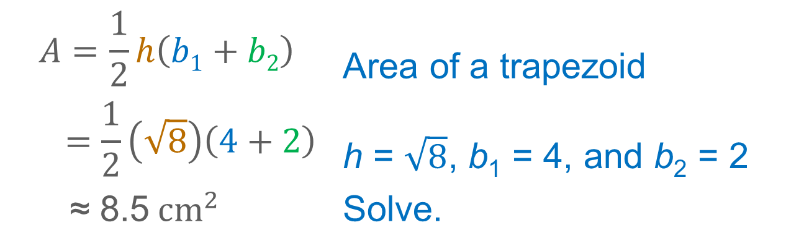
Example 4
Use Right Triangles to Find the Area of a Trapezoid
Step 3 Find the area.
$$A=\frac{1}{2}h\left(b1+b2\right)$$ | Area of a trapezoid
$$=\frac{1}{2}\left(\sqrt{8}\right)\left(4+2\right)$$ | h = $\sqrt{8}$, b₁ = 4, and b₂ = 2
≈ 8.5${cm}^{2}$ | Solve.

Slide 34
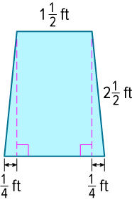
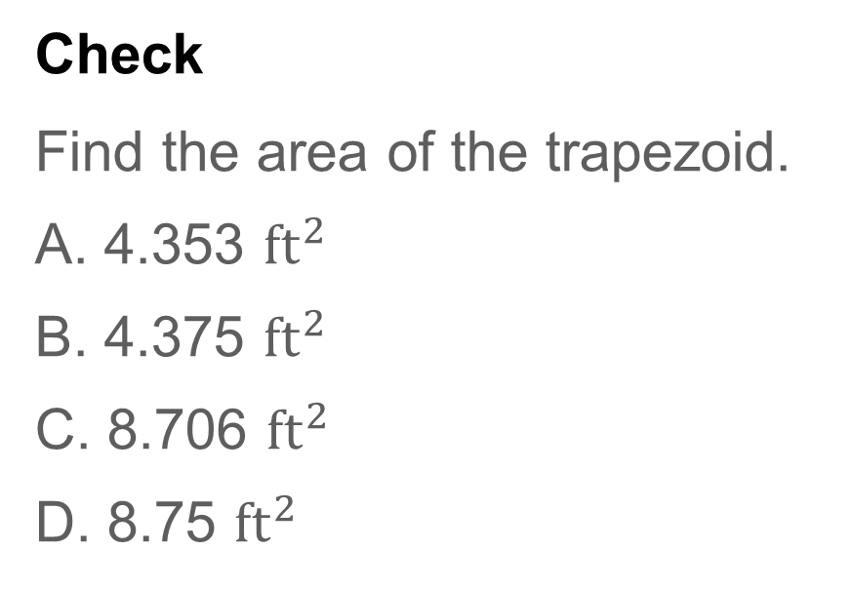
Example 4
Use Right Triangles to Find the Area of a Trapezoid
Check
Find the area of the trapezoid.
A. 4.353 ${ft}^{2}$
B. 4.375 ${ft}^{2}$
C. 8.706 ${ft}^{2}$
D. 8.75 ${ft}^{2}$

Slide 35
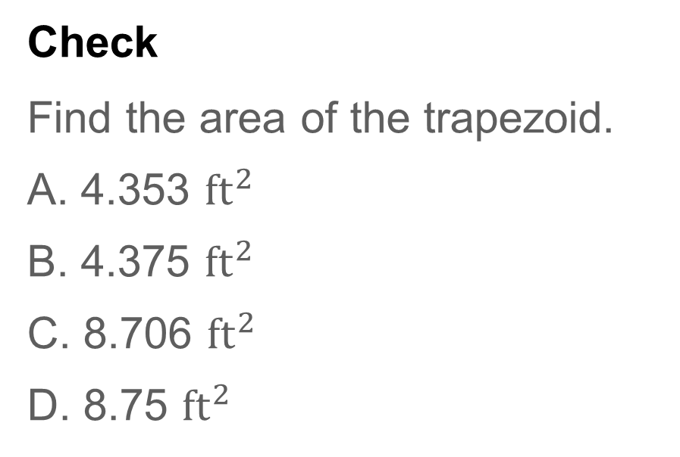
Example 4
Use Right Triangles to Find the Area of a Trapezoid
Check
Find the area of the trapezoid.
A. 4.353 ${ft}^{2}$
B. 4.375 ${ft}^{2}$
C. 8.706 ${ft}^{2}$
D. 8.75 ${ft}^{2}$
A
Notes:
A

Slide 36
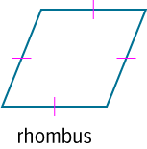
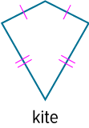
Learn
Areas of Kites and Rhombi
Recall that a rhombus is a parallelogram with all four sides congruent, and a kite is a quadrilateral with exactly two pairs of consecutive congruent sides.
The areas of rhombi and kites are related to the lengths of their diagonals.

Slide 37
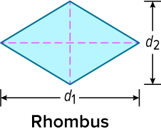
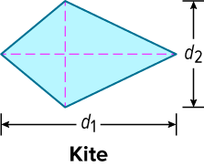
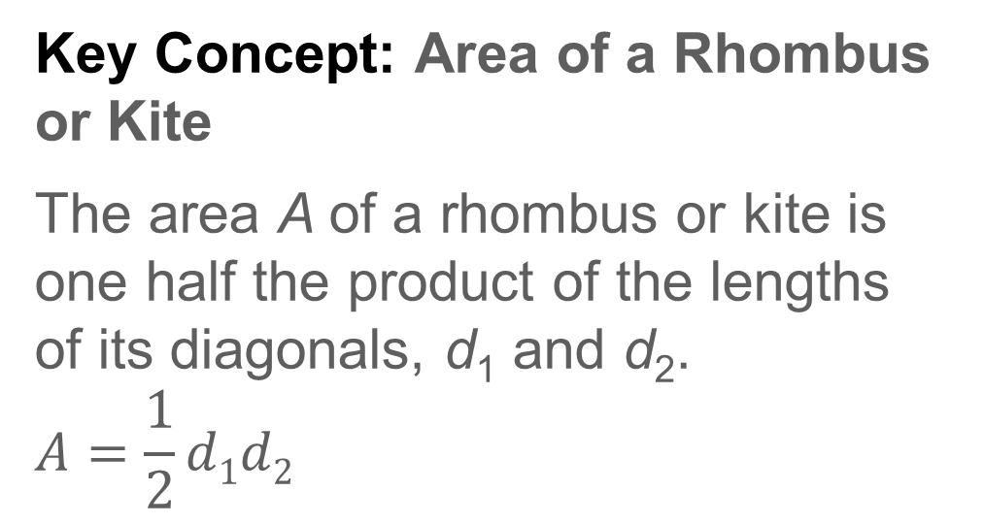
Learn
Areas of Kites and Rhombi
Key Concept: Area of a Rhombus or Kite
The area A of a rhombus or kite is one half the product of the lengths of its diagonals, d₁ and d₂.
$$A=\frac{1}{2}d1d2$$

Slide 38
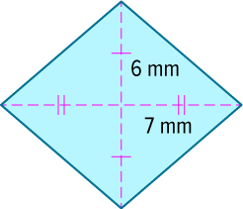
Example 5
Area of a Rhombus
Find the area of the rhombus.

Slide 39
Example 5
Area of a Rhombus
Step 1 Find the length of each diagonal.
Because the diagonals of a rhombus bisect each other, the lengths of the diagonals are
6 + 6 or 12 millimeters and 7 + 7 or 14 millimeters.

Slide 40
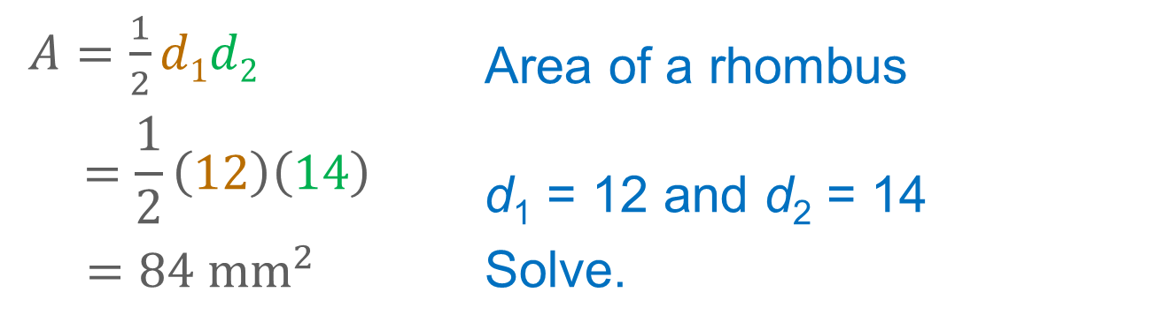
Example 5
Area of a Rhombus
Step 2 Find the area of the rhombus.
$A=\frac{1}{2}d1d2$ | Area of a rhombus
$$=\frac{1}{2}\left(12\right)\left(14\right)$$ | d₁ = 12 and d₂ = 14
${=84 mm}^{2}$ | Solve.

Slide 41
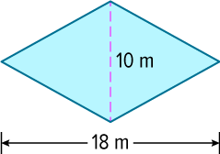

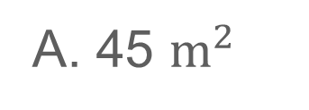
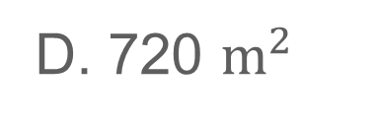
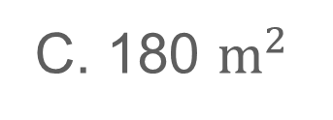
Example 5
Area of a Rhombus
Check
Find the area of the rhombus.
A. 45 $m^{2}$
B. 90 $m^{2}$
C. 180 $m^{2}$
D. 720 $m^{2}$

Slide 42
Example 5
Area of a Rhombus
Check
Find the area of the rhombus.
A. 45 $m^{2}$
B. 90 $m^{2}$
C. 180 $m^{2}$
D. 720 $m^{2}$
B
Notes:
B

Slide 43
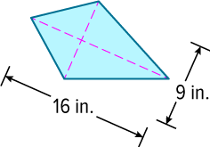
Example 6
Area of a Kite
Find the area of the kite.

Slide 44
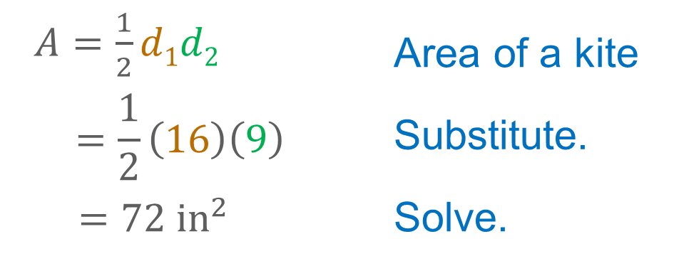
Example 6
Area of a Kite
Find the area of the kite.
$A=\frac{1}{2}d1d2$ | Area of a kite
$$=\frac{1}{2}\left(16\right)\left(9\right)$$ | Substitute.
${ =72 in}^{2}$ | Solve.

Slide 45
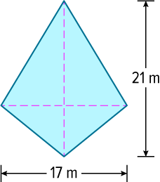
Example 6
Area of a Kite
Check
Find the area of the kite.

Slide 46
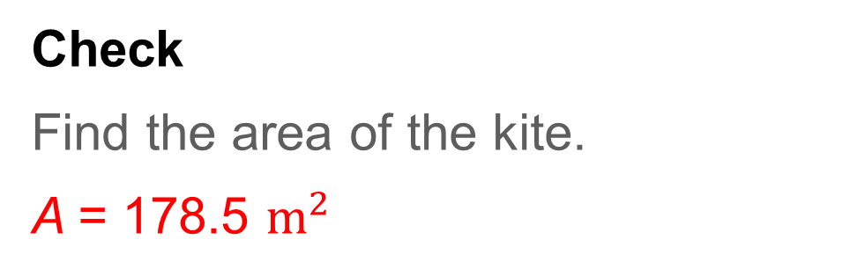
Example 6
Area of a Kite
Check
Find the area of the kite.
A = 178.5 $m^{2}$
Notes:
A = 178.5 m²

Slide 47
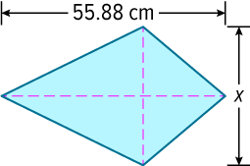
Example 7
Use Area to Find Missing Measures
One diagonal of a kite measures
55.88 centimeters. If the area of the kite is 92 square inches, what is the length of the other diagonal in inches rounded to the nearest tenth?

Slide 48
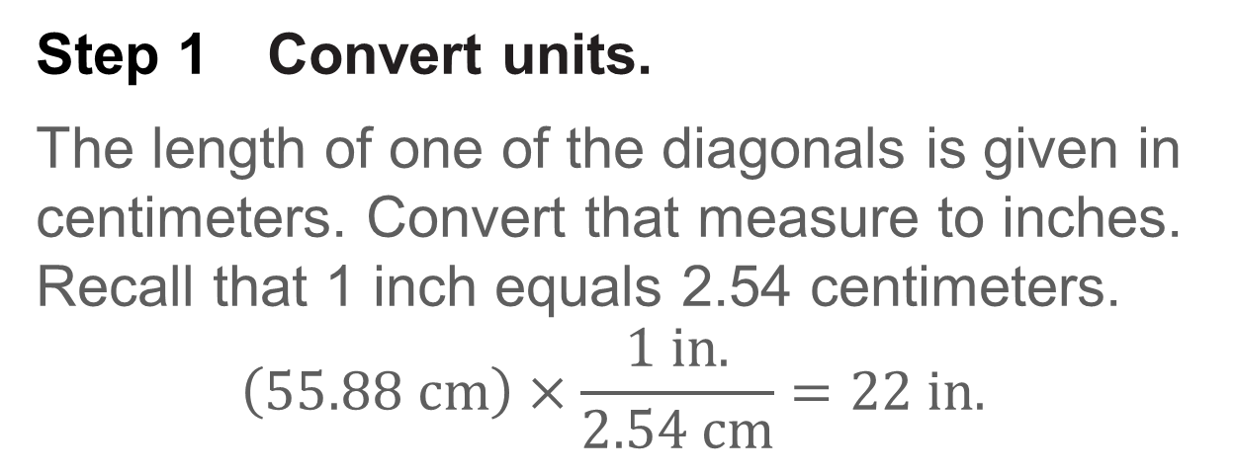
Example 7
Use Area to Find Missing Measures
Step 1 Convert units.
The length of one of the diagonals is given in centimeters. Convert that measure to inches. Recall that 1 inch equals 2.54 centimeters.
$$\left(55.88 cm\right)×\frac{1 in.}{2.54 cm}=22 in.$$

Slide 49
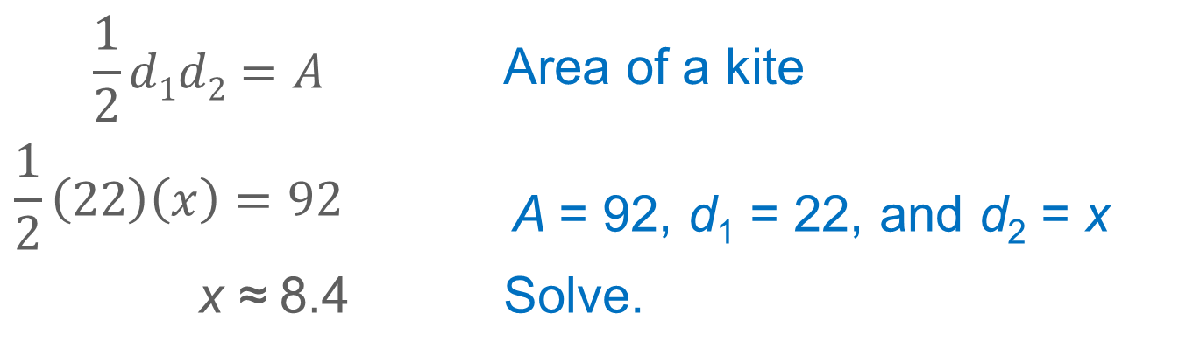
Example 7
Use Area to Find Missing Measures
Step 2 Use the formula for the area of a kite.
Use the formula for the area of a kite to find the measure of the other diagonal in inches.
$$\frac{1}{2}d1d2=A$$ | Area of a kite
$$\frac{1}{2}\left(22\right)\left(x\right)=92$$ | A = 92, d₁ = 22, and d₂ = x
x ≈ 8.4 | Solve.
The length of the diagonal is about 8.4 inches.

Slide 50
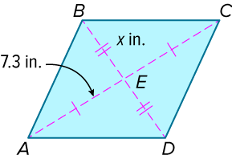
Example 7
Use Area to Find Missing Measures
Check
In rhombus ABCD, AE = 7.3 inches. If the area of the rhombus is 96 square inches, find the value of x and the length of each diagonal. Round to the nearest tenth, if necessary.

Slide 51
Example 6
Use Area to Find Missing Measures
Check
In rhombus ABCD, AE = 7.3 inches. If the area of the rhombus is 96 square inches, find the value of x and the length of each diagonal. Round to the nearest tenth, if necessary.
x ≈ 6.6 in.
AC = 14.6 in.
BD ≈ 13.2 in.
Notes:
x ≈ 6.6 in.
AC = 14.6 in.
BD ≈ 13.2 in.

Slide 52
Pause and Reflect
Did you struggle with anything in this lesson? If so, how did you deal with it?

Slide 53
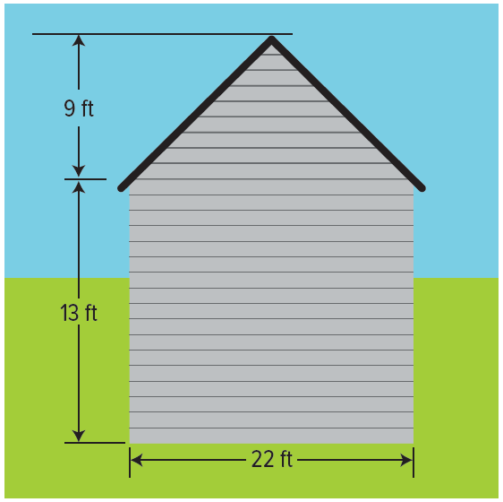
Exit Ticket
1. CONSTRUCTION Vinyl siding is sold by the square, which is 100 square feet. How many squares of siding would be necessary to cover the side of the house?

Slide 54
Exit Ticket
2. ENTERTAINMENT The stage at the Glen Head Reception Hall is shaped like an isosceles trapezoid. The bases measure 12 feet and 15 feet, and the depth of the stage is 14 feet. The stage floor is 3 feet off the ground. What is the area of the stage?

Slide 55
Exit Ticket
1. CONSTRUCTION Vinyl siding is sold by the square, which is 100 square feet. How many squares of siding would be necessary to cover the side of the house?
4
Notes:
4

Slide 56
Exit Ticket
2. ENTERTAINMENT The stage at the Glen Head Reception Hall is shaped like an isosceles trapezoid. The bases measure 12 feet and 15 feet, and the depth of the stage is 14 feet. The stage floor is 3 feet off the ground. What is the area of the stage?
189 square feet
Notes:
189 square feet

