Slide 1
2-2 Angle Relationships
COMPLEMENTARY AND SUPPLEMENTARY ANGLES

Slide 2
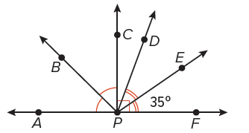
Warm Up
Use the figure to complete each exercise.
1. Find the measure of ∠APB.
2. Find the measure of ∠FPD.
3. Find the measure of ∠APC.
4. Name all of the obtuse angles.
5. What kind of angle is ∠BPD?

Slide 3
Florida’s B.E.S.T. Standards for Mathematics
MA.912.GR.1.1
Prove relationships and theorems about lines and angles. Solve mathematical and real-world problems involving postulates, relationships and theorems of lines and angles.

Slide 4
Florida’s Mathematical Thinking and Reasoning Standards
MA.K12.MTR.1.1
Actively participate in effortful learning both individually and collectively.
MA.K12.MTR.4.1
Engage in discussions that reflect on the mathematical thinking of self and others.

Slide 5
Lesson Objectives
Content Objective
Students use the properties of perpendicular lines to find the measures of angles.
Language Objectives
Students talk about angle relationships using assume, assuming, and assumption.
To support sense-making, students participate in MLR2: Collect and Display.

Slide 6
Learn pg. 71
Complementary and Supplementary Angles
Complementary and Supplementary Angles
Complementary Angles | Supplementary Angles
Definition
two angles with measures that have a sum of 90° | two angles with measures that have a sum of 180°

Slide 7
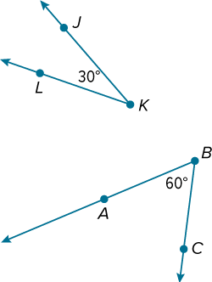
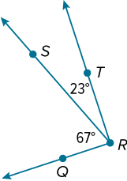
Learn
Complementary and Supplementary Angles
Examples of Complementary Angles
m∠QRS + m∠SRT = 90°
67° + 23° = 90°
m∠JKL + m∠ABC = 90°
30° + 60° = 90°

Slide 8
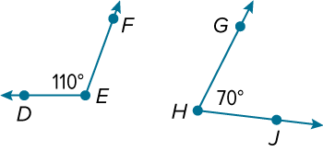
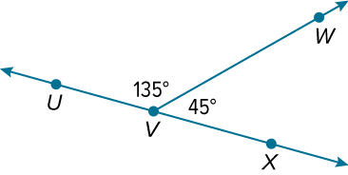
Learn
Complementary and Supplementary Angles
Examples of Supplementary Angles
m∠DEF + m∠GHJ = 180°
110° + 70° = 180°
m∠UVW + m∠WVX = 180°
135° + 45° = 180°

Slide 9
Example 1 pg. 72
Complementary and Supplementary Angles
Find the measures of two complementary angles if the measure of the larger angle is five more than four times the measure of the smaller angle.

Slide 10
Learn pg. 72
Perpendicularity
Lines, segments, or rays that intersect at right angles are perpendicular. Segments or rays can be perpendicular to lines or other line segments and rays. The right angle symbol indicates that the lines are perpendicular.

Slide 11
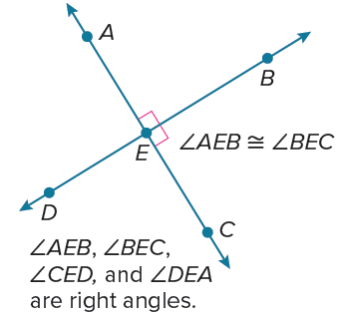
Learn pg. 73
Perpendicularity
Perpendicular lines intersect to form four right angles. Perpendicular lines intersect to form congruent adjacent angles.

Slide 12
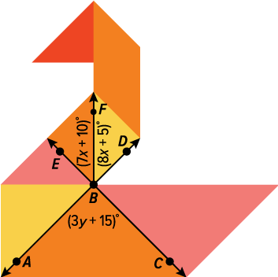
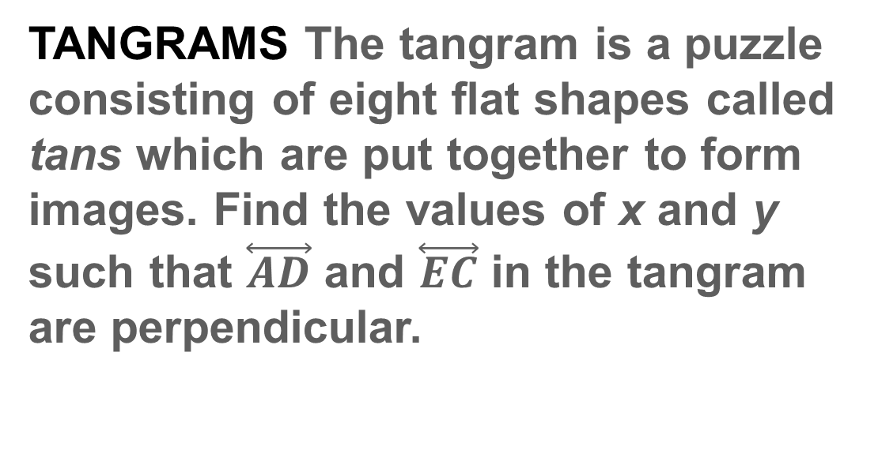
Example 2 pg. 73
Perpendicular Lines
TANGRAMS The tangram is a puzzle consisting of eight flat shapes called tans which are put together to form images. Find the values of x and y such that $\overset{⃡}{AD}$ and $\overset{⃡}{EC}$ in the tangram are perpendicular.

Slide 13
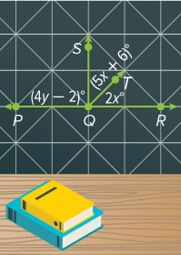
Example 2 pg. 74
Perpendicular Lines
Check
DESIGN Find the values of x and y such that $\overset{⃡}{PR}$ and $\vec{QS}$ are perpendicular.

Slide 14
Learn pg. 74
Interpreting Diagrams
In geometry, figures are sketches that are used to depict a situation. They are not drawn to reflect total accuracy. Certain relationships can be assumed from a figure, but most cannot.

Slide 15
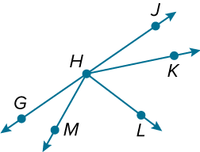
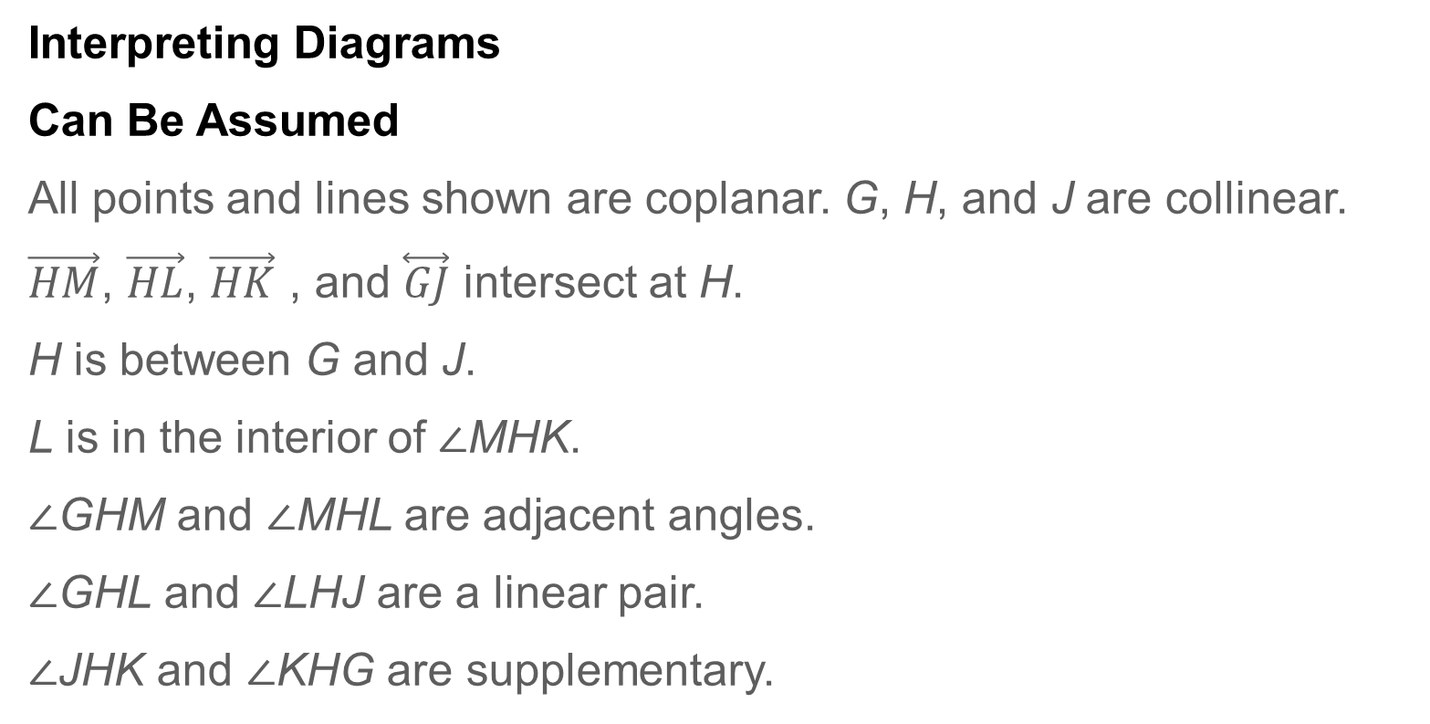
Learn pg. 74
Interpreting Diagrams
Interpreting Diagrams
Can Be Assumed
All points and lines shown are coplanar. G, H, and J are collinear.
$\vec{HM}$, $\vec{HL}$, $\vec{HK}$ , and $\overset{⃡}{GJ}$ intersect at H.
H is between G and J.
L is in the interior of ∠MHK.
∠GHM and ∠MHL are adjacent angles.
∠GHL and ∠LHJ are a linear pair.
∠JHK and ∠KHG are supplementary.

Slide 16
Learn pg. 74
Interpreting Diagrams
Interpreting Diagrams
Cannot Be Assumed
Lines that appear perpendicular may not be perpendicular.
Angles that appear congruent may not be congruent.
Segments that appear congruent may not be congruent.
The list of statements that can be assumed is not a complete list. There are more special pairs of angles than those listed.

Slide 17
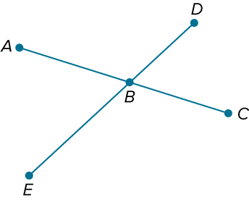
Learn pg. 75
Interpreting Diagrams
Because points of intersection can be assumed, you can identify vertical angles from the figure.
Because linear pairs can be assumed from the figure, you can apply known characteristics of a linear pair, such as supplementary angles.
∠ABD and ∠CBE are vertical angles.
∠EBA and ∠ABD form a linear pair, so m∠EBA + m∠ABD = 180°.

Slide 18
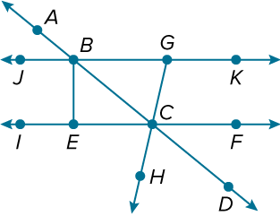
Example 3 pg. 76 “ YOU DO!”
Interpreting Diagrams
Determine whether each statement can be assumed from the figure. Explain.

Slide 19
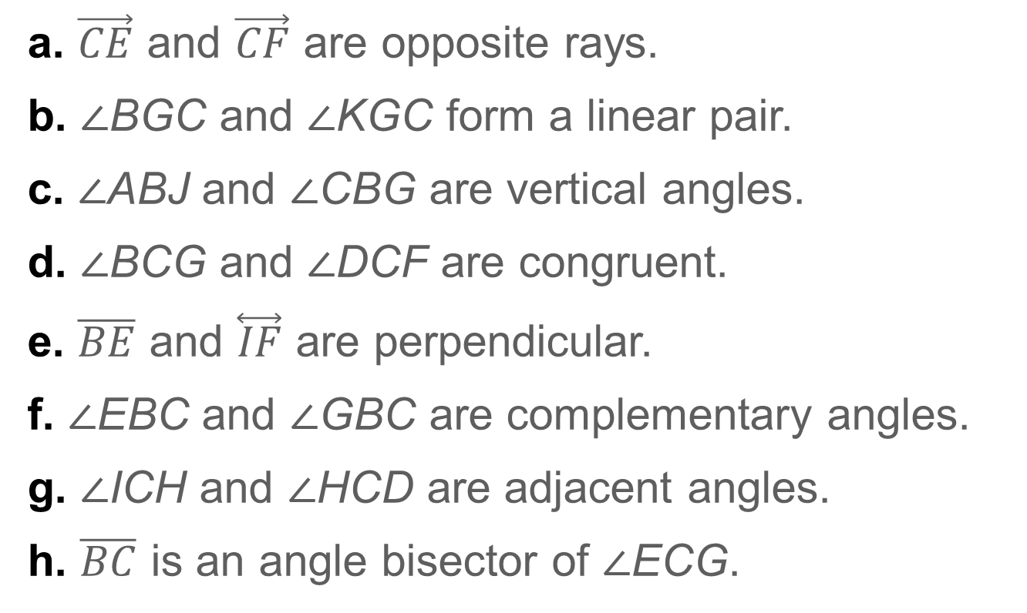
Example 3
Interpreting Diagrams
a. $\vec{CE}$ and $\vec{CF}$ are opposite rays.
b. ∠BGC and ∠KGC form a linear pair.
c. ∠ABJ and ∠CBG are vertical angles.
d. ∠BCG and ∠DCF are congruent.
e. $\overline{BE}$ and $\overset{⃡}{IF}$ are perpendicular.
f. ∠EBC and ∠GBC are complementary angles.
g. ∠ICH and ∠HCD are adjacent angles.
h. $\overline{BC}$ is an angle bisector of ∠ECG.

Slide 20
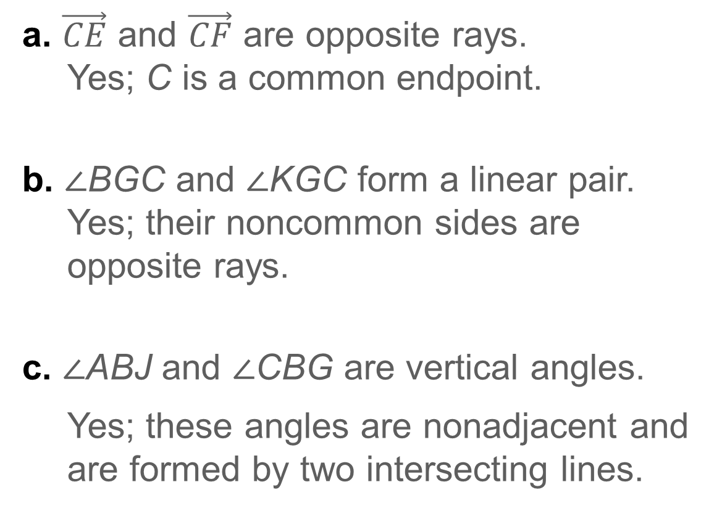
Example 3
Interpreting Diagrams
a. $\vec{CE}$ and $\vec{CF}$ are opposite rays.
Yes; C is a common endpoint.
b. ∠BGC and ∠KGC form a linear pair.
Yes; their noncommon sides are opposite rays.
c. ∠ABJ and ∠CBG are vertical angles.
Yes; these angles are nonadjacent and are formed by two intersecting lines.

Slide 21
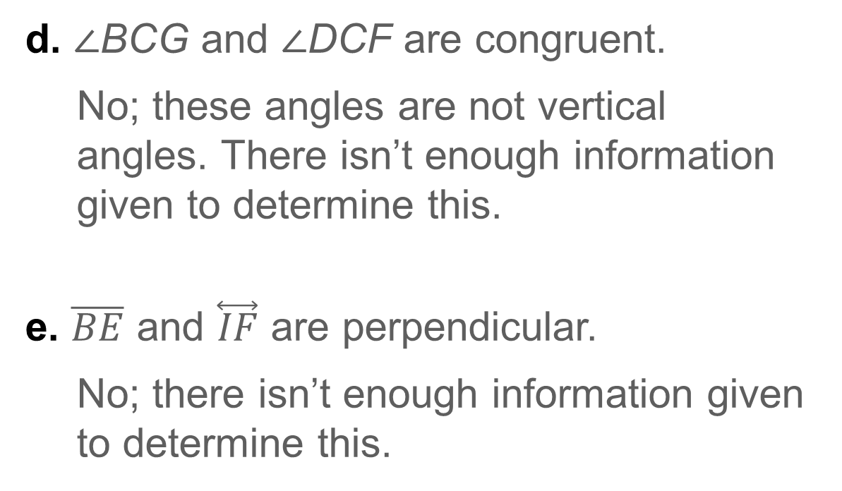
Example 3
Interpreting Diagrams
d. ∠BCG and ∠DCF are congruent.
No; these angles are not vertical angles. There isn’t enough information given to determine this.
e. $\overline{BE}$ and $\overset{⃡}{IF}$ are perpendicular.
No; there isn’t enough information given to determine this.

Slide 22
Example 3
Interpreting Diagrams
f. ∠EBC and ∠GBC are complementary angles.
No; there isn’t any information about perpendicularity or angle measure so this cannot be determined.
g. ∠ICH and ∠HCD are adjacent angles.
Yes; these angles share a common side.

Slide 23

Example 3
Interpreting Diagrams
h. $\overline{BC}$ is an angle bisector of ∠ECG.
No; there isn’t any information about congruent angles so this cannot be determined.

Slide 24
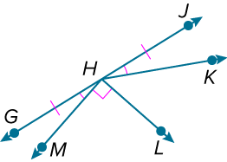
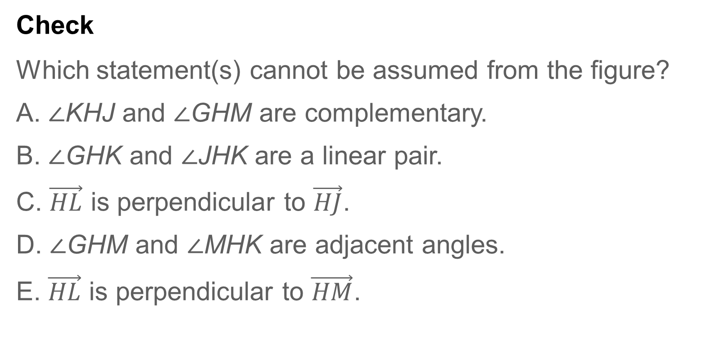
Example 3
Interpreting Diagrams
Check
Which statement(s) cannot be assumed from the figure?
A. ∠KHJ and ∠GHM are complementary.
B. ∠GHK and ∠JHK are a linear pair.
C. $\vec{HL}$ is perpendicular to $\vec{HJ}$.
D. ∠GHM and ∠MHK are adjacent angles.
E. $\vec{HL}$ is perpendicular to $\vec{HM}$.

Slide 25

Example 3
Interpreting Diagrams
Check
Which statement(s) cannot be assumed from the figure?
A. ∠KHJ and ∠GHM are complementary.
B. ∠GHK and ∠JHK are a linear pair.
C. $\vec{HL}$ is perpendicular to $\vec{HJ}$.
D. ∠GHM and ∠MHK are adjacent angles.
E. $\vec{HL}$ is perpendicular to $\vec{HM}$.
A, C
Notes:
A, C

Slide 26
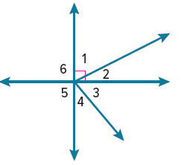
Exit Ticket
Use the figure.
1. ∠1 and what other angle are complementary angles?
2. ∠5 and what other angle are supplementary angles?
3. Are ∠1 and ∠2 a linear pair of angles?

Slide 27
Exit Ticket
Use the figure.
4. How are the vertical and horizontal lines in the figure related?
5. If m∠2 = 27° and m∠3 = 59°, what is m∠1, m∠4, and m∠5?

