Slide 1
Pythagorean Theorem and Its Converse

Slide 2
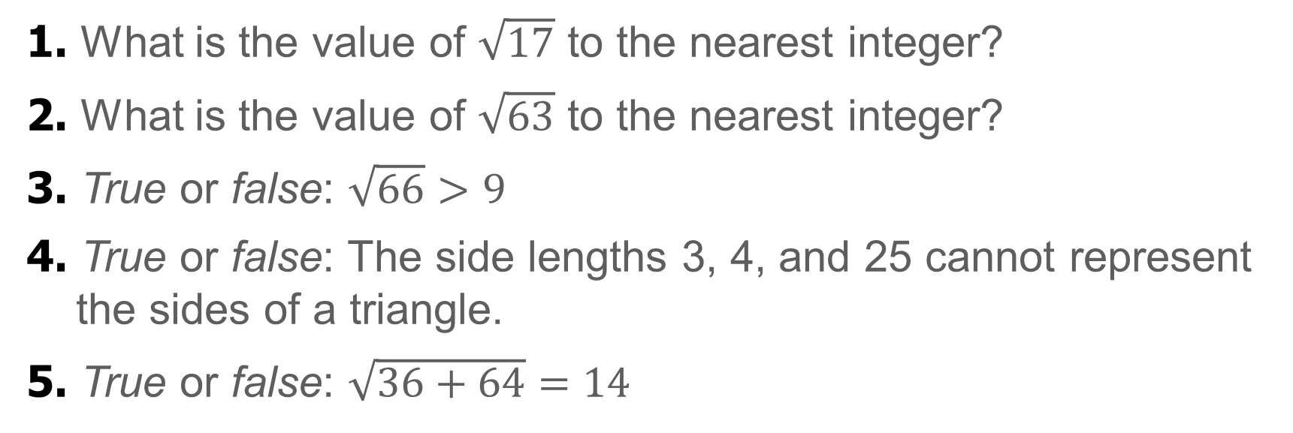
Warm Up
1. What is the value of $\sqrt{17}$ to the nearest integer?
2. What is the value of $\sqrt{63}$ to the nearest integer?
3. True or false: $\sqrt{66}>9$
4. True or false: The side lengths 3, 4, and 25 cannot represent the sides of a triangle.
5. True or false: $\sqrt{36+64}=14$

Slide 3
Warm Up
1. What is the value of $\sqrt{17}$ to the nearest integer?
2. What is the value of $\sqrt{63}$ to the nearest integer?
3. True or false: $\sqrt{66}>9$
4. True or false: The side lengths 3, 4, and 25 cannot represent the sides of a triangle.
5. True or false: $\sqrt{36+64}=14$
4
8
false
true
false
Notes:
4
8
false
true
false

Slide 4
Florida’s B.E.S.T. Standards for Mathematics
MA.912.GR.3.2
Given a mathematical context, use coordinate geometry to classify or justify definitions, properties and theorems involving circles, triangles or quadrilaterals.
MA.912.T.1.2
Solve mathematical and real-world problems involving right triangles using trigonometric ratios and the Pythagorean Theorem.

Slide 5
Florida’s Mathematical Thinking and Reasoning Standards
MA.K12.MTR.4.1
Engage in discussions that reflect on the mathematical thinking of self and others.
MA.K12.MTR.6.1
Assess the reasonableness of solutions.

Slide 6
Lesson Objectives
Content Objective
Students will solve problems using the Pythagorean Theorem and its converse.
Language Objectives
Students explain how to solve problems using the Pythagorean Theorem and its converse with complex sentences using If…then… statements, because, and therefore.
To optimize output, students participate in MLR1: Stronger and Clearer Each Time.

Slide 7
Learn
The Pythagorean Theorem
The Pythagorean Theorem relates the lengths of the hypotenuse and legs of a right triangle.
Theorem 9.1: Pythagorean Theorem
In a right triangle, the sum of the squares of the lengths of the legs is equal to the square of the length of the hypotenuse.

Slide 8
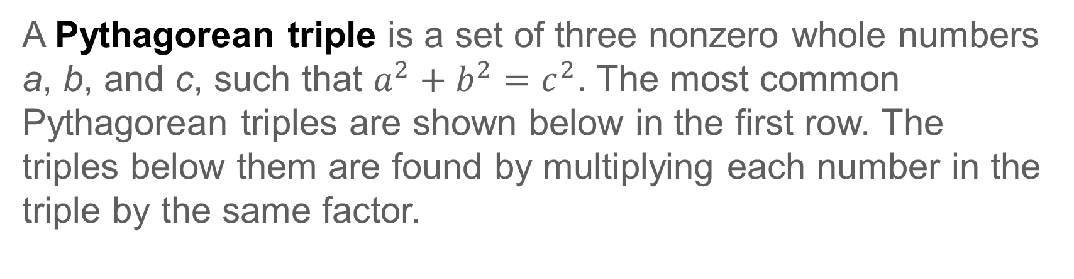
Learn
The Pythagorean Theorem
A Pythagorean triple is a set of three nonzero whole numbers a, b, and c, such that $a^{2}+b^{2}=c^{2}$. The most common Pythagorean triples are shown below in the first row. The triples below them are found by multiplying each number in the triple by the same factor.
Common Pythagorean Triples
3, 4, 5 | 5, 12, 13 | 8, 15, 17 | 7, 24, 25
6, 8, 10 9, 12, 15 3x, 4x, 5x | 10, 24, 26 15, 36, 39 5x, 12x, 13x | 16, 30, 34 24, 45, 51 8x, 15x, 17x | 14, 48, 50 21, 72, 75 7x, 24x, 25x

Slide 9
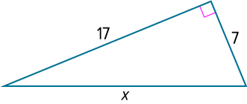
Example 1
Find Missing Measures by Using the Pythagorean Theorem
Find the value of x.

Slide 10
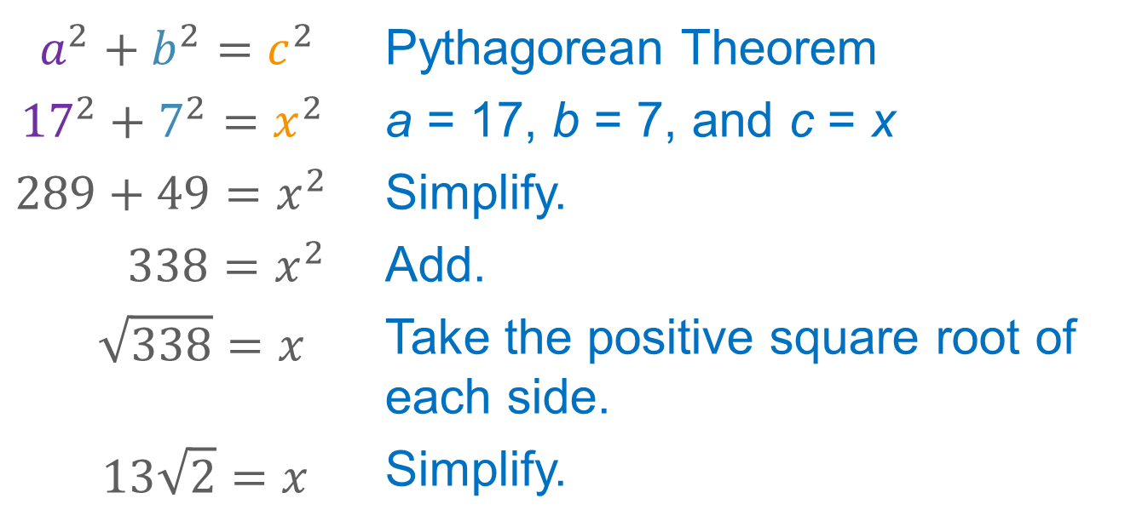
Example 1
Find Missing Measures by Using the Pythagorean Theorem
The side opposite the right angle is the hypotenuse, so c = x.
$$a^{2}+b^{2}=c^{2}$$ | Pythagorean Theorem
$${17}^{2}+7^{2}=x^{2}$$ | a = 17, b = 7, and c = x
$$289+49=x^{2}$$ | Simplify.
$$338=x^{2}$$ | Add.
$$\sqrt{338}=x$$ | Take the positive square root of each side.
$$13\sqrt{2}=x$$ | Simplify.

Slide 11
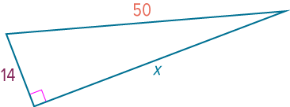
Example 2
Use a Pythagorean Triple
Use a Pythagorean triple to find the value of x.

Slide 12
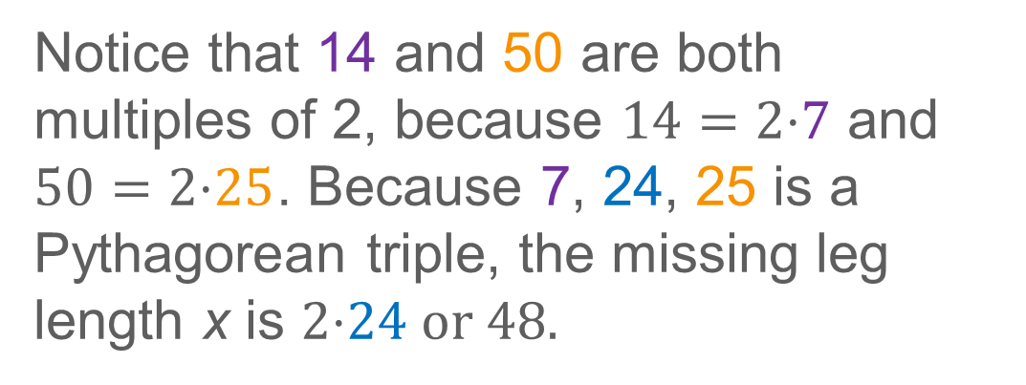
Example 2
Use a Pythagorean Triple
Notice that 14 and 50 are both multiples of 2, because $14=2\text{⋅}\text{7}$ and $50=2\text{⋅}\text{25}$. Because 7, 24, 25 is a Pythagorean triple, the missing leg length x is $2\text{⋅}\text{24} \text{or}\text{ 48.}$

Slide 13
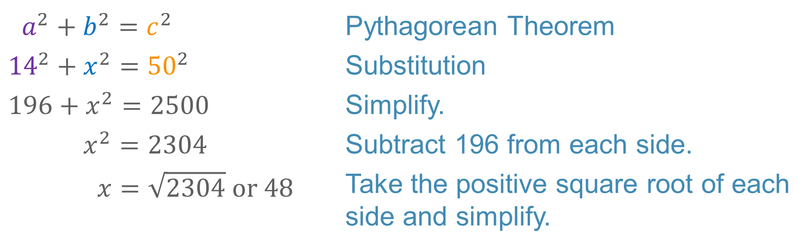
Example 2
Use a Pythagorean Triple
Alternate Method
$$a^{2}+b^{2}=c^{2}$$ | Pythagorean Theorem
$${14}^{2}+x^{2}={50}^{2}$$ | Substitution
$$196+x^{2}=2500$$ | Simplify.
$$x^{2}=2304$$ | Subtract 196 from each side.
$$x=\sqrt{2304} or 48$$ | Take the positive square root of each side and simplify.

Slide 14
Example 2
Use a Pythagorean Triple
Talk About It!
Compare and contrast the methods. Which method do you think is more efficient?

Slide 15
Example 3
Use the Pythagorean Theorem
ZIP LINING A summer camp is building a new zip lining course. The designer of the course wants the last zip line to start at a platform 450 meters above the ground and end 775 meters away from the base of the platform. How long must the zip line be to meet the designer’s specifications?

Slide 16
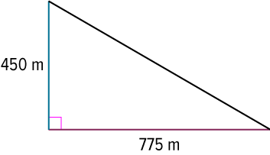
Example 3
Use the Pythagorean Theorem
Step 1 Visualize and describe the situation.
The base of the platform and the ground should be approximately perpendicular. We need to find the length of the zip line, which is the hypotenuse of a right triangle. Draw a diagram that models the situation.

Slide 17
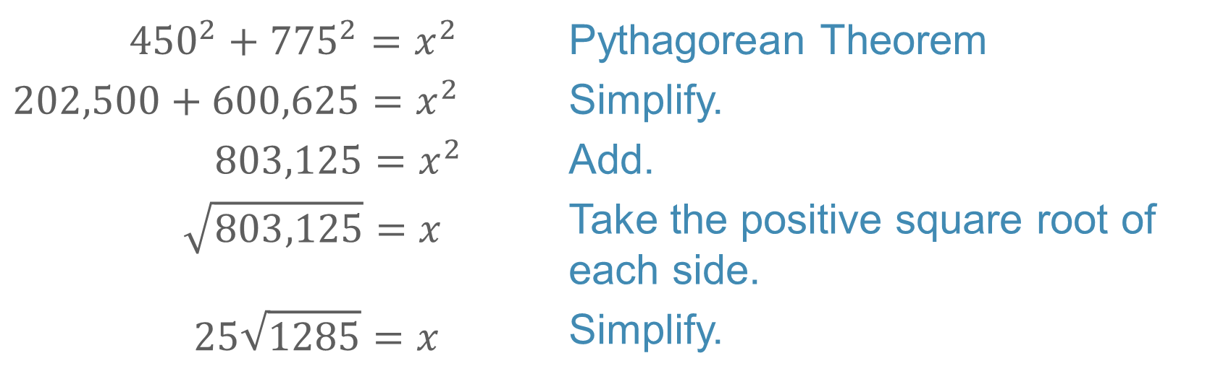
Example 3
Use the Pythagorean Theorem
Step 2 Find the length of the zip line.
Use the Pythagorean Theorem to find the length x of the zip line.
$${450}^{2}+{775}^{2}=x^{2}$$ | Pythagorean Theorem
$$202,500+600,625=x^{2}$$ | Simplify.
$${803,125=x}^{2}$$ | Add.
$$\sqrt{803,125}=x$$ | Take the positive square root of each side.
$$25\sqrt{1285}=x$$ | Simplify.
So, the length of the zip line is $25\sqrt{1285}$ or about 896.17 meters.

Slide 18
Example 3
Use the Pythagorean Theorem
Think About It!
Is your answer reasonable? Use estimation to justify your reasoning.

Slide 19
Example 3
Use the Pythagorean Theorem
Check
RAMPS Lincoln High School is installing more wheelchair ramps around the school. One of the new ramps needs to have a base that is 12 feet long and reaches a height of 1 foot. If the side of the ramp forms a right triangle, how long should the inclined surface of the ramp be?
Find the exact length of the inclined surface of the ramp.

Slide 20
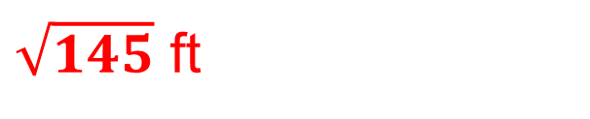
Example 3
Use the Pythagorean Theorem
Check
RAMPS Lincoln High School is installing more wheelchair ramps around the school. One of the new ramps needs to have a base that is 12 feet long and reaches a height of 1 foot. If the side of the ramp forms a right triangle, how long should the inclined surface of the ramp be?
Find the exact length of the inclined surface of the ramp.
$\sqrt{145}$ ft
Notes:
$\sqrt{145}$ ft

Slide 21
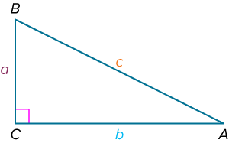
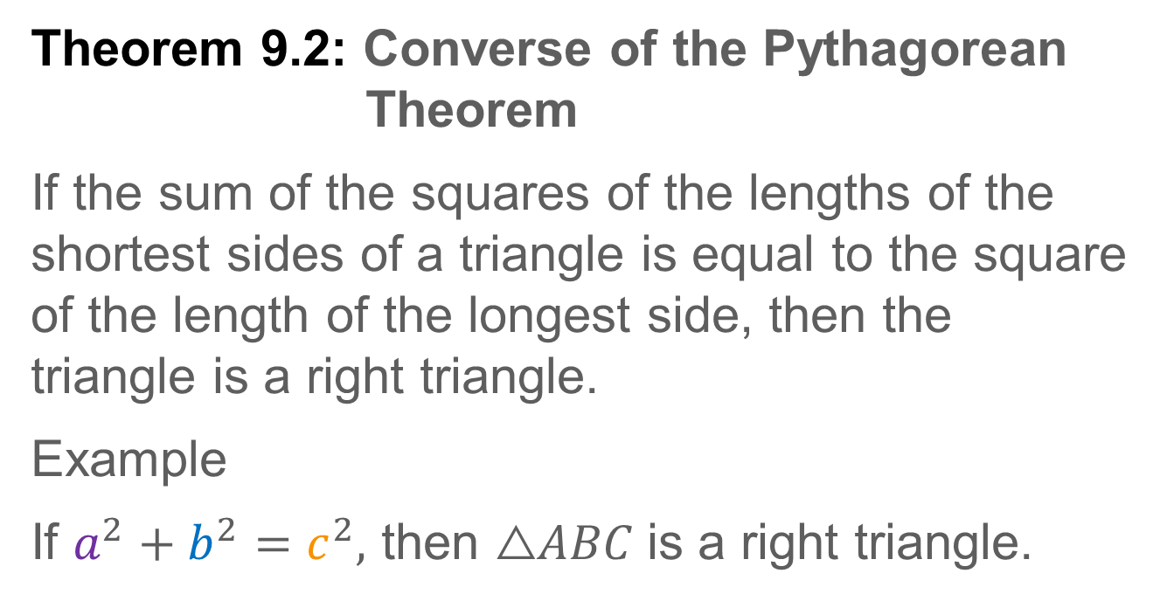
Learn
Converse of the Pythagorean Theorem
Theorem 9.2: Converse of the Pythagorean Theorem
If the sum of the squares of the lengths of the shortest sides of a triangle is equal to the square of the length of the longest side, then the triangle is a right triangle.
Example
If $a^{2}+b^{2}=c^{2},$ then $\text{△}ABC$is a right triangle.
You can also use side lengths to classify a triangle as acute or obtuse.

Slide 22
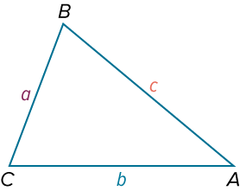
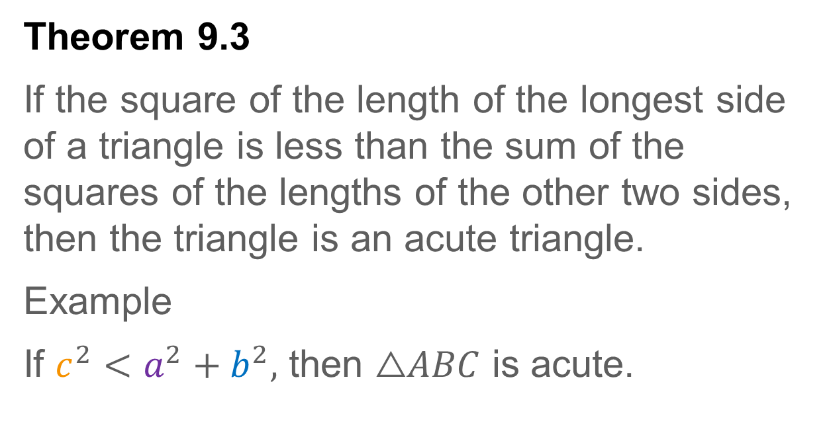
Learn
Converse of the Pythagorean Theorem
Theorem 9.3
If the square of the length of the longest side of a triangle is less than the sum of the squares of the lengths of the other two sides, then the triangle is an acute triangle.
Example
If $c^{2}<a^{2}+b^{2},$ then $\text{△}ABC$ is acute.

Slide 23
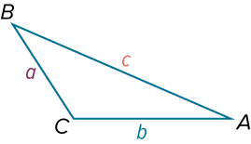
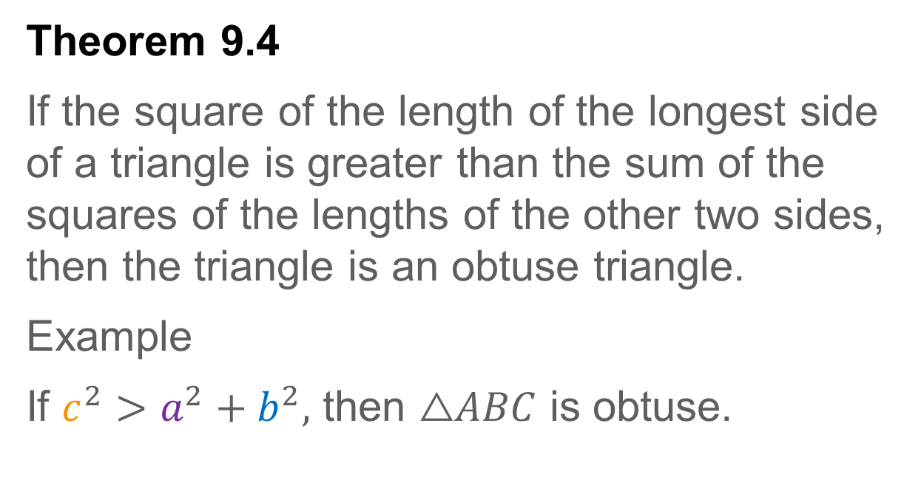
Learn
Converse of the Pythagorean Theorem
Theorem 9.4
If the square of the length of the longest side of a triangle is greater than the sum of the squares of the lengths of the other two sides, then the triangle is an obtuse triangle.
Example
If $c^{2}>a^{2}+b^{2},$ then $\text{△}ABC$ is obtuse.

Slide 24
Example 4
Classify Triangles
Determine whether the points A(2, 2), B(5, 7), and C(10, 6) can be the vertices of a triangle. If so, classify the triangle as acute, right, or obtuse. Justify your answer.

Slide 25
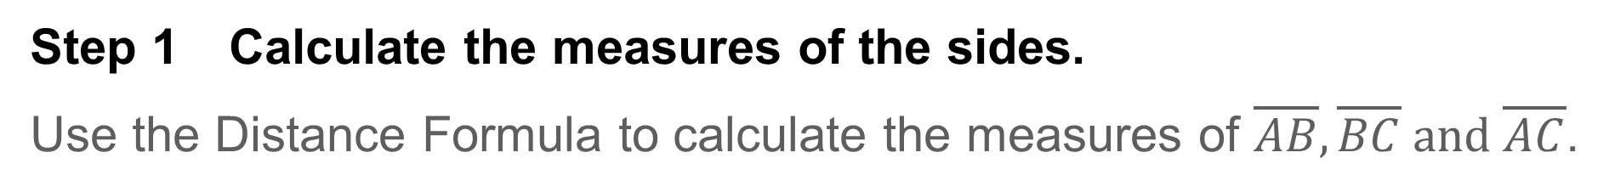
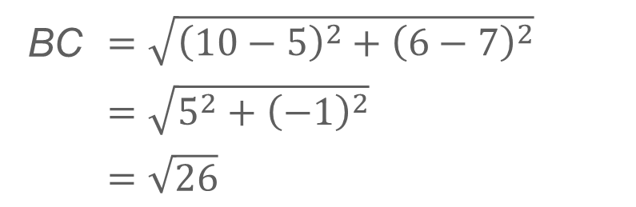
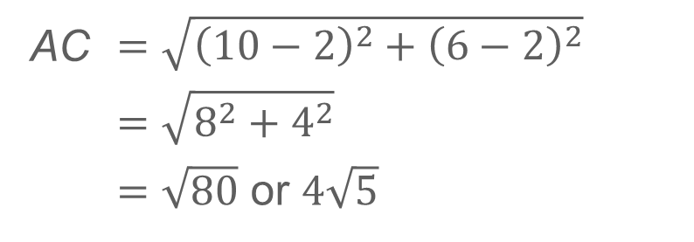
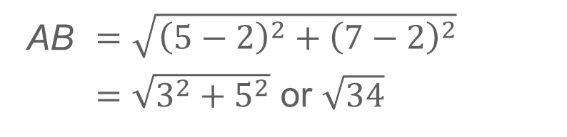
Example 4
Classify Triangles
Step 1 Calculate the measures of the sides.
Use the Distance Formula to calculate the measures of $\overline{AB},\overline{BC} and \overline{AC}$.
AB | $$=\sqrt{{\left(5−2\right)}^{2}+{\left(7−2\right)}^{2}}$$
 | $=\sqrt{3^{2}+5^{2}}$ or $\sqrt{34}$
BC | $$=\sqrt{{\left(10−5\right)}^{2}+{\left(6−7\right)}^{2}}$$
 | $$=\sqrt{5^{2}+{\left(−1\right)}^{2}}$$
 | $$=\sqrt{26}$$
AC | $$=\sqrt{{\left(10−2\right)}^{2}+{\left(6−2\right)}^{2}}$$
 | $$=\sqrt{8^{2}+4^{2}}$$
 | $=\sqrt{80}$ or $4\sqrt{5}$
Use a calculator to approximate the measure of each side. So, AB ≈ 5.83, BC ≈ 5.10, and AC ≈ 8.94.

Slide 26
Example 4
Classify Triangles
Step 2 Determine whether the measures can form a triangle.
Use the Triangle Inequality Theorem to determine whether the measures 5.83, 5.10, and 8.94 can form a triangle.
5.83 + 5.10 > 8.94 ✓
5.83 + 8.94 > 5.10 ✓
5.10 + 8.94 > 5.83 ✓
The side lengths 5.83, 5.10, and 8.94 can form a triangle.

Slide 27
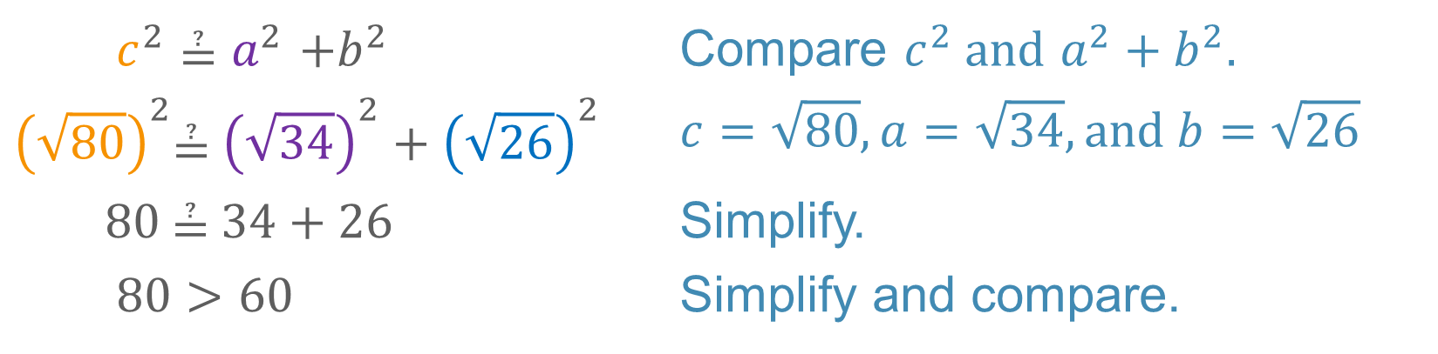
Example 4
Classify Triangles
Step 3 Classify the triangle.
Classify the triangle by comparing the square of the longest side to the sum of the squares of the other two sides.
$$c^{2}{\text{≟ }a}^{2}+b^{2}$$ | Compare $c^{2} and{ a}^{2}+b^{2}.$
$${\left(\sqrt{80}\right)}^{2}\text{≟} {\left(\sqrt{34}\right)}^{2}+{\left(\sqrt{26}\right)}^{2}$$ | $$c=\sqrt{80},a=\sqrt{34}, and b=\sqrt{26}$$
$$80 \text{≟} 34+26$$ | Simplify.
$$80>60$$ | Simplify and compare.
Because $c^{2}>a^{2}+b^{2}$, the triangle is obtuse.

Slide 28
Example 4
Classify Triangles
Think About It!
Does your conclusion seem reasonable? Explain.

Slide 29
Example 4
Classify Triangles
Check
Determine whether the points J(1, 6), K(3, 2), and L(5, 3) can be the vertices of a triangle. If so, classify the triangle as acute, right, or obtuse.

Slide 30
Example 4
Classify Triangles
Check
Determine whether the points J(1, 6), K(3, 2), and L(5, 3) can be the vertices of a triangle. If so, classify the triangle as acute, right, or obtuse.
yes; right
Notes:
yes; right

Slide 31
Exit Ticket
Pythagorean triples always consist of
all even numbers, or
two odd numbers and an even number.
Make a convincing argument that explains this.

Slide 32
Exit Ticket
Pythagorean triples always consist of
all even numbers, or
two odd numbers and an even number.
Make a convincing argument that explains this.
Sample answer: The square of an odd number is an odd number, and the square of an even number is an even number. So when two of the numbers are even, the sum of their squares is even. Therefore, the third number must also be even. When two of the numbers are odd, the sum of their squares is even, so the third number must also be even.
Notes:
Sample answer: The square of an odd number is an odd number, and the square of an even number is an even number. So when two of the numbers are even, the sum of their squares is even. Therefore, the third number must also be even. When two of the numbers are odd, the sum of their squares is even, so the third number must also be even.

