Slide 1
Section 4-4
Compositions of Transformations

Slide 2
Warm Up
△ABC has vertices A(2, 2), B(2, 5), and C(4, 2). Name the coordinates of the image of point C after each transformation.
1. Translate △ABC along ⟨−6, 2⟩.
2. Rotate △ABC 90° clockwise about the origin.
3. Reflect △ABC in the x-axis.
4. Reflect △ABC in the x-axis, and then reflect that image in the y-axis.

Slide 3
Florida’s B.E.S.T. Standards for Mathematics
MA.912.GR.2.3 Identify a sequence of transformations that will map a given figure onto itself or onto another congruent or similar figure.
MA.912.GR.2.5 Given a geometric figure and a sequence of transformations, draw the transformed figure on a coordinate plane.

Slide 4
Florida’s Mathematical Thinking and Reasoning Standards
MA.K12.MTR.3.1
Complete tasks with mathematical fluency.
MA.K12.MTR.5.1
Use patterns and structure to help understand and connect mathematical concepts.
MA.K12.MTR.6.1
Assess the reasonableness of solutions.

Slide 5
Lesson Objectives
Content Objective
Students will determine the image of a figure after a composition of transformations on the coordinate plane and describe the composition of transformations that maps one figure onto other.
Language Objectives
Students explain the composition of transformations that maps one figure onto another using the verbs translate, reflect, and rotate.
To cultivate conversation, students participate in MLR7: Compare and Connect.

Slide 6
Learn
Compositions of Transformations
When a transformation is applied to a figure and then another transformation is applied to its image, the result is called a composition of transformations. A glide reflection is one type of composition of transformations.
A glide reflection is the composition of a translation followed by a reflection in a line parallel to the translation vector.

Slide 7
Learn
Compositions of Transformations
Theorem 4.1: Composition of Isometries
The composition of two (or more) isometries is an isometry.
So, the composition of two or more isometries—reflections, translations, or rotations—results in an image that is congruent to its preimage.

Slide 8

Example 1
Glide Reflection
Triangle PQR has vertices P(1, 1), Q(2, 5), and R(4, 2). Determine the coordinates of the vertices of the image after a translation along $\left\langle −4,0\right\rangle$ and a reflection in the x-axis.

Slide 9
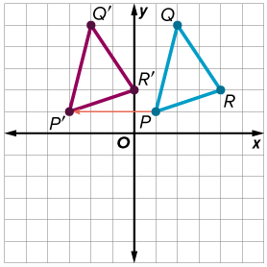
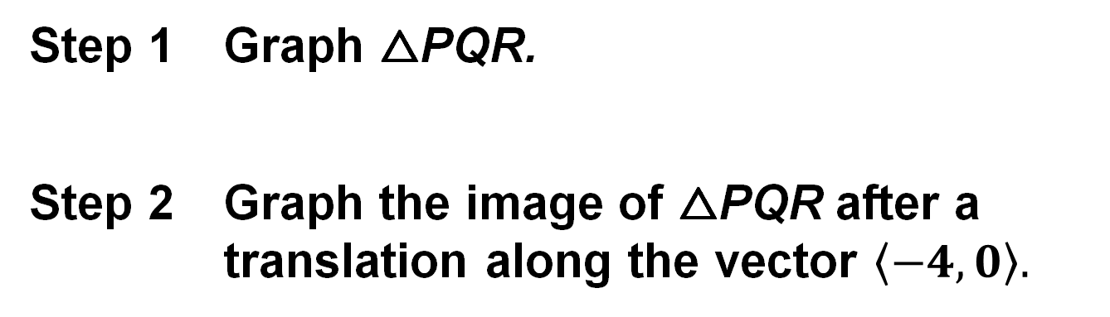
Example 1
Glide Reflection
Step 1 Graph △PQR.
Step 2 Graph the image of △PQR after a translation along the vector $\left\langle −4,0\right\rangle .$
(x, y) | → | (x − 4, y)
P(1, 1) | → | P′(−3, 1)
Q(2, 5) | → | Q′(−2, 5)
R(4, 2) | → | R′(0, 2)

Slide 10
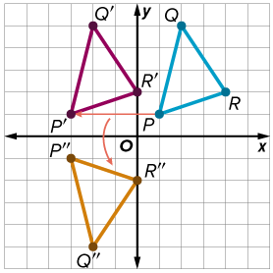
Example 1
Glide Reflection
Step 3 Graph the image of △P′Q′R′ after a reflection in the x-axis.
(x, y) | → | (x, −y)
P′(−3, 1) | → | P″(−3, −1)
Q′(−2, 5) | → | Q″(−2, −5)
R′(0, 2) | → | R″(0, −2)

Slide 11
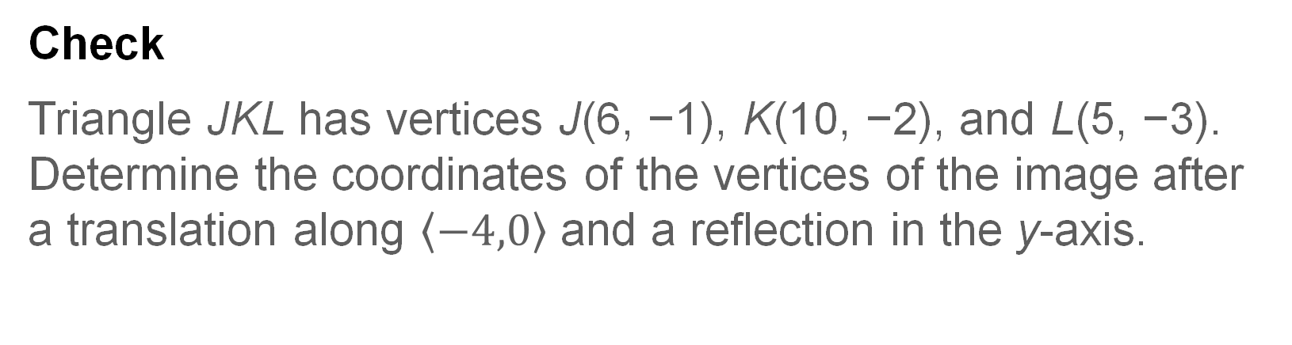
Example 1
Glide Reflection
Check
Triangle JKL has vertices J(6, −1), K(10, −2), and L(5, −3). Determine the coordinates of the vertices of the image after a translation along $\left\langle −4,0\right\rangle$ and a reflection in the y-axis.

Slide 12
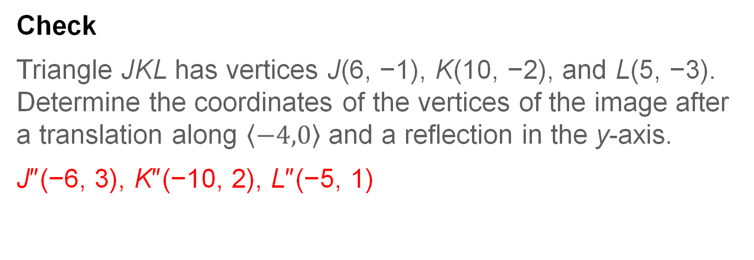
Example 1
Glide Reflection
Check
Triangle JKL has vertices J(6, −1), K(10, −2), and L(5, −3). Determine the coordinates of the vertices of the image after a translation along $\left\langle −4,0\right\rangle$ and a reflection in the y-axis.
J″(−6, 3), K″(−10, 2), L″(−5, 1)
Notes:
J″(−6, 3), K″(−10, 2), L″(−5, 1)

Slide 13
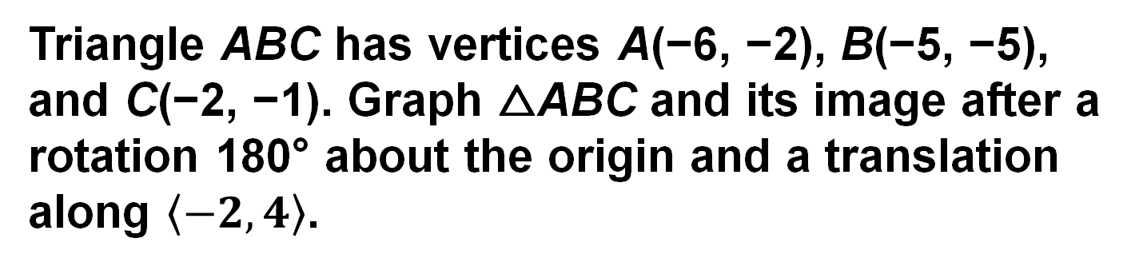
Example 2
Composition of Isometries
Triangle ABC has vertices A(−6, −2), B(−5, −5), and C(−2, −1). Graph △ABC and its image after a rotation 180° about the origin and a translation along $\left\langle −2,4\right\rangle$.

Slide 14
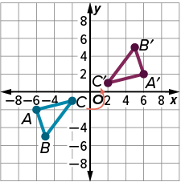
Example 2
Composition of Isometries
Step 1 Graph △ABC.
Step 2 Graph the image of △ABC after a rotation 180° about the origin.
(x, y) | → | (−x, −y)
A(−6, −2) | → | A′(6, 2)
B(−5, −5) | → | B′(5, 5)
C(−2, −1) | → | C′(2, 1)

Slide 15
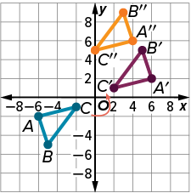

Example 2
Composition of Isometries
Step 3 Graph the image of △A′B′C′ after a translation along $\left\langle −2,4\right\rangle$.
(x, y) | → | (x − 2, y + 4)
A′(6, 2) | → | A″(4, 6)
B′(5, 5) | → | B″(3, 9)
C′(2, 1) | → | C″(0, 5)

Slide 16
Example 2
Composition of Isometries
Talk About It!
Do any points remain invariant, or unchanged, under glide reflections? under compositions of transformations? Explain.

Slide 17
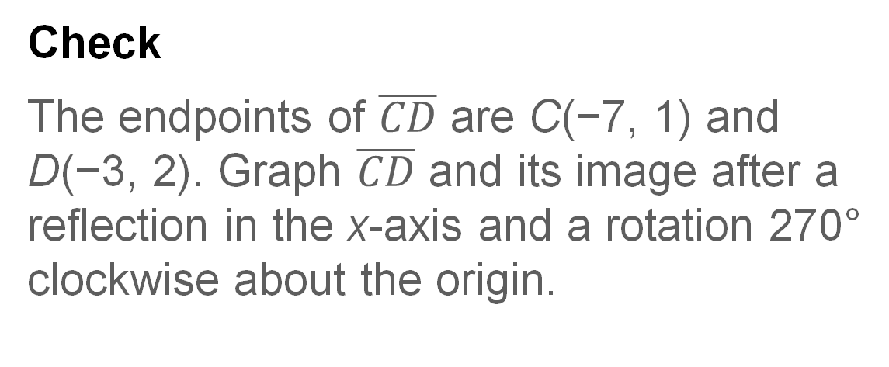
Example 2
Composition of Isometries
Check
The endpoints of $\overline{CD}$ are C(−7, 1) and D(−3, 2). Graph $\overline{CD}$ and its image after a reflection in the x-axis and a rotation 270° clockwise about the origin.

Slide 18
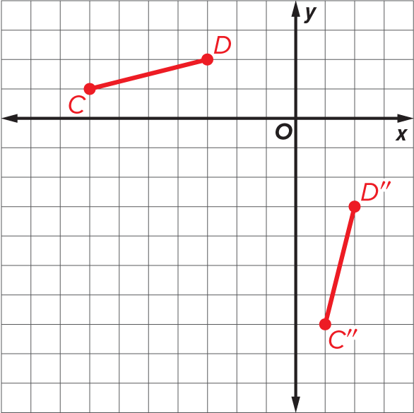
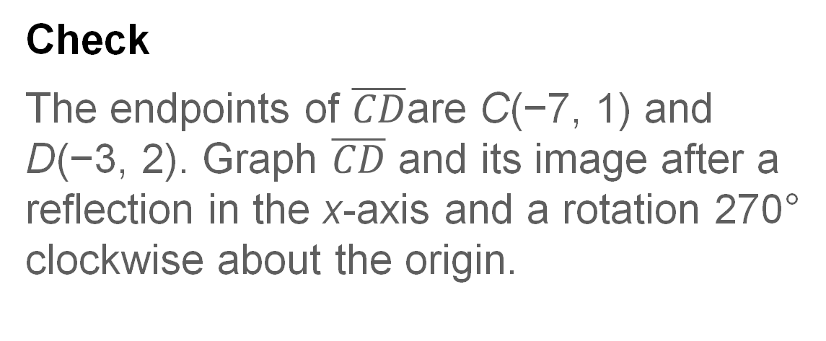
Example 2
Composition of Isometries
Check
The endpoints of $\overline{CD}$are C(−7, 1) and D(−3, 2). Graph $\overline{CD}$ and its image after a reflection in the x-axis and a rotation 270° clockwise about the origin.

Slide 19
Learn
Compositions of Two Reflections
The composition of two reflections can result in the same image as a translation or rotation.

Slide 20
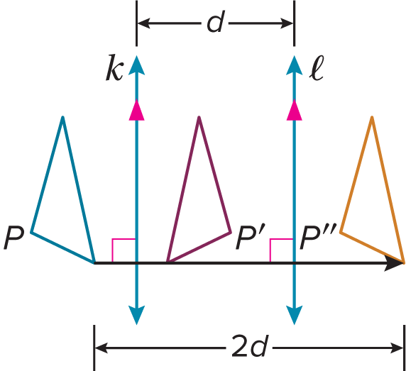
Learn
Compositions of Two Reflections
The composition of two reflections can result in the same image as a translation or rotation.
Theorem 4.2: Reflections in Parallel Lines
The composition of two reflections in parallel lines can be described by a translation vector that is
perpendicular to the two lines and
twice the distance between the two lines.

Slide 21
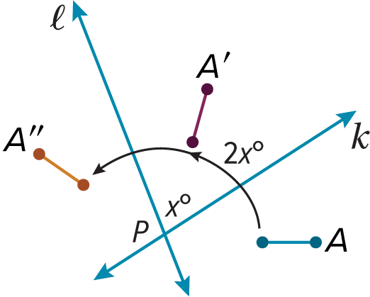
Learn
Compositions of Two Reflections
Theorem 4.3: Reflections in Intersecting Lines
The composition of two reflections in intersecting lines can be described by a rotation that is
about the point where the lines intersect and
through an angle that is twice the measure of the acute or right angle formed by the lines.

Slide 22
Learn
Compositions of Two Reflections
Think About It!
In what type of intersecting lines will a composition of two reflections form a 180° rotation?

Slide 23
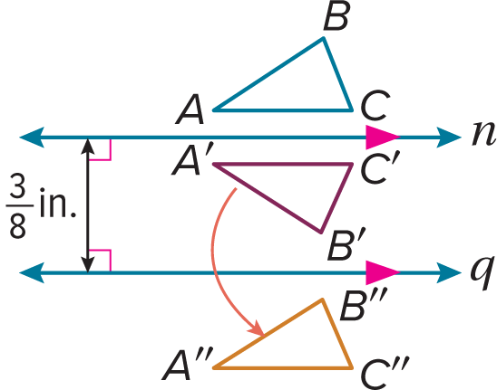
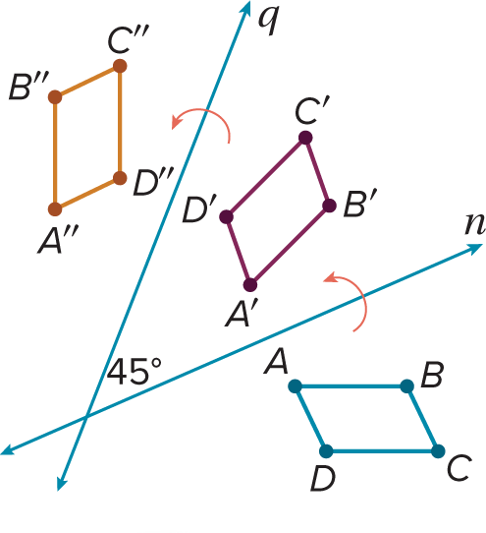
Example 3
Reflect a Figure in Two Lines
Reflect each figure in line 𝓃 and then line 𝓆. Then describe a single transformation that maps the preimage onto the final image.
a.
b.

Slide 24
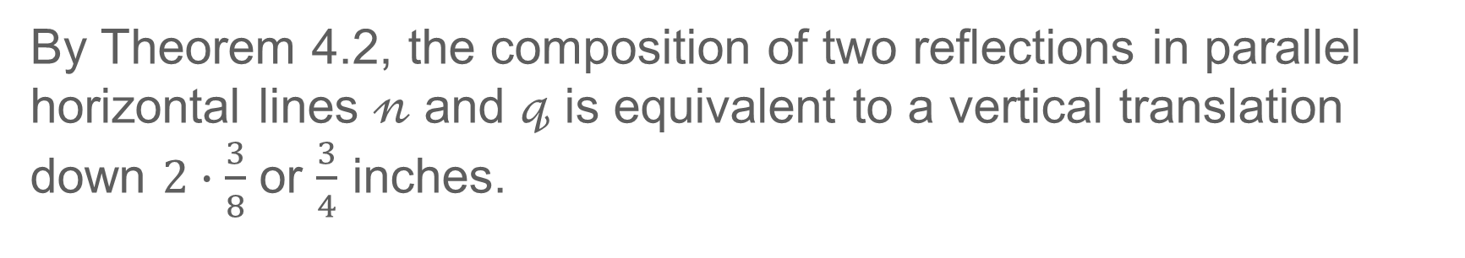
Example 3
Reflect a Figure in Two Lines
a.
By Theorem 4.2, the composition of two reflections in parallel horizontal lines 𝓃 and 𝓆 is equivalent to a vertical translation down $2∙\frac{3}{8}$ or $\frac{3}{4}$ inches.

Slide 25
Example 3
Reflect a Figure in Two Lines
b.
By Theorem 4.3, the composition of two reflections in intersecting lines 𝓃 and 𝓆 is equivalent to a 2 · 45° or 90° counterclockwise rotation about the intersection point of lines 𝓃 and 𝓆.

Slide 26
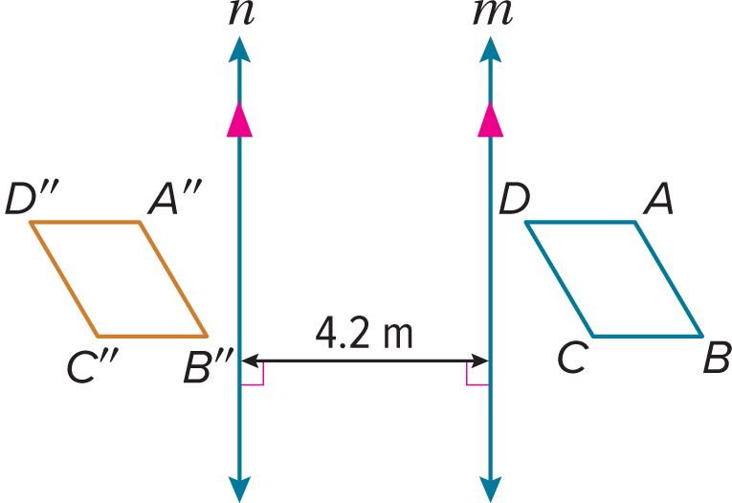
Example 3
Reflect a Figure in Two Lines
Check
Reflect quadrilateral ABCD in line 𝓂 and then line 𝓃. Then describe a single transformation that maps ABCD onto A″B″C″D″.

Slide 27
Example 3
Reflect a Figure in Two Lines
Check
Reflect quadrilateral ABCD in line 𝓂 and then line 𝓃. Then describe a single transformation that maps ABCD onto A″B″C″D″.
a horizontal translation left 8.4 m
Notes:
a horizontal translation left 8.4 m

Slide 28
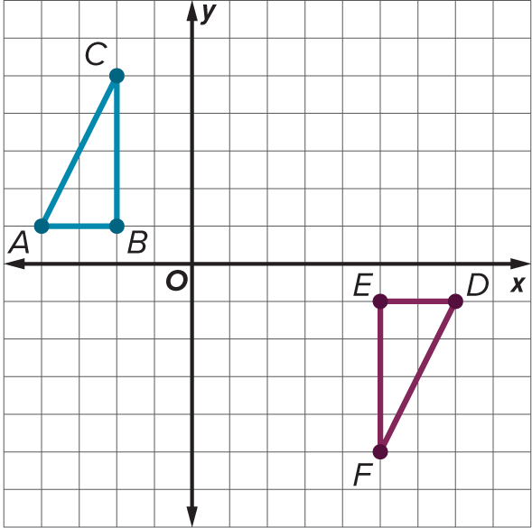
Example 4
Determine Congruence
Are triangles ABC and DEF congruent? If so, what composition of transformations maps △ABC onto △DEF?

Slide 29
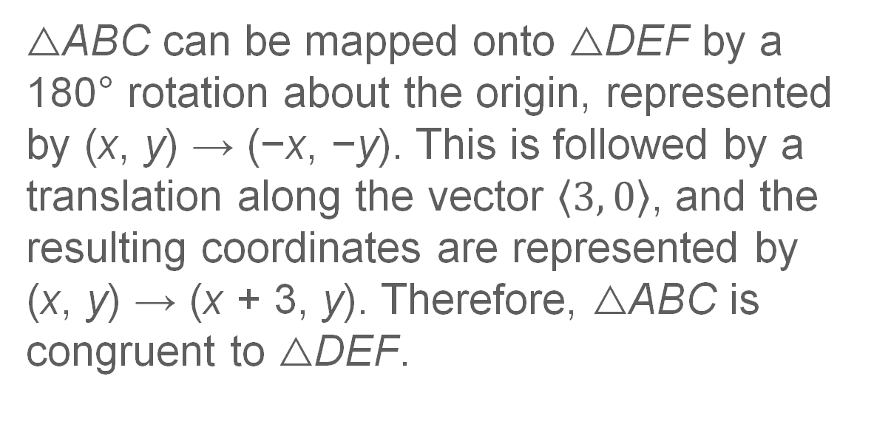
Example 4
Determine Congruence
△ABC can be mapped onto △DEF by a 180° rotation about the origin, represented by (x, y) → (−x, −y). This is followed by a translation along the vector $\left\langle 3, 0\right\rangle$, and the resulting coordinates are represented by (x, y) → (x + 3, y). Therefore, △ABC is congruent to △DEF.

Slide 30
Example 4
Determine Congruence
Think About It!
How can you tell that △ABC needs to be rotated 180° before being translated? Use the position of △DEF to justify your argument.

Slide 31

Example 5
Describe Transformations
DESIGN PATTERNS Describe the transformations that are combined to create the pattern shown.

Slide 32
Example 5
Describe Transformations
The pattern is created by successive translations of the first third of the design. So this pattern can be created by combining two reflections in a pair of vertical parallel lines.

Slide 33
Example 5
Describe Transformations
Talk About It!
Is there a transformation or a composition of transformations that will map a part of the pattern onto itself?

Slide 34
Exit Ticket
△ABC has vertices A(1, −3), B(3, −2), and C(0, −1). Give the coordinates of A″B″C″D″ after each set of transformations.
1. Translate △ABC 2 units left followed by a reflection in the x-axis.
2. Rotate △ABC 90° counterclockwise about the origin followed by a translation up 2 units.
3. Reflect △ABC in the x-axis and then rotate the image 90° counterclockwise.
4. Rotate △ABC 90° counterclockwise about the origin and then reflect the image in the x-axis.

Slide 35
Exit Ticket
△ABC has vertices A(1, −3), B(3, −2), and C(0, −1). Give the coordinates of A″B″C″D″ after each set of transformations.
1. Translate △ABC 2 units left followed by a reflection in the x-axis. A″(−1, 3), B″(1, 2), C″(−2, 1)
2. Rotate △ABC 90° counterclockwise about the origin followed by a translation up 2 units. A″(3, 3), B″(2, 5), C″(1, 2)
3. Reflect △ABC in the x-axis and then rotate the image 90° counterclockwise. A″(−3, 1), B″(−2, 3), C″(−1, 0)
4. Rotate △ABC 90° counterclockwise about the origin and then reflect the image in the x-axis. A″(3, −1), B″(2, −3), C″(1, 0)
Notes:
A″(−1, 3), B″(1, 2), C″(−2, 1)
A″(3, 3), B″(2, 5), C″(1, 2)
A″(−3, 1), B″(−2, 3), C″(−1, 0)
A″(3, −1), B″(2, −3), C″(1, 0)

