Slide 1
Similar Polygons

Slide 2
Warm Up
Are the triangles congruent? Justify your answer.
1. 2.
3.

Slide 3
Warm Up
4. PAINTING A painter needs to determine the height of a building to estimate the amount of paint she will need. If she is 5 feet tall and casts a 3.5-foot shadow at the same time as the building casts a 25-foot shadow, how tall is the building to the nearest tenth?

Slide 4
Warm Up
Are the triangles congruent? Justify your answer.
1. 2.
3.
yes; SSS
no
yes; SAS
Notes:
yes; SSS
no
yes; SAS

Slide 5
Warm Up
4. PAINTING A painter needs to determine the height of a building to estimate the amount of paint she will need. If she is 5 feet tall and casts a 3.5-foot shadow at the same time as the building casts a 25-foot shadow, how tall is the building to the nearest tenth? 35.7 ft
Notes:
35.7 ft

Slide 6
Florida’s B.E.S.T. Standards for Mathematics
MA.912.GR.1.6 Solve mathematical and real-world problems involving congruence or similarity in two-dimensional figures.
MA.912.GR.2.3 Identify a sequence of transformations that will map a given figure onto itself or onto another congruent or similar figure.
MA.912.GR.2.8 Apply an appropriate transformation to map one figure onto another to justify that the two figures are similar.

Slide 7
Florida’s Mathematical Thinking and Reasoning Standards
MA.K12.MTR.4.1
Engage in discussions that reflect on the mathematical thinking of self and others.
MA.K12.MTR.7.1
Apply mathematics to real-world contexts.

Slide 8
Lesson Objectives
Content Objective
Students solve problems using the definition of similar polygons.
Language Objectives
Students talk about solving problems using the definition of similar polygons with the adjective similar.
To cultivate conversation, students participate in MLR8: Discussion Supports.

Slide 9
Learn
Similar Polygons
A dilation is a type of similarity transformation. A similarity transformation is a transformation composed of a dilation or a dilation and a rigid transformation. Two figures are similar polygons if one can be obtained from the other by a dilation or a dilation with one or more rigid transformations.

Slide 10
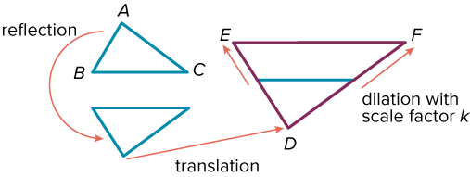
Learn
Similar Polygons
△ABC can be mapped onto △DEF with two rigid transformations and a dilation with a scale factor of k. So, △ABC ∼ △DEF.
When two triangles are similar, their angles and sides are related.

Slide 11
Learn
Similar Polygons
Theorem 8.1: Similar Polygons
Words | Two polygons are similar if and only if their corresponding angles are congruent and their corresponding side lengths are proportional.
Symbols | ABCD ∼ WXYZ

Slide 12
Learn
Similar Polygons
Like congruence, similarity is reflexive, symmetric, and transitive.
Theorem 8.2: Properties of Similarity
Reflexive Property of Similarity
△ABC ∼ △ABC
Symmetric Property of Similarity
If △ABC ∼ △DEF, then △DEF ∼ △ABC.
Transitive Property of Similarity
If △ABC ∼ △DEF and △DEF ∼ △XYZ, then △ABC ∼ △XYZ.

Slide 13
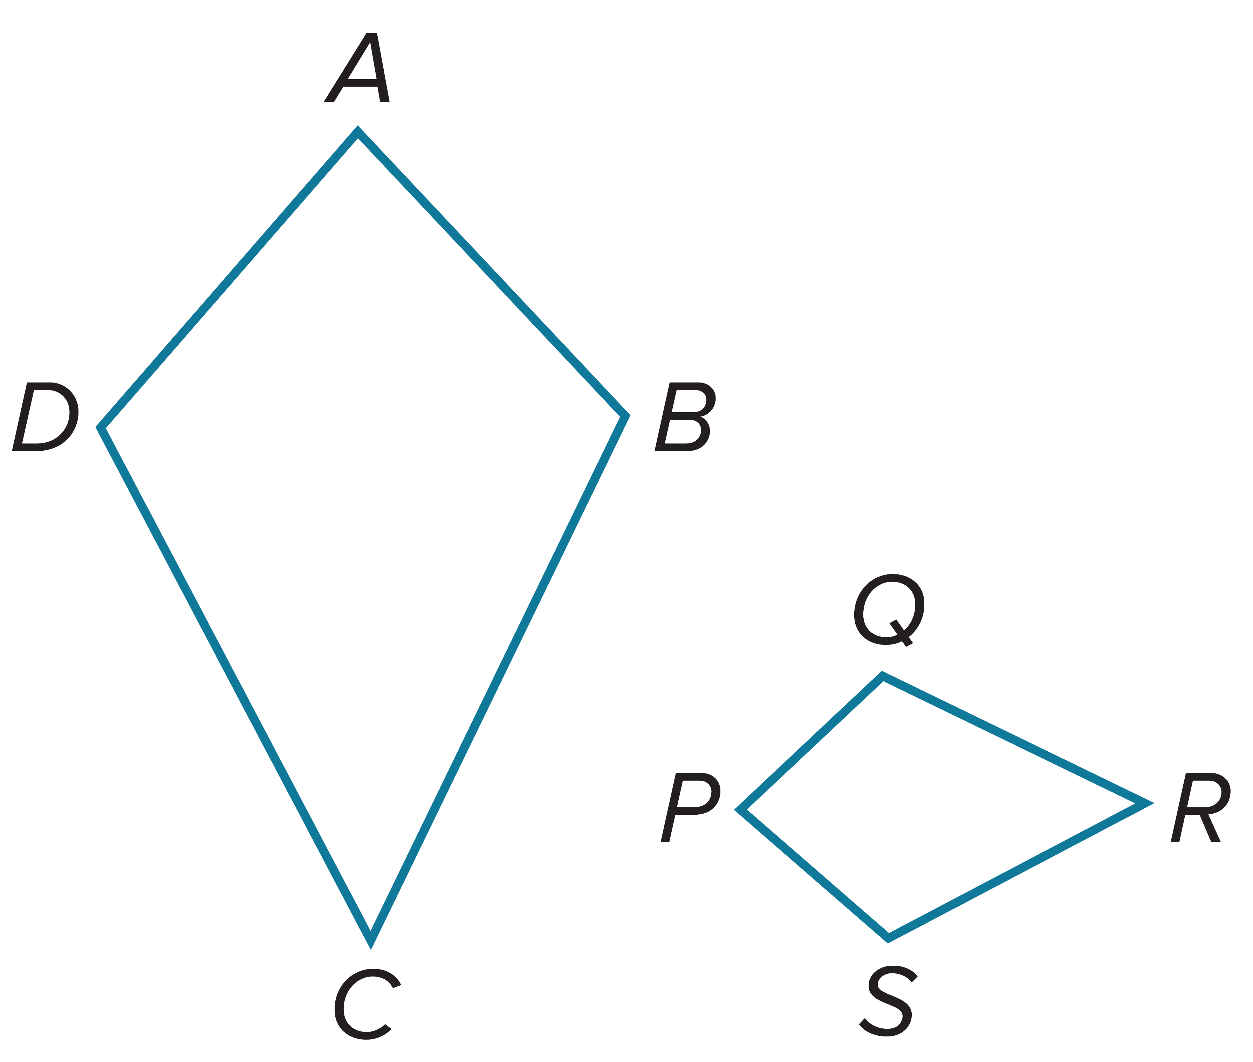
Example 1
Use a Similarity Statement
ABCD ∼ PQRS. List all pairs of congruent angles, and write a proportion that relates the corresponding sides.

Slide 14
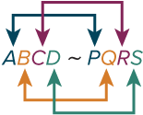

Example 1
Use a Similarity Statement
Use the similarity statement.
Congruent angles: $∠A≅∠P,∠B≅∠Q,∠C≅∠R,∠D≅∠S$
Proportion: $\frac{AB}{PQ}=\frac{BC}{QR}=\frac{CD}{RS}=\frac{DA}{SP}$

Slide 15
Example 1
Use a Similarity Statement
Think About It!
If two polygons are congruent, are they also similar? Justify your argument.

Slide 16
Example 1
Use a Similarity Statement
Check
NPQR ∼ UVST. List all pairs of congruent angles, and write a proportion that relates the corresponding sides.

Slide 17
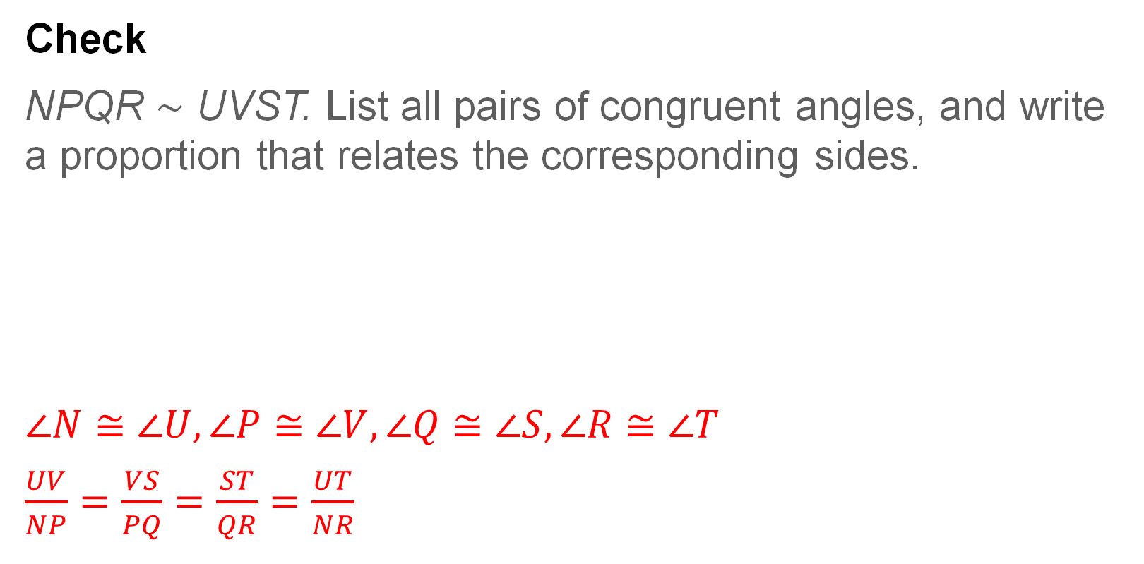
Example 1
Use a Similarity Statement
Check
NPQR ∼ UVST. List all pairs of congruent angles, and write a proportion that relates the corresponding sides.
$∠N≅∠U,∠P≅∠V,∠Q≅∠S,∠R≅∠T$
$\frac{UV}{NP}=\frac{VS}{PQ}=\frac{ST}{QR}=\frac{UT}{NR}$
Notes:
$∠N≅∠U,∠P≅∠V,∠Q≅∠S,∠R≅∠T$
$\frac{UV}{NP}=\frac{VS}{PQ}=\frac{ST}{QR}=\frac{UT}{NR}$

Slide 18
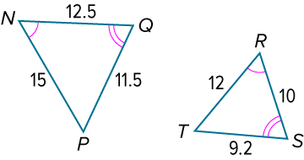
Example 2
Identify Similar Polygons
Determine whether △NQP is similar to △RST. If so, find the scale factor. Explain your reasoning.

Slide 19
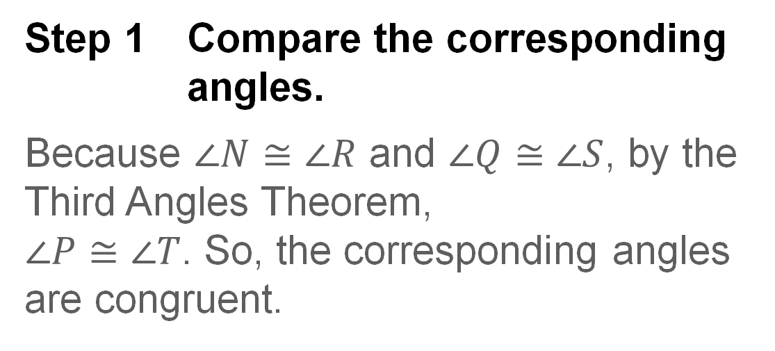
Example 2
Identify Similar Polygons
Step 1 Compare the corresponding angles.
Because $∠N≅∠R$ and $∠Q≅∠S$, by the Third Angles Theorem,
$∠P≅∠T$. So, the corresponding angles are congruent.

Slide 20
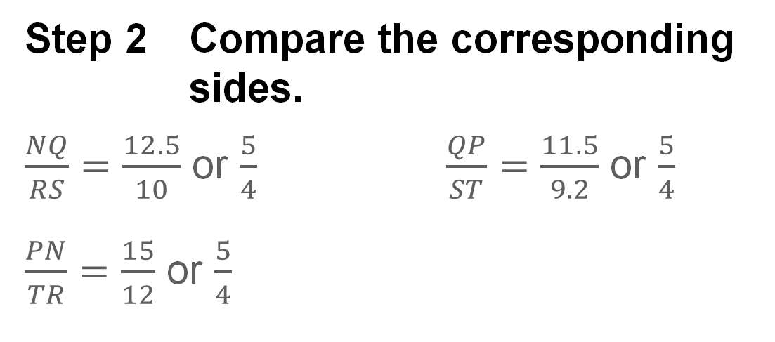
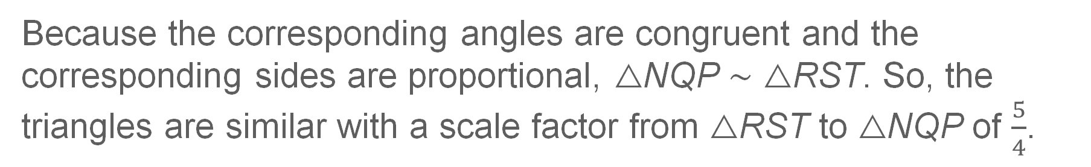
Example 2
Identify Similar Polygons
Step 2 Compare the corresponding sides.
$\frac{NQ}{RS}=\frac{12.5}{10}$ or $\frac{5}{4}$ $\frac{QP}{ST}=\frac{11.5}{9.2}$ or $\frac{5}{4}$
$\frac{PN}{TR}=\frac{15}{12}$ or $\frac{5}{4}$
Because the corresponding angles are congruent and the corresponding sides are proportional, △NQP ∼ △RST. So, the triangles are similar with a scale factor from △RST to △NQP of $\frac{5}{4}$.

Slide 21
Example 2
Identify Similar Polygons
Think About It!
What transformations can be used to create △NQP from △RST?

Slide 22
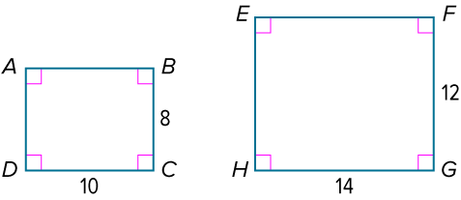
Example 2
Identify Similar Polygons
Check
Determine whether quadrilateral ABCD is similar to quadrilateral EFGH. If so, find the scale factor. Explain your reasoning.

Slide 23
Example 2
Identify Similar Polygons
Check
Determine whether quadrilateral ABCD is similar to quadrilateral EFGH. If so, find the scale factor. Explain your reasoning.
No; The corresponding angles are congruent, but the corresponding sides are not proportional.
Notes:
No; sample answer: The corresponding angles are congruent, but the corresponding sides are not proportional.

Slide 24
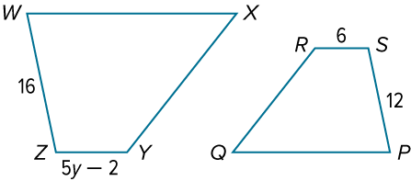
Example 3
Use Similar Figures to Find Missing Measures
In the diagram, WXYZ ∼ PQRS. Find the value of y.

Slide 25
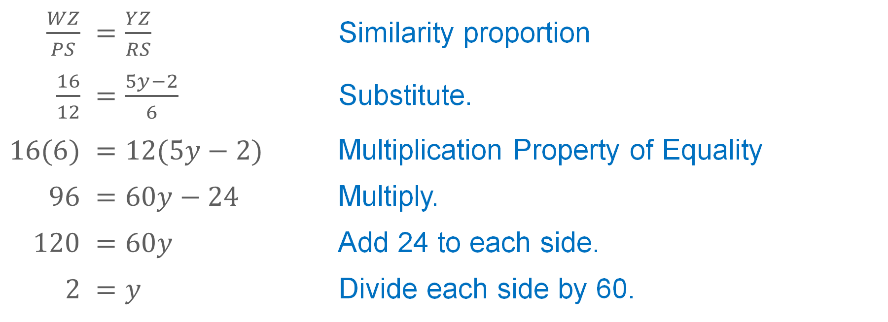
Example 3
Use Similar Figures to Find Missing Measures
Use the corresponding side lengths to write a proportion.
$\frac{WZ}{PS}$ | $=\frac{YZ}{RS}$ | Similarity proportion
$\frac{16}{12}$ | $=\frac{5y−2}{6}$ | Substitute.
$$16(6)$$ | $$=12(5y−2)$$ | Multiplication Property of Equality
$$96$$ | $$=60y−24$$ | Multiply.
$$120$$ | $$=60y$$ | Add 24 to each side.
$$2$$ | $$=y$$ | Divide each side by 60.

Slide 26
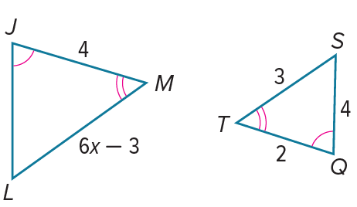
Example 3
Use Similar Figures to Find Missing Measures
Check
In the diagram, △JLM ∼ △QST. Find the value of x. Round to the nearest tenth, if necessary.

Slide 27
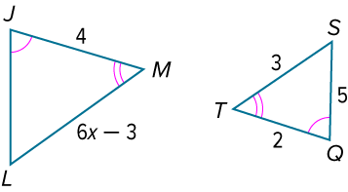
Example 3
Use Similar Figures to Find Missing Measures
Check
In the diagram, △JLM ∼ △QST. Find the value of x. Round to the nearest tenth, if necessary. x = 1.5
Notes:
x = 1.5

Slide 28
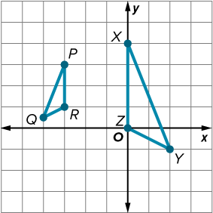
Example 4
Determine Similarity
Is △PQR ∼ △XYZ? If so, what composition of transformations maps △PQR onto △XYZ?

Slide 29
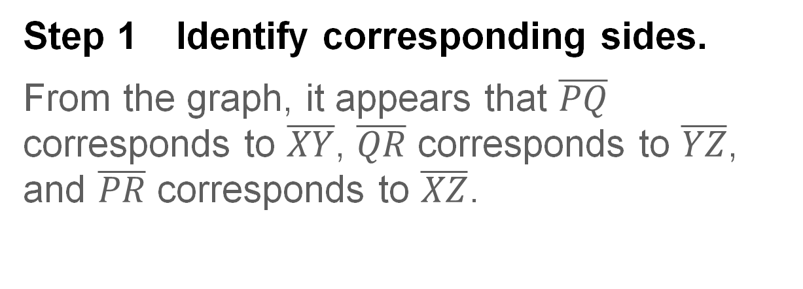
Example 4
Determine Similarity
Step 1 Identify corresponding sides.
From the graph, it appears that $\overline{PQ}$ corresponds to $\overline{XY}$, $\overline{QR}$ corresponds to $\overline{YZ}$, and $\overline{PR}$ corresponds to $\overline{XZ}$.

Slide 30
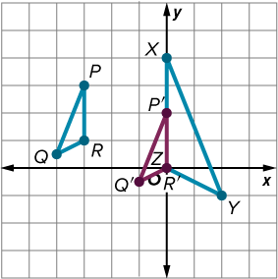
Example 4
Determine Similarity
Step 2 Identify a composition of transformations that could map △PQR onto △XYZ.
If R and Z are corresponding vertices,
we need to map point R onto point Z.
Translate △PQR along the vector ⟨3, −1⟩.
(x, y) | → | (x + 3, y − 1)
P(−3, 3) | → | P′(0, 2)
Q(−4, 0.5) | → | Q′(−1, −0.5)
R(−3, 1) | → | R′(0, 0)

Slide 31
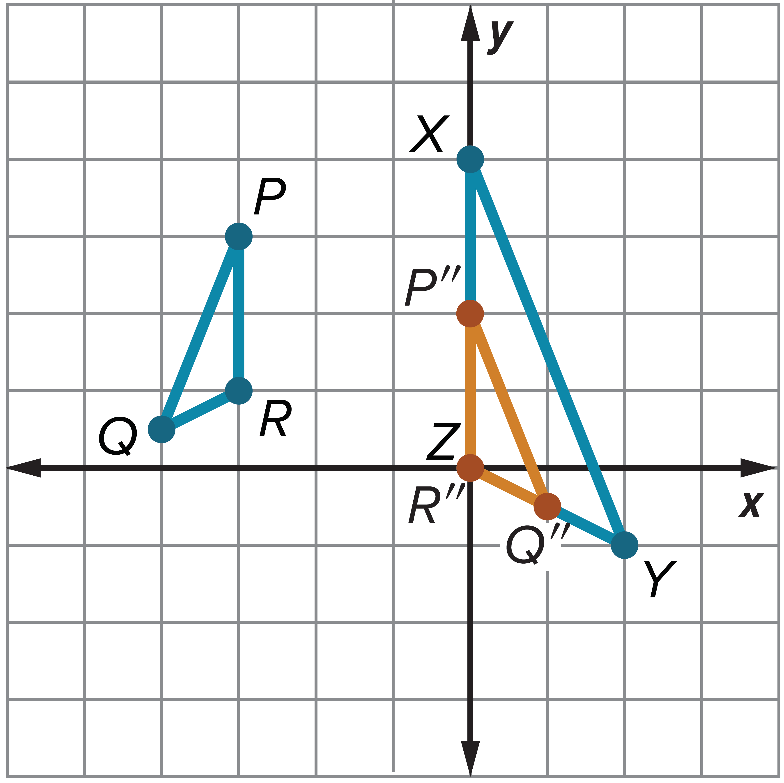

Example 4
Determine Similarity
After the translation, △P′Q′R′ needs to be reflected in the y-axis so that $\overline{R″Q″}$ coincides with $\overline{ZY}$.
(x, y) | → | (−x, y)
P′(0, 2) | → | P"(0, 2)
Q′(−1, −0.5) | → | Q"(1, −0.5)
R′(0, 0) | → | R"(0, 0)

Slide 32

Example 4
Determine Similarity
Because $\frac{XZ}{P^{″}R^{″}}=\frac{4}{2}$ or 2, dilate △P″Q″R″ with respect to the origin and a scale factor of 2.
(x, y) | → | (2x, 2y)
P″(0, 2) | → | P‴(0, 4)
Q″(1, −0.5) | → | Q‴(2, −1)
R″(0, 0) | → | R‴(0, 0)

Slide 33
Example 4
Determine Similarity
△PQR can be mapped onto △XYZ by a translation along the vector ⟨3, −1⟩ , represented by (x, y) → (x + 3, y − 1). The image is reflected in the y-axis and is represented by (x, y) → (−x, y). This is followed by a dilation centered at the origin with a scale factor of 2, and the resulting coordinates are represented by (x, y) → (2x, 2y). The corresponding angles of the two triangles are congruent, and the corresponding sides are proportional. Therefore, △PQR is similar to △XYZ.

Slide 34
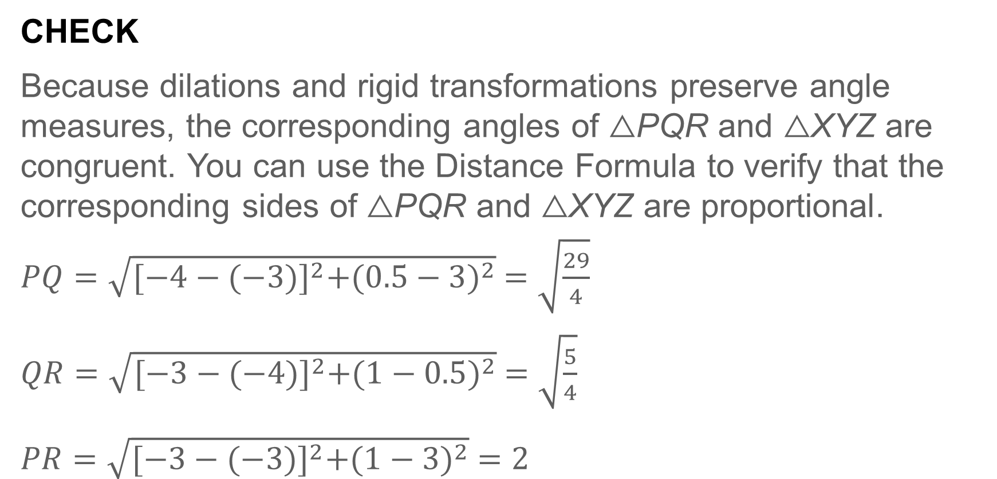
Example 4
Determine Similarity
CHECK
Because dilations and rigid transformations preserve angle measures, the corresponding angles of △PQR and △XYZ are congruent. You can use the Distance Formula to verify that the corresponding sides of △PQR and △XYZ are proportional.
$PQ=\sqrt{{[−4−(−3)]}^{2}+{(0.5−3)}^{2}} =$ $\sqrt{\frac{29}{4}}$
$QR=\sqrt{{[−3−(−4)]}^{2}+{(1−0.5)}^{2}} =$ $\sqrt{\frac{5}{4}}$
$PR=\sqrt{{[−3−(−3)]}^{2}+{(1−3)}^{2}} =$ $2$

Slide 35
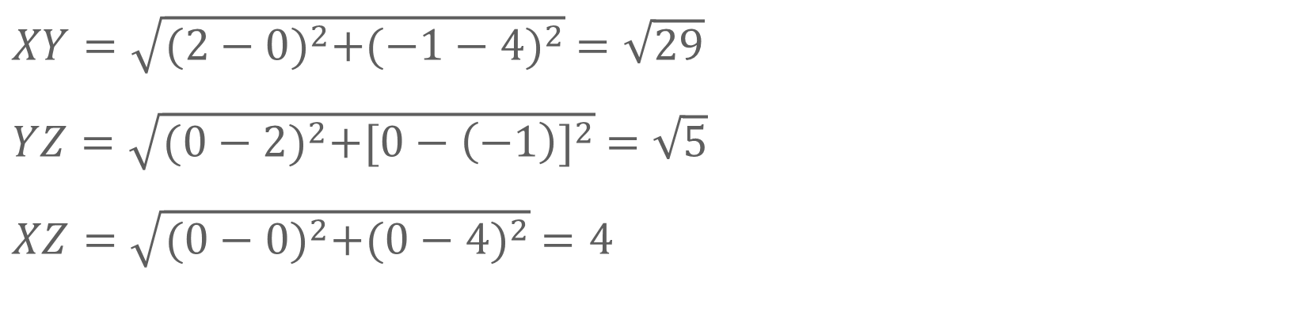
Example 4
Determine Similarity
$XY=\sqrt{{(2−0)}^{2}+{(−1−4)}^{2}} =$ $\sqrt{29}$
$YZ=\sqrt{{(0−2)}^{2}+{[0−\left(−1\right)]}^{2}} =$ $\sqrt{5}$
$XZ=\sqrt{{(0−0)}^{2}+{(0−4)}^{2}} =$ $4$

Slide 36
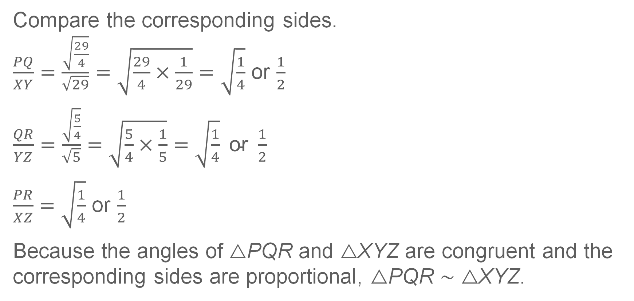
Example 4
Determine Similarity
Compare the corresponding sides.
$\frac{PQ}{XY}=\frac{\sqrt{\frac{29}{4}}}{\sqrt{29}}=\sqrt{\frac{29}{4}×\frac{1}{29}}=$ $\sqrt{\frac{1}{4}}$ or $\frac{1}{2}$
$\frac{QR}{YZ}=\frac{\sqrt{\frac{5}{4}}}{\sqrt{5}}=\sqrt{\frac{5}{4}×\frac{1}{5}}=\sqrt{\frac{1}{4}} \text{or} \frac{1}{2}$
$\frac{PR}{XZ}=$ $\sqrt{\frac{1}{4}}$ or $\frac{1}{2}$
Because the angles of △PQR and △XYZ are congruent and the corresponding sides are proportional, △PQR ∼ △XYZ.

Slide 37
Example 4
Determine Similarity
Think About It!
Identify a triangle that is similar to △PQR and can be mapped onto △PQR with a single dilation. Describe the dilation.

Slide 38
Example 4
Determine Similarity
Think About It!
What composition of rigid and nonrigid transformations can map a square onto itself?

Slide 39
Learn
Perimeters of Similar Polygons
In similar polygons, the ratio of any two corresponding lengths is equal to the scale factor or similarity ratio between them. So, you can write a proportion to relate them. This leads to the following theorem about the perimeters of two similar polygons.
Theorem 8.3: Perimeters of Similar Polygons Theorem
If two polygons are similar, then their perimeters are proportional in the same ratio as the scale factor between them.

Slide 40
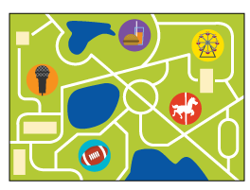
Example 5
Use Similar Polygons to Find Perimeter
STATE FAIR Geoffrey plans on going to the state fair this summer. He has downloaded a map of the fairgrounds that shows all of the attractions. Geoffrey plans to visit the concert hall, the Ferris wheel, and the sports center. On the map, the distance between the concert hall and the Ferris wheel is 9 centimeters, the distance between the Ferris wheel and the sports center is 8 centimeters, and the distance between the sports center and the concert hall is 4 centimeters.

Slide 41
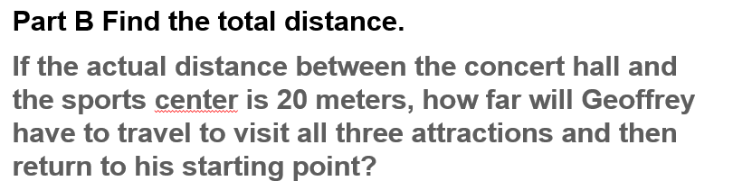
Example 5
Use Similar Polygons to Find Perimeter
Part A Describe Geoffrey’s path.
Part B Find the total distance.

Slide 42
Example 5
Use Similar Polygons to Find Perimeter
Part A Describe Geoffrey’s path.
Geoffrey wants to visit the concert hall, the Ferris wheel, and the sports center. If Geoffrey returns to the concert hall after visiting the sports center, what polygon can be used to model Geoffrey’s path between the three attractions?

Slide 43
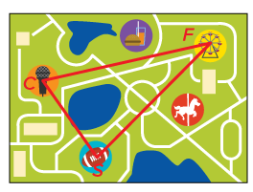
Example 5
Use Similar Polygons to Find Perimeter
Geoffrey’s path can be modeled by a triangle.
On the map, draw line segments between the three attractions. Then label the points that represent the three attractions. Label the concert hall as C, the sports center as S, and the Ferris wheel as F.

Slide 44
Example 5
Use Similar Polygons to Find Perimeter
Part B Find the total distance.
If the actual distance between the concert hall and the sports center is 20 meters, how far will Geoffrey have to travel to visit all three attractions and then return to his starting point?

Slide 45
Example 5
Use Similar Polygons to Find Perimeter
△CSF will be similar to the triangle formed by Geoffrey as he walks to the three attractions. Let’s call the figure formed by Geoffrey’s path △C′S′F′.
So, △CSF ∼ △C′S′F′. To find how far Geoffrey will have to travel to visit all three attractions, find the perimeter of △C′S′F′.

Slide 46
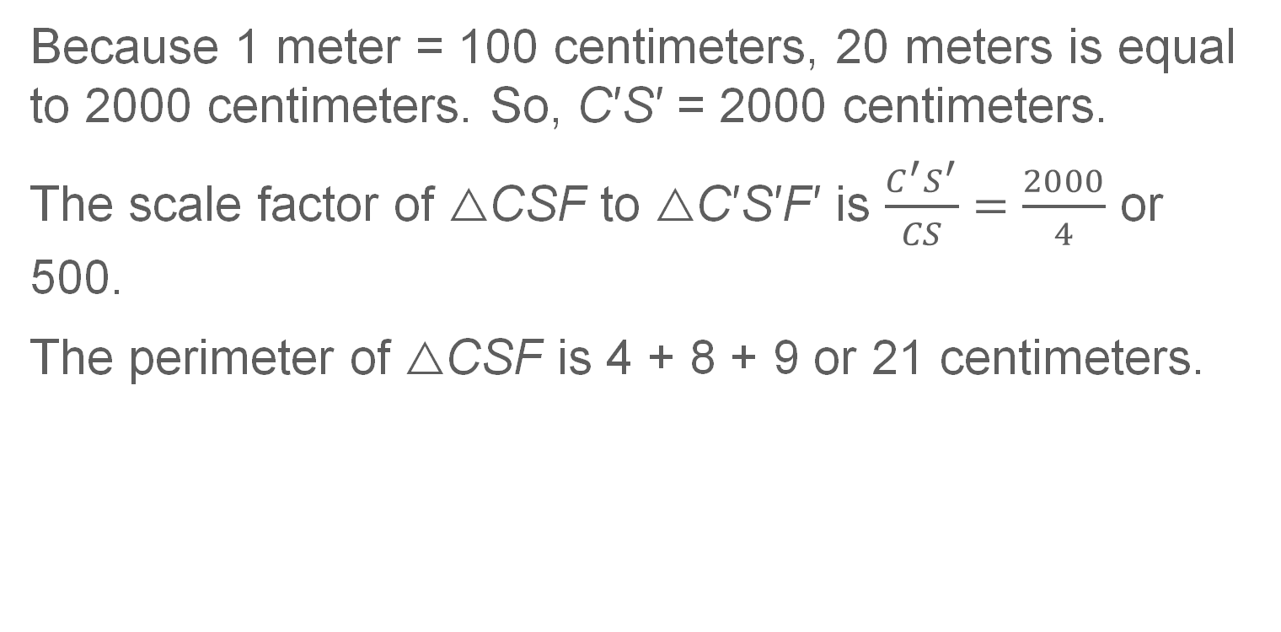
Example 5
Use Similar Polygons to Find Perimeter
Because 1 meter = 100 centimeters, 20 meters is equal to 2000 centimeters. So, C′S′ = 2000 centimeters.
The scale factor of △CSF to △C′S′F′ is $\frac{C^{′}S^{′}}{CS}=\frac{2000}{4}$ or 500.
The perimeter of △CSF is 4 + 8 + 9 or 21 centimeters.

Slide 47
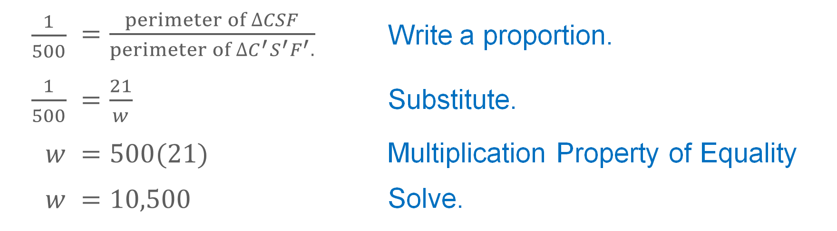
Example 5
Use Similar Polygons to Find Perimeter
Use the perimeter of △CSF and the scale factor to write a proportion. Let w represent the perimeter of △C′S′F′.
$\frac{1}{500}$ | $=\frac{perimeter of ∆CSF}{perimeter of ∆C^{′}{S^{′}F}^{′}.}$ | Write a proportion.
$\frac{1}{500}$ | $=\frac{21}{w}$ | Substitute.
$$w$$ | $=500(21)$ | Multiplication Property of Equality
$$w$$ | $=10,500$ | Solve.
So, the perimeter of △C′S′F′ is 10,500 centimeters or 105 meters.

Slide 48
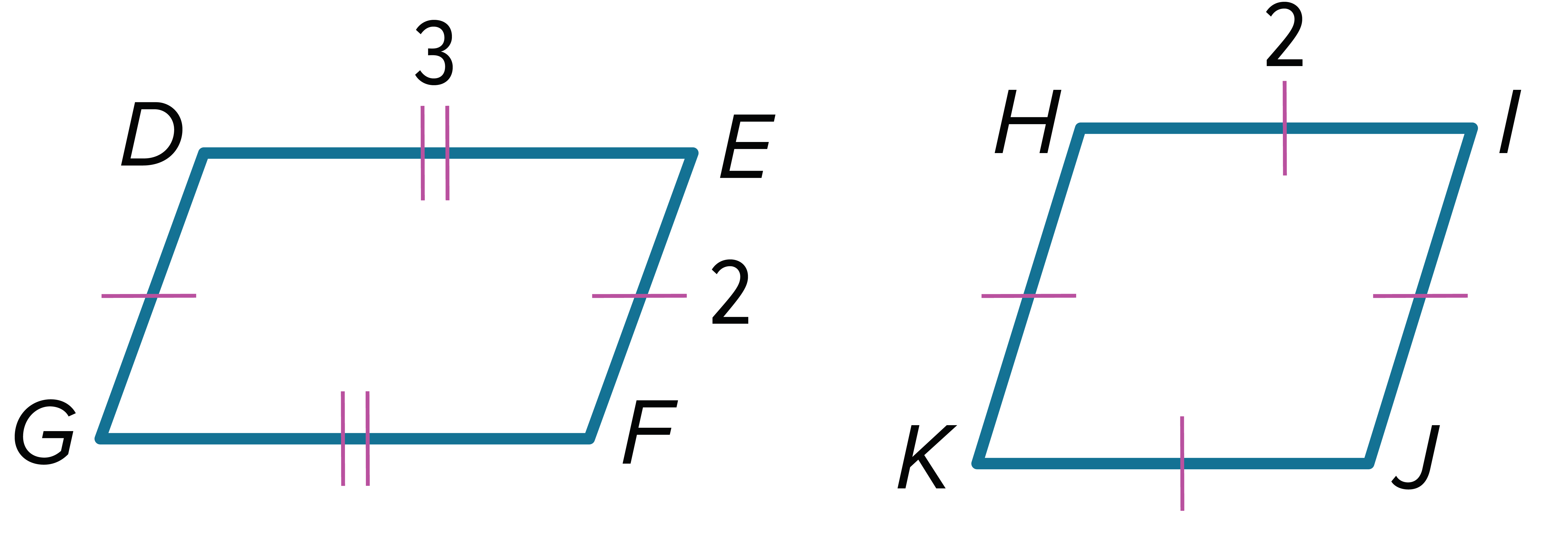
Exit Ticket
Determine whether the two polygons are similar. If so, write a similarity statement and find the similarity ratio.
1. 2.

Slide 49
Exit Ticket
3. The perimeters of two similar polygons are in the ratio 1:25. If the length of one side of the smaller polygon is 3 centimeters, what is the length of the corresponding side of the larger polygon?

Slide 50
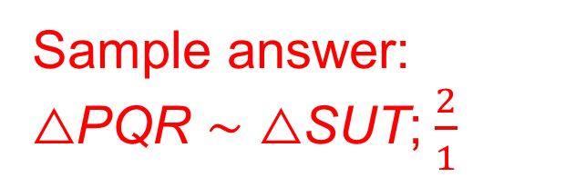
Exit Ticket
Determine whether the two polygons are similar. If so, write a similarity statement and find the similarity ratio.
1. 2.
Sample answer: △PQR ∼ △SUT;$\frac{2}{1}$
no
Notes:
△PQR ∼ △SUT;$\frac{2}{1}$
no

Slide 51
Exit Ticket
3. The perimeters of two similar polygons are in the ratio 1:25. If the length of one side of the smaller polygon is 3 centimeters, what is the length of the corresponding side of the larger polygon? 75 cm
Notes:
75 cm

