Slide 1
Module 1-3
Locating Points Using Ratios

Slide 2
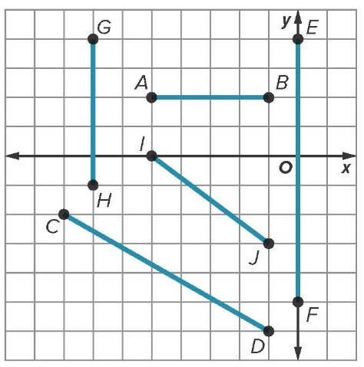
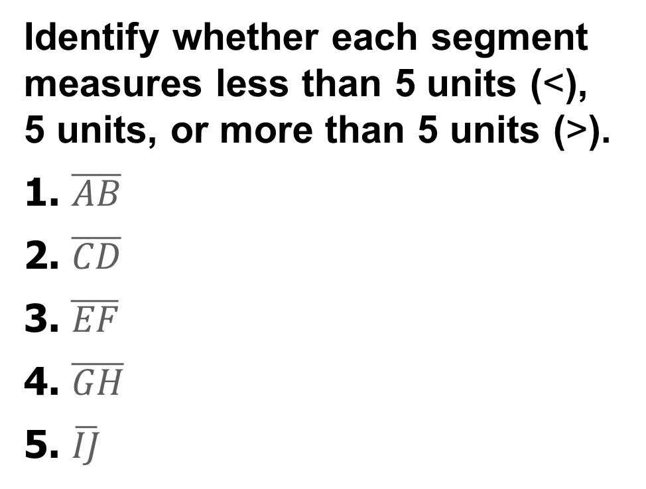
Warm Up
Identify whether each segment measures less than 5 units (<), 5 units, or more than 5 units (>).
1. $\overline{AB}$
2. $\overline{CD}$
3. $\overline{EF}$
4. $\overline{GH}$
5. $\overline{IJ}$

Slide 3
Florida’s B.E.S.T. Standards for Mathematics
MA.912.GR.3.3
Use coordinate geometry to solve mathematical and real-world geometric problems involving lines, circles, triangles and quadrilaterals.

Slide 4
Florida’s Mathematical Thinking and Reasoning Standards
MA.K12.MTR.3.1
Complete tasks with mathematical fluency.
MA.K12.MTR.6.1
Assess the reasonableness of solutions.

Slide 5
Lesson Objectives
Content Objective
Students will find points that partition line segments on number lines and determine the coordinates of a point on a line segment that partitions the segment in a given ratio on the coordinate plane.
Language Objectives
Students use by + -ing verbs to explain how to locate points using ratios.
To support sense-making, students participate in MLR2: Collect and Display.

Slide 6
Learn pg. 23
Locating Points on a Number Line with a
Given Ratio
Knowing the distance between the two endpoints on a line segment can be helpful, but in many cases, you may want to calculate the distance from an endpoint to some intermediary point on the line segment. To do this, you can calculate the coordinate of a point that partitions a line segment into a given ratio.

Slide 7
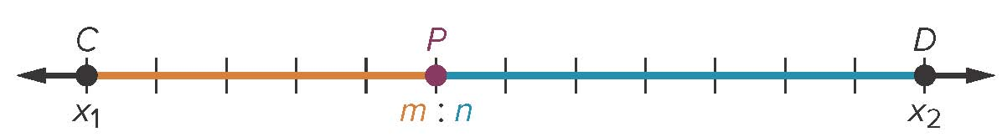
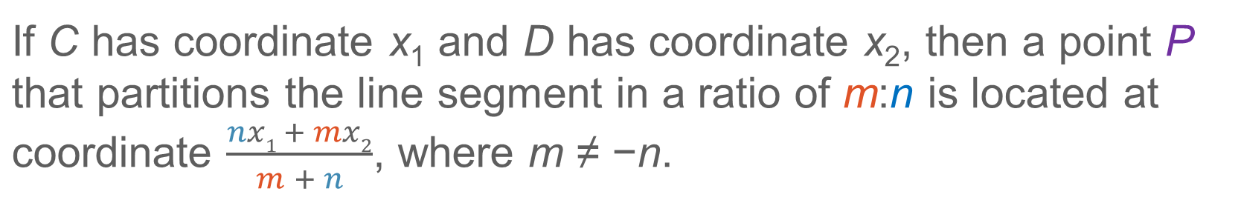
Learn
Locating Points on a Number Line with a
Given Ratio
Key Concept: Section Formula on a Number Line
If C has coordinate x₁ and D has coordinate x₂, then a point P that partitions the line segment in a ratio of m:n is located at coordinate $\frac{nx1 + mx2}{m + n}$, where m ≠ −n.

Slide 8

Example 1 – WE DO! Pg. 23 SI
Locate a Point on a Number Line When Given a Ratio
Find B on $\overline{AC}$ such that the ratio of AB to BC is 3:4.

Slide 9

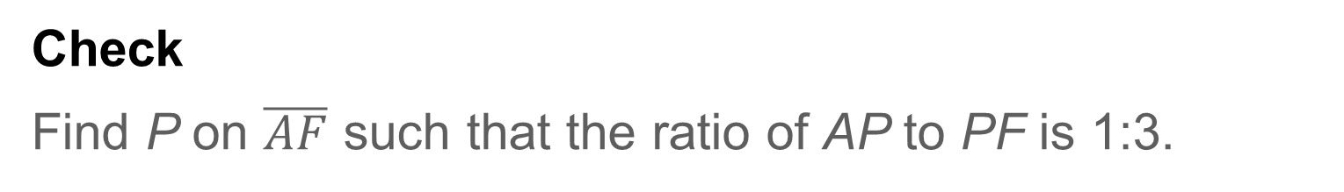
Example 1-YOU DO! Pg. 24 SI
Locate a Point on a Number Line When Given a Ratio
Check
Find P on $\overline{AF}$ such that the ratio of AP to PF is 1:3.

Slide 10
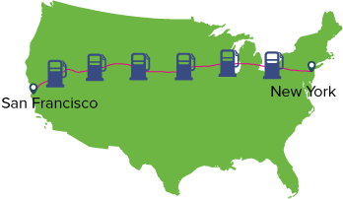
Example 2 – WE DO! Pg. 24
Partition a Line Segment
ROAD TRIP Jorge is traveling 2563 miles from New York City to San Francisco by car. His next stop for gas will be when the ratio of the distance he has already traveled to the distance he still has to travel is 2:5. How far has Jorge traveled the next time he stops for gas?

Slide 11
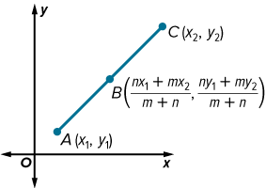
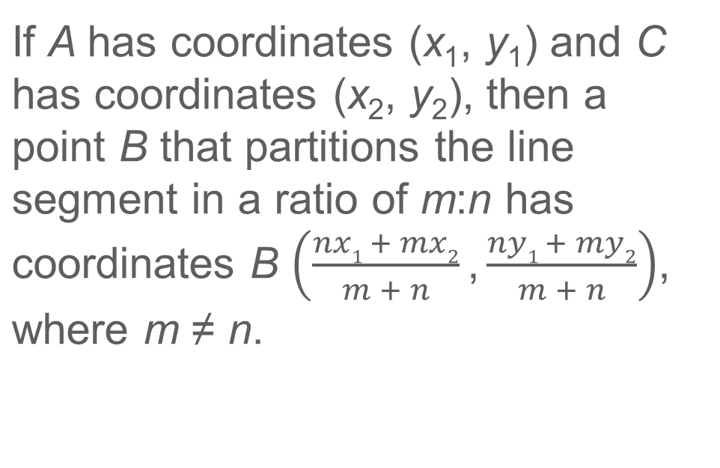
Learn – I DO! Pg. 24
Locating Points on the Coordinate Plane with a Given Ratio
Key Concept: Section Formula on the Coordinate Plane
If A has coordinates (x₁, y₁) and C has coordinates (x₂, y₂), then a point B that partitions the line segment in a ratio of m:n has coordinates B $\left(\frac{nx1 + mx2}{m + n}\text{,}\frac{ny1 + my2}{m + n}\right)$, where m ≠ n.

Slide 12
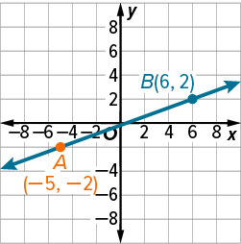

Example 3 – WE DO! Pg. 25
Locate a Point on the Coordinate Plane When Given a Ratio
Find C on $\overline{AB}$ such that the ratio of AC to CB is 1:2.

Slide 13
Example 4 – I DO! Pg. 25
Partition a Line Segment on the Coordinate Plane
ZIP LINES Kendrick is riding a zip line. The zip line is 1800 meters long and starts at a platform 600 meters above the ground. After he jumps, someone takes a picture of his descent. When the picture is taken, the ratio of the distance Kendrick has traveled to the distance he has remaining is 1:2. The picture will show the horizontal distance from 400 meters to 1200 meters from the base of the platform and the vertical distance from ground level to a height of 500 meters. Will Kendrick be in the frame of the picture?

Slide 14
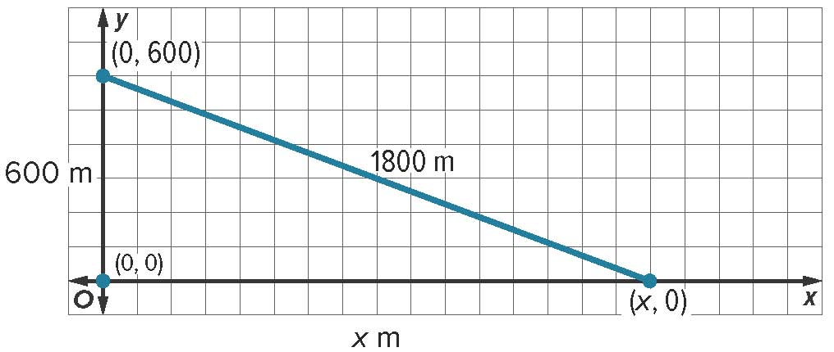
Example 4 – WE DO! Pg. 25
Partition a Line Segment on the Coordinate Plane
To determine whether Kendrick is in the frame of the picture, first, determine the horizontal distance x of the zip line. Then, use this information to determine Kendrick’s location using the Section Formula.
Step 1 Determine the horizontal distance x of the zip line.

Slide 15
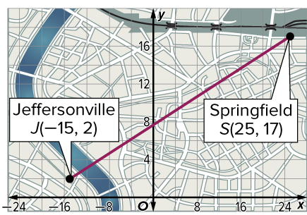
Example 4
Partition a Line Segment on the Coordinate Plane
Check
TRAVEL Andre is traveling from Jeffersonville to Springfield. He plans to stop for a break when the distance he has traveled and the distance he has left to travel have a ratio of 3:7. Where should Andre stop for his break?
A. (13, 12.5) B. (22, 12.5) C. (−3, 6.5) D. (−12, 6.5)

Slide 16
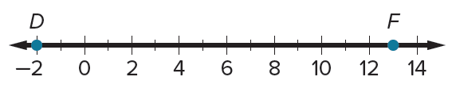

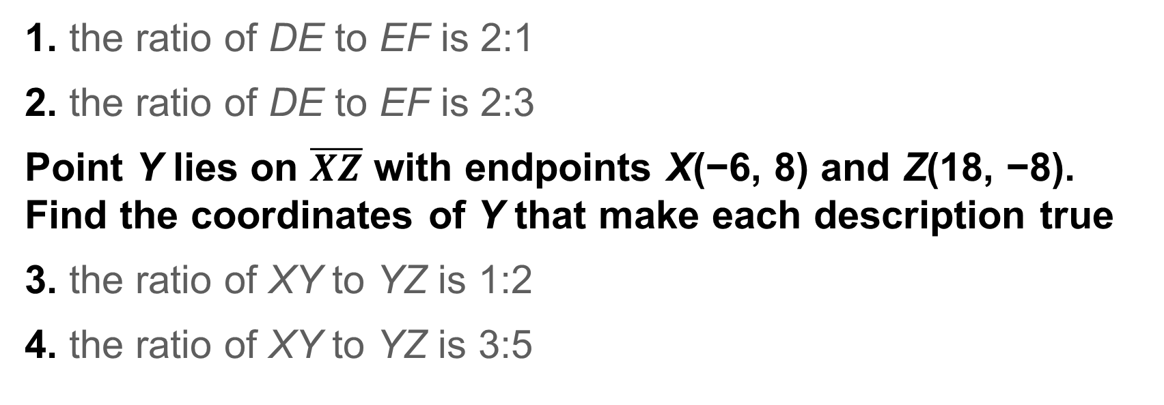
Exit Ticket
Use the number line to find the coordinate of E on $\overline{DF}$ that makes each description true.
1. the ratio of DE to EF is 2:1
2. the ratio of DE to EF is 2:3
Point Y lies on $\overline{XZ}$ with endpoints X(−6, 8) and Z(18, −8). Find the coordinates of Y that make each description true
3. the ratio of XY to YZ is 1:2
4. the ratio of XY to YZ is 3:5

