Slide 1
5-6 Isosceles and Equilateral Triangles

Slide 2
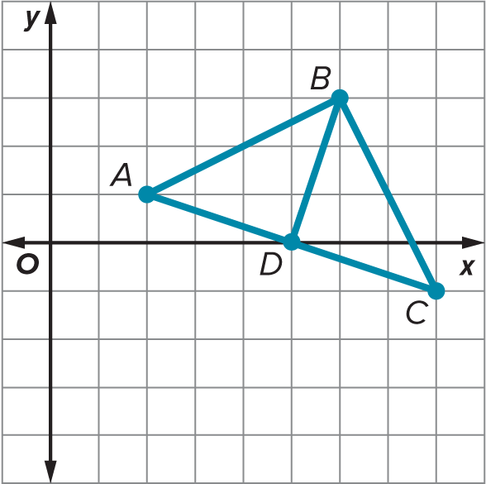
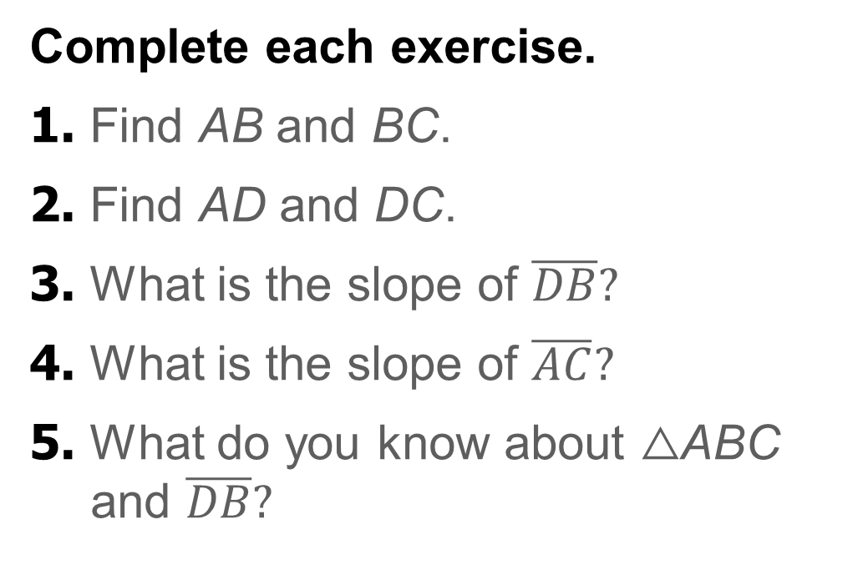
Warm Up
Complete each exercise.
1. Find AB and BC.
2. Find AD and DC.
3. What is the slope of $\overline{DB}?$
4. What is the slope of $\overline{AC}?$
5. What do you know about △ABC and $\overline{DB}?$

Slide 3
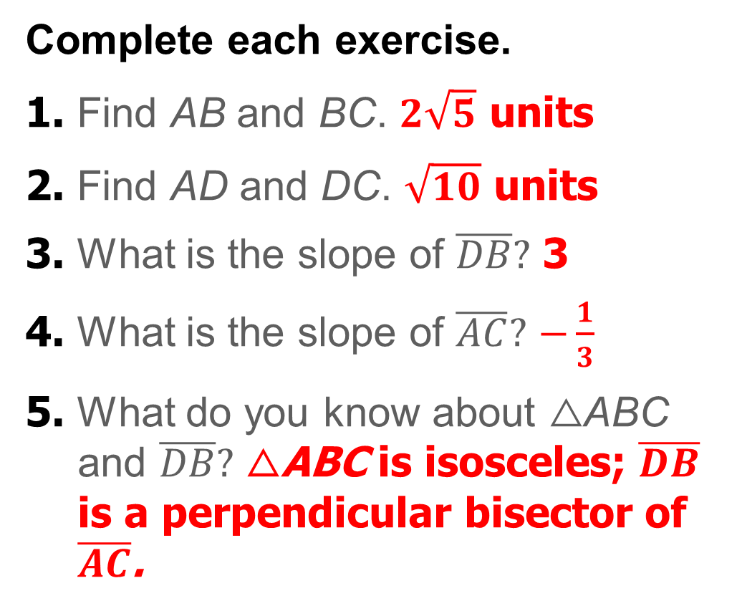
Warm Up
Complete each exercise.
1. Find AB and BC. $2\sqrt{5}$ units
2. Find AD and DC. $\sqrt{10}$ units
3. What is the slope of $\overline{DB}?$ 3
4. What is the slope of $\overline{AC}?$ $−\frac{1}{3}$
5. What do you know about △ABC and $\overline{DB}?$ △ABC is isosceles; $\overline{DB}$ is a perpendicular bisector of $\overline{AC}$.
Notes:
$2\sqrt{5}$ units
$\sqrt{10}$ units
3
$$−\frac{1}{3}$$
△ABC is isosceles; $\overline{DB}$ is a perpendicular bisector of $\overline{AC}$.

Slide 4
Florida’s B.E.S.T. Standards for Mathematics
MA.912.GR.1.3 Prove relationships and theorems about triangles. Solve mathematical and real-world problems involving postulates, relationships and theorems of triangles.

Slide 5
Florida’s Mathematical Thinking and Reasoning Standards
MA.K12.MTR.1.1
Actively participate in effortful learning both individually and collectively.
MA.K12.MTR.4.1
Engage in discussions that reflect on the mathematical thinking of self and others.

Slide 6
Lesson Objectives
Content Objective
Students will solve problems involving isosceles and equilateral triangles.
Language Objectives
Students describe triangles using must have and must be.
To support conversation, students participate in MLR3: Critique, Correct, and Clarify.

Slide 7
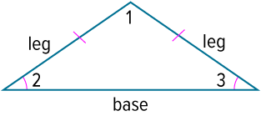
Learn
Isosceles Triangles
An isosceles triangle is a triangle with at least two sides congruent. The two congruent sides are called the legs of an isosceles triangle.
The angle between the sides that are the legs is called the vertex angle of an isosceles triangle. ∠1 is the vertex angle of the triangle. The side of the triangle opposite the vertex angle is called the base. The two angles formed by the base and the congruent sides are called the base angles of an isosceles triangle. ∠2 and ∠3 are the base angles.

Slide 8
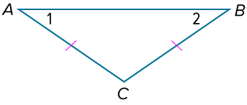
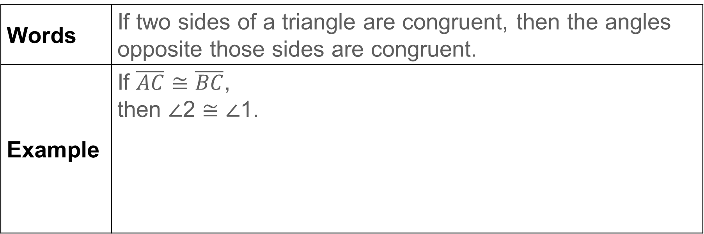
Learn
Isosceles Triangles
Theorem 5.10: Isosceles Triangle Theorem
Words | If two sides of a triangle are congruent, then the angles opposite those sides are congruent.
Example | If $\overline{AC}≅\overline{BC}$, then ∠2 ≅ ∠1.

Slide 9
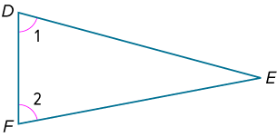
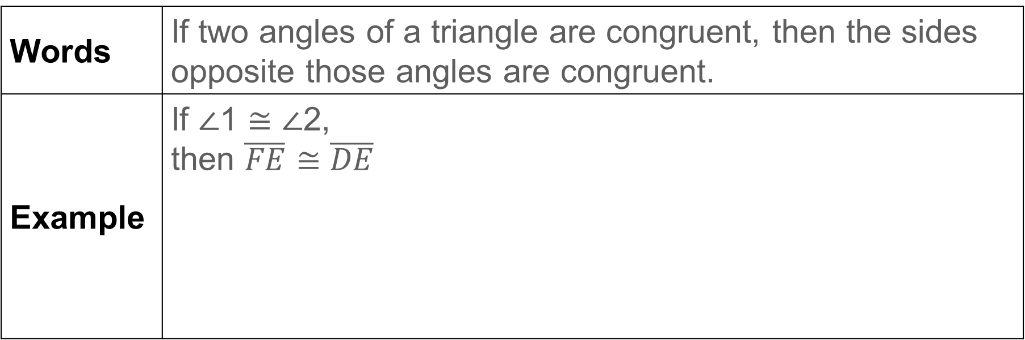
Learn
Isosceles Triangles
Theorem 5.11: Converse of the Isosceles Triangle Theorem
Words | If two angles of a triangle are congruent, then the sides opposite those angles are congruent.
Example | If ∠1 ≅ ∠2, then $\overline{FE}≅\overline{DE}$

Slide 10
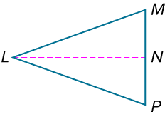
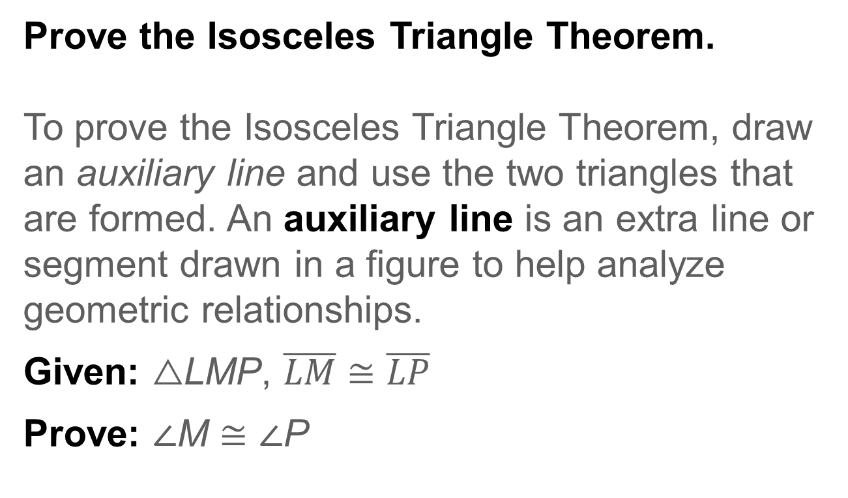
Example 1
Prove Theorems About Isosceles Triangles
Prove the Isosceles Triangle Theorem.
To prove the Isosceles Triangle Theorem, draw an auxiliary line and use the two triangles that are formed. An auxiliary line is an extra line or segment drawn in a figure to help analyze geometric relationships.
Given: △LMP, $\overline{LM}≅\overline{LP}$
Prove: ∠M ≅ ∠P

Slide 11
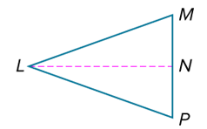

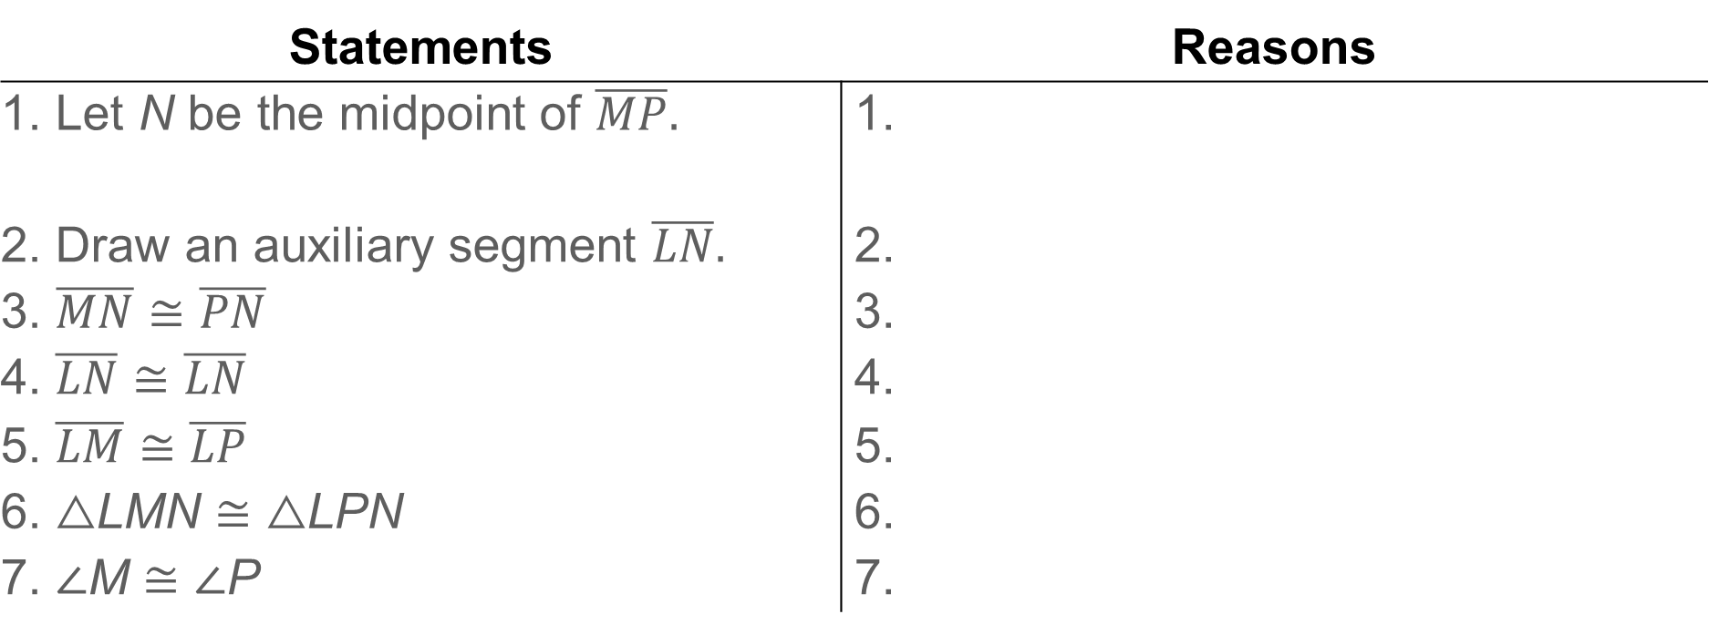
Example 1
Proof:
Statements | Reasons
1. Let N be the midpoint of $\overline{MP}.$ | 1.
2. Draw an auxiliary segment $\overline{LN}.$ | 2.
3. $\overline{MN}≅\overline{PN}$ | 3.
4. $\overline{LN}≅\overline{LN}$ | 4.
5. $\overline{LM}≅\overline{LP}$ | 5.
6. △LMN ≅ △LPN | 6.
7. ∠M ≅ ∠P | 7.

Slide 12
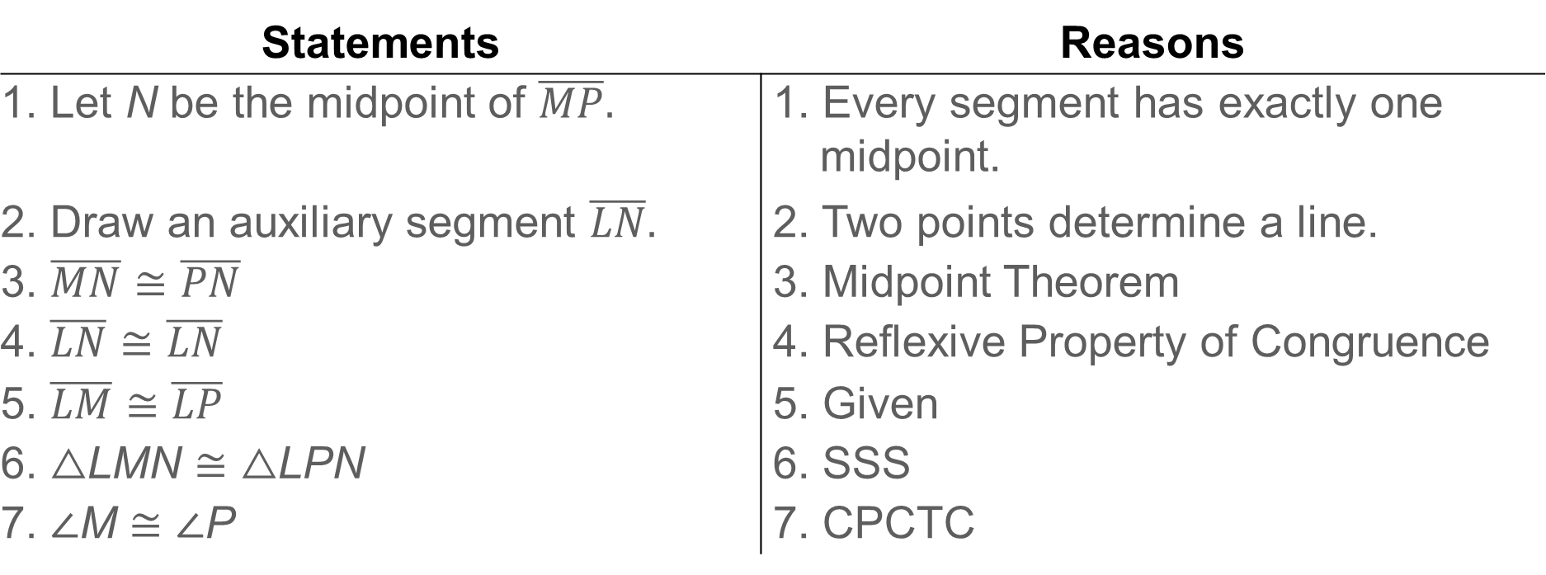
Example 1
Proof:
Statements | Reasons
1. Let N be the midpoint of $\overline{MP}.$ | 1. Every segment has exactly one midpoint.
2. Draw an auxiliary segment $\overline{LN}.$ | 2. Two points determine a line.
3. $\overline{MN}≅\overline{PN}$ | 3. Midpoint Theorem
4. $\overline{LN}≅\overline{LN}$ | 4. Reflexive Property of Congruence
5. $\overline{LM}≅\overline{LP}$ | 5. Given
6. △LMN ≅ △LPN | 6. SSS
7. ∠M ≅ ∠P | 7. CPCTC

Slide 13
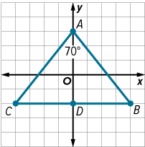
Example 2
Find Missing Measures in Isosceles Triangles
Find m∠B and m∠C.
Part A Determine side relationships.
Part B Determine the angle measures.

Slide 14
Example 2
Find Missing Measures in Isosceles Triangles
Part A Determine side relationships.
Use the Distance Formula to determine the measures of the sides of △ABC. The coordinates of △ABC are A(0, 3), B(4, −2), and C(−4, −2).

Slide 15
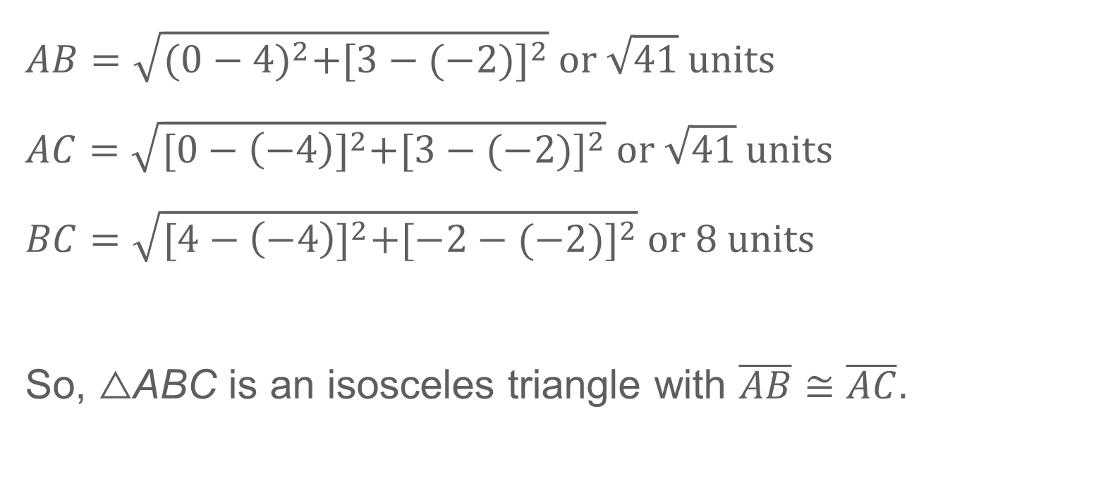
Example 2
Find Missing Measures in Isosceles Triangles
$$AB=\sqrt{{(0−4)}^{2}+{[3−(−2)]}^{2}} or \sqrt{41} units$$
$$AC=\sqrt{{[0−\left(−4\right)]}^{2}+{[3−(−2)]}^{2}} or \sqrt{41} units$$
$$BC=\sqrt{{[4−\left(−4\right)]}^{2}+{[−2−(−2)]}^{2}} or 8 units$$
So, △ABC is an isosceles triangle with $\overline{AB}≅\overline{AC}.$

Slide 16
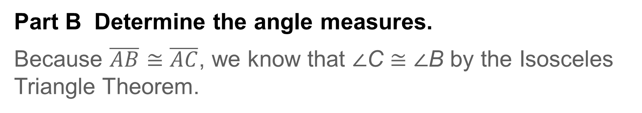
Example 2
Find Missing Measures in Isosceles Triangles
Part B Determine the angle measures.
Because $\overline{AB}≅\overline{AC}$, we know that ∠C ≅ ∠B by the Isosceles Triangle Theorem.
m∠A + m∠B + m∠C | = 180° | Triangle Angle-Sum Theorem
m∠A + 2m∠B | = 180° | Definition of congruent
70° + 2m∠B | = 180° | Substitute.
m∠B = m∠C | = 55° | Solve.

Slide 17
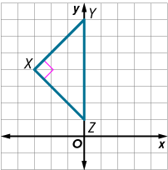
Example 2
Find Missing Measures in Isosceles Triangles
Check
Find m∠XYZ and m∠YZX.

Slide 18
Example 2
Find Missing Measures in Isosceles Triangles
Check
Find m∠XYZ and m∠YZX.
m∠XYZ = 45°
m∠YZX = 45°
Notes:
m∠XYZ = 45°
m∠YZX = 45°

Slide 19
Learn
Equilateral Triangles
The Isosceles Triangle Theorem leads to two corollaries about the angles of an equilateral triangle.
Corollary 5.3
A triangle is equilateral if and only if it is equiangular.
Corollary 5.4
Each angle of an equilateral triangle measures 60°.

Slide 20
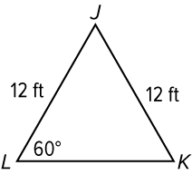
Example 3
Find Missing Measures in Equilateral Triangles
Find m∠J.

Slide 21
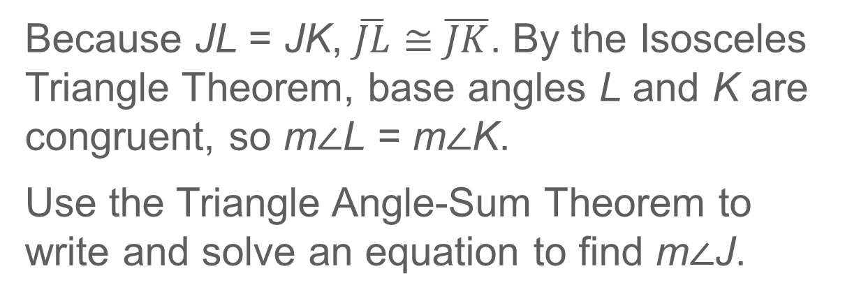
Example 3
Find Missing Measures in Equilateral Triangles
Because JL = JK, $\overline{JL}≅\overline{JK}$. By the Isosceles Triangle Theorem, base angles L and K are congruent, so m∠L = m∠K.
Use the Triangle Angle-Sum Theorem to write and solve an equation to find m∠J.
m∠J + m∠K + m∠L | = 180° | Triangle Angle-Sum Theorem
m∠J + 60° + 60° | = 180° | Substitute.
m∠J | = 160° | Solve.

Slide 22
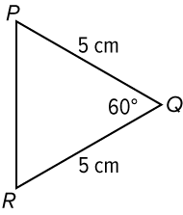
Example 3
Find Missing Measures in Equilateral Triangles
Check
Find m∠R and PR.

Slide 23
Example 3
Find Missing Measures in Equilateral Triangles
Check
Find m∠R and PR.
m∠R = 60°
PR = 5 cm
Notes:
m∠R = 60°
PR = 5 cm

Slide 24
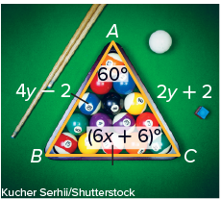
Example 4
Find Missing Values
BILLIARDS Find the value of each variable.

Slide 25
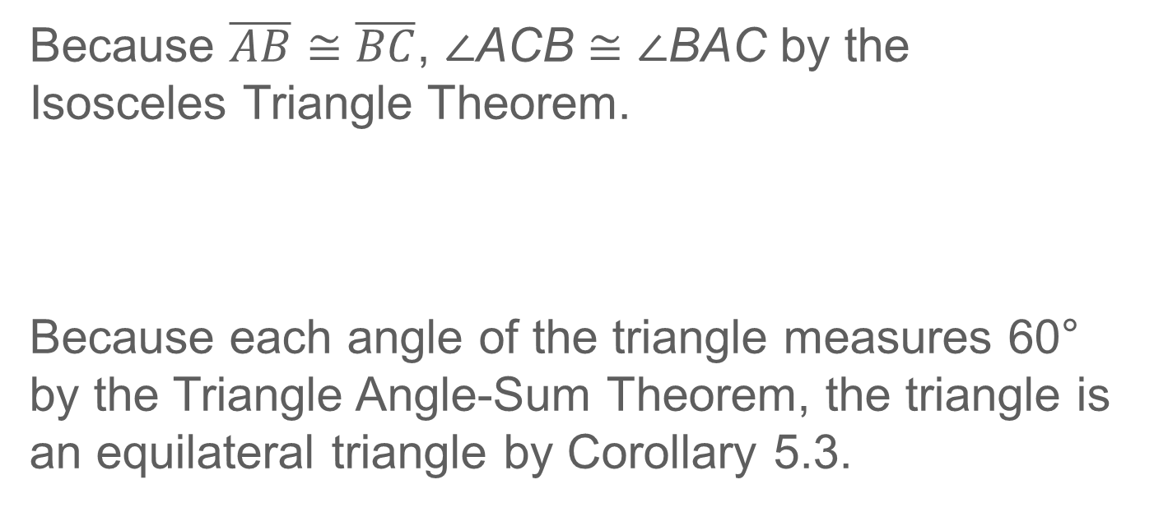
Example 4
Find Missing Values
Because $\overline{AB}≅\overline{BC}$, ∠ACB ≅ ∠BAC by the Isosceles Triangle Theorem.
Because each angle of the triangle measures 60° by the Triangle Angle-Sum Theorem, the triangle is an equilateral triangle by Corollary 5.3.
(6x + 6)° | = 60° | Isosceles Triangle Theorem
x | = 9 | Solve.
4y − 2 | = 2y + 2 | Corollary 5.3; definition of equilateral △
y | = 2 | Solve.

Slide 26
Example 4
Find Missing Values
Talk About It!
Arturo argues that you do not have to use the properties of equilateral triangles to solve for y. Do you agree? Explain your reasoning.

Slide 27
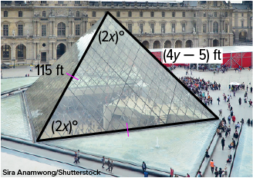
Example 4
Find Missing Values
Check
ARCHITECTURE The main entrance to the Louvre Museum is a unique metal and glass pyramid. Find the value of each variable.

Slide 28
Example 4
Find Missing Values
Check
ARCHITECTURE The main entrance to the Louvre Museum is a unique metal and glass pyramid. Find the value of each variable.
x = 30 and y = 30
Notes:
x = 30 and y = 30

Slide 29
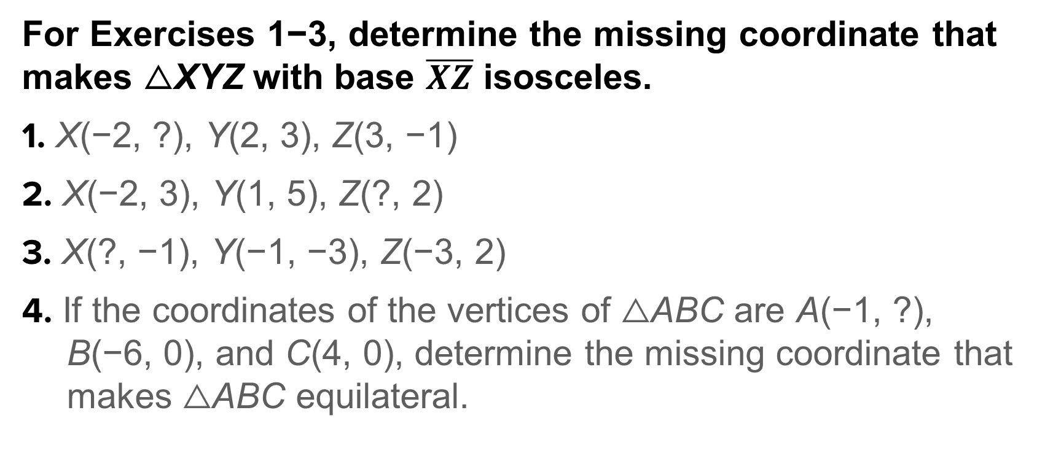
Exit Ticket
For Exercises 1−3, determine the missing coordinate that makes △XYZ with base $\overline{XZ}$ isosceles.
1. X(−2, ?), Y(2, 3), Z(3, −1)
2. X(−2, 3), Y(1, 5), Z(?, 2)
3. X(?, −1), Y(−1, −3), Z(−3, 2)
4. If the coordinates of the vertices of △ABC are A(−1, ?), B(−6, 0), and C(4, 0), determine the missing coordinate that makes △ABC equilateral.

Slide 30
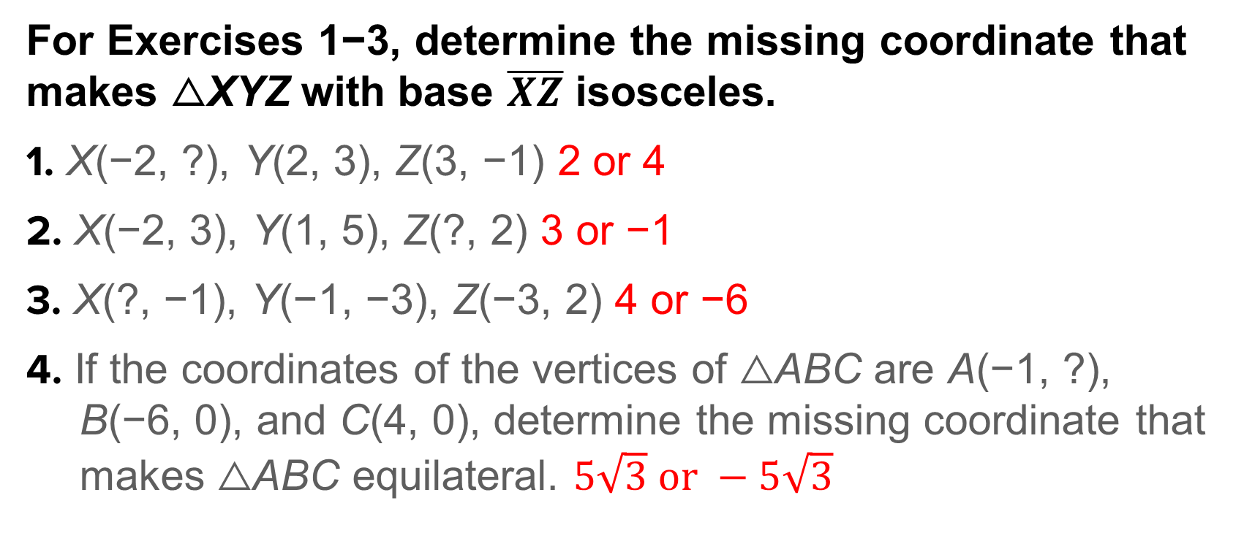
Exit Ticket
For Exercises 1−3, determine the missing coordinate that makes △XYZ with base $\overline{XZ}$ isosceles.
1. X(−2, ?), Y(2, 3), Z(3, −1) 2 or 4
2. X(−2, 3), Y(1, 5), Z(?, 2) 3 or −1
3. X(?, −1), Y(−1, −3), Z(−3, 2) 4 or −6
4. If the coordinates of the vertices of △ABC are A(−1, ?), B(−6, 0), and C(4, 0), determine the missing coordinate that makes △ABC equilateral. $5\sqrt{3} or −5\sqrt{3}$
Notes:
2 or 4
3 or −1
4 or −6
$$5\sqrt{3} or −5\sqrt{3}$$

