Slide 1
Special Right Triangles
45-45-90 Triangles
30-60-90 Triangles

Slide 2
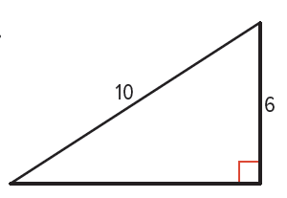
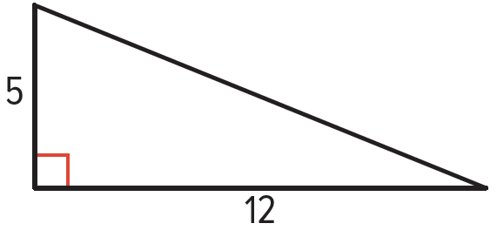
Warm Up
Use the Pythagorean Theorem to find the unknown lengths. Round to the nearest tenth if necessary.
1.
2.

Slide 3
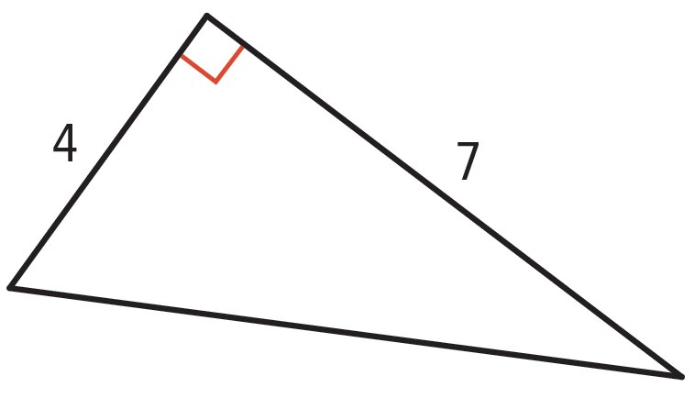
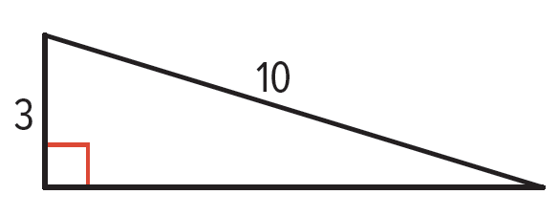
Warm Up
Use the Pythagorean Theorem to find the unknown lengths. Round to the nearest tenth if necessary.
3.
4.

Slide 4
Warm Up
5. MONITORS Maria thinks that the largest monitor her small desk will hold is 10 inches tall by 16 inches wide. On an online shopping site, she finds a 22-inch monitor with the same aspect ratio, measured diagonally. Will the computer fit on Maria’s desk?

Slide 5
Florida’s B.E.S.T. Standards for Mathematics
MA.912.T.1.2
Solve mathematical and real-world problems involving right triangles using trigonometric ratios and the Pythagorean Theorem.

Slide 6
Florida’s Mathematical Thinking and Reasoning Standards
MA.K12.MTR.1.1
Actively participate in effortful learning both individually and collectively.
MA.K12.MTR.3.1
Complete tasks with mathematical fluency.
MA.K12.MTR.4.1
Engage in discussions that reflect on the mathematical thinking of self and others.

Slide 7
Florida’s Mathematical Thinking and Reasoning Standards
MA.K12.MTR.5.1
Use patterns and structure to help understand and connect mathematical concepts.

Slide 8
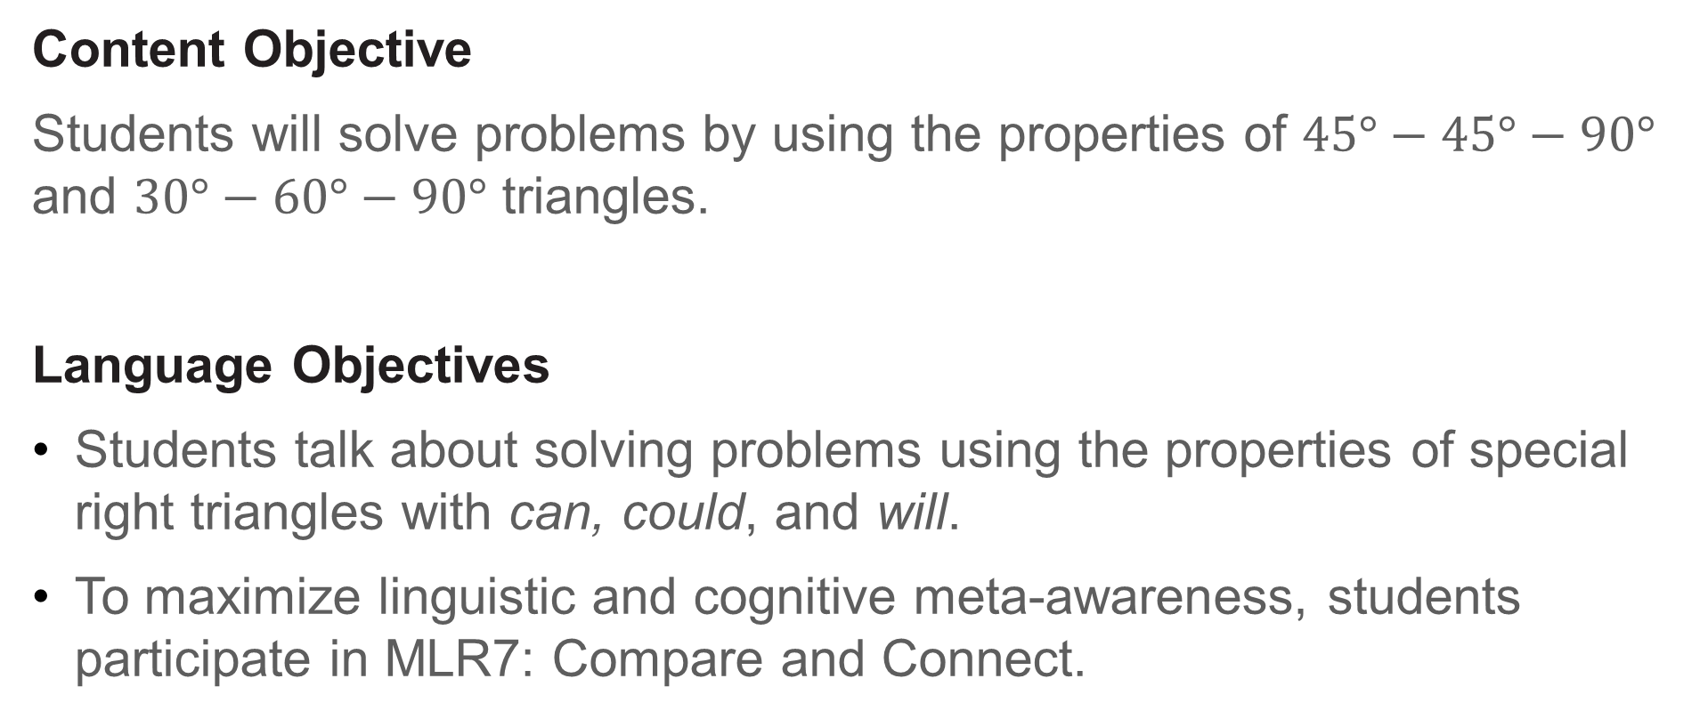
Lesson Objectives
Content Objective
Students will solve problems by using the properties of $45°−45°−90°$ and $30°−60°−90°$ triangles.
Language Objectives
Students talk about solving problems using the properties of special right triangles with can, could, and will.
To maximize linguistic and cognitive meta-awareness, students participate in MLR7: Compare and Connect.

Slide 9
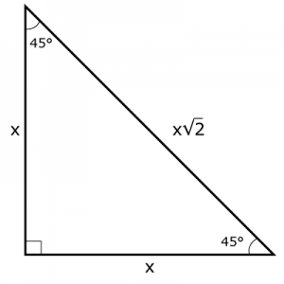
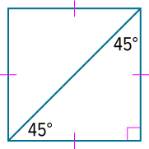

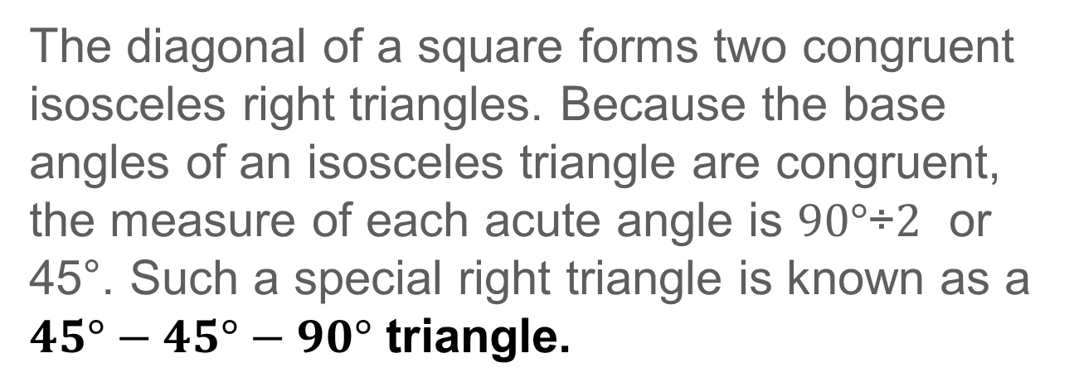
Learn
$45°−45°−90°$ Triangles
The diagonal of a square forms two congruent isosceles right triangles. Because the base angles of an isosceles triangle are congruent, the measure of each acute angle is $90°\text{÷}2$ or 45°. Such a special right triangle is known as a $45°−45°−90°$ triangle.

Slide 10
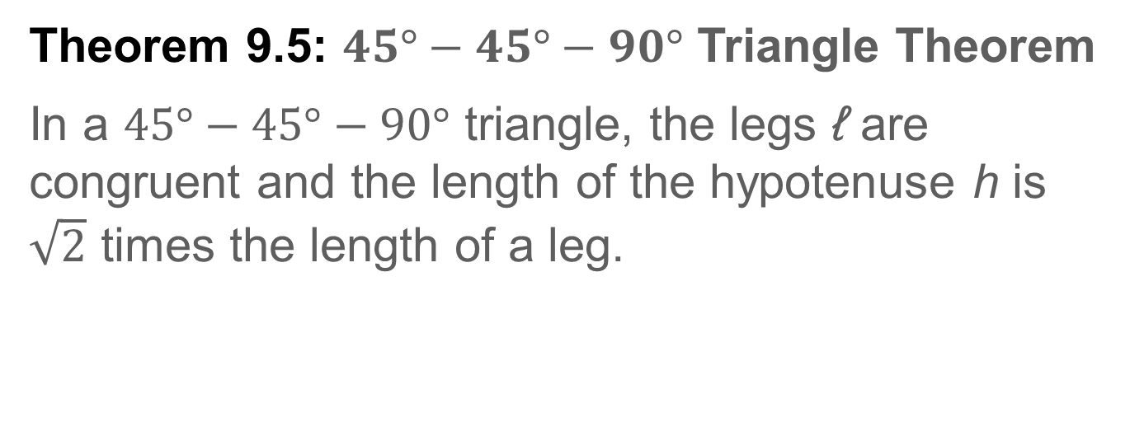
Learn
$45°−45°−90°$ Triangles
Theorem 9.5: $45°−45°−90°$ Triangle Theorem
In a $45°−45°−90°$ triangle, the legs ℓ are congruent and the length of the hypotenuse h is $\sqrt{2}$ times the length of a leg.

Slide 11
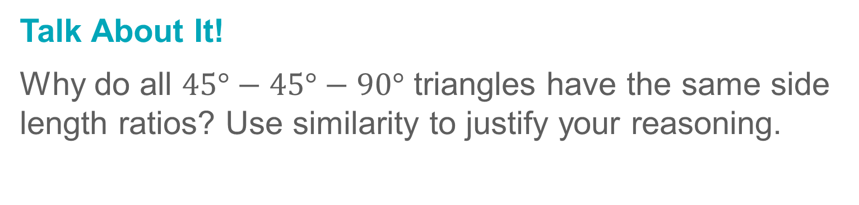
Learn
$45°−45°−90°$ Triangles
Talk About It!
Why do all $45°−45°−90°$ triangles have the same side length ratios? Use similarity to justify your reasoning.

Slide 12
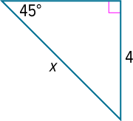
Example 1A
Find the Hypotenuse Length Given an Angle Measure
Find the value of x.

Slide 13
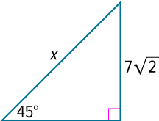
Example 1B
Find the Hypotenuse Length Given an Angle Measure
Check
Find the value of x.

Slide 14
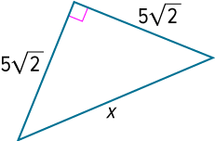
Example 2A
Find the Hypotenuse Length Given a Side Measure
Find the value of x.

Slide 15
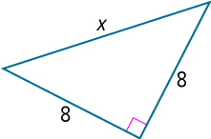
Example 2B
Find the Hypotenuse Length Given a Side Measure
Check
Find the value of x.

Slide 16
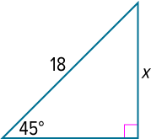

Example 3A
Find Leg Lengths in a $45°−45°−90°$Triangle
Find the value of x.

Slide 17
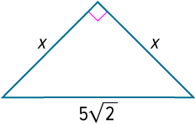

Example 3B
Find Leg Lengths in a $45°−45°−90°$Triangle
Check
Find the value of x.

Slide 18
Exit Ticket
1. The perimeter of a square is 16. What is the length of the diagonal?
2. The perimeter of an equilateral triangle is 36. What is the length of the altitude?

Slide 19
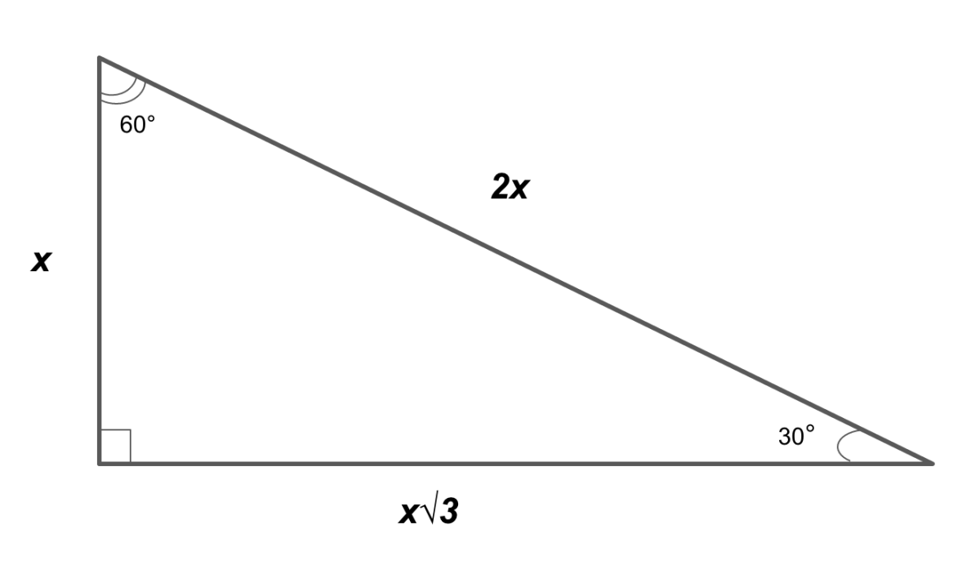
DAY 2 - 30-60-90 Special Right Triangles

Slide 20
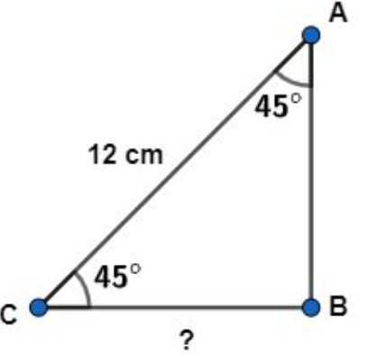
WARM UP
Find the missing side.

Slide 21

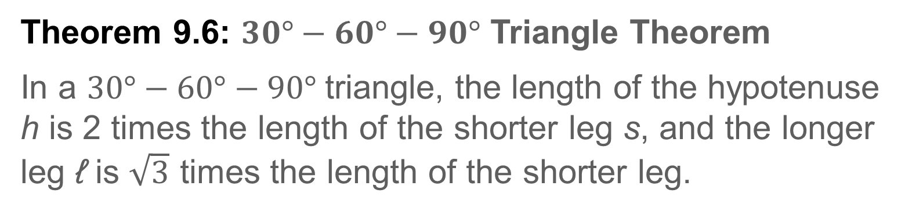
Learn
$30°−60°−90°$Triangles
Theorem 9.6: $30°−60°−90°$ Triangle Theorem
In a $30°−60°−90°$triangle, the length of the hypotenuse h is 2 times the length of the shorter leg s, and the longer leg ℓ is $\sqrt{3}$ times the length of the shorter leg.

Slide 22
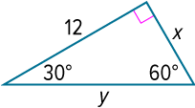

Example 1A
Find Leg Lengths in a $30°−60°−90°$Triangle
Find the values of x and y.

Slide 23
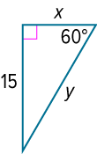

Example 1B
Find Leg Lengths in a $30°−60°−90°$Triangle
Check
Find the values of x and y.

Slide 24
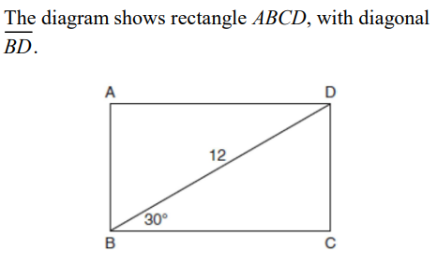


Example #2
Use Properties of $30°−60°−90°$Triangles

Slide 25
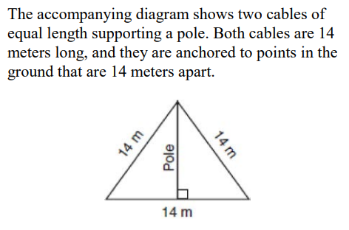

Example #3
Use Properties of $30°−60°−90°$Triangles

Slide 26
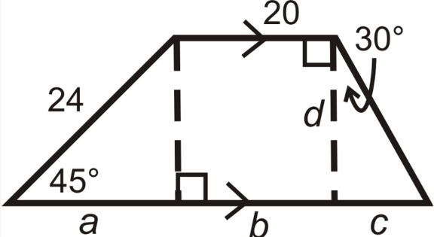

Example #4
Use Properties of $30°−60°−90°$Triangles
Find the value of a, b, c, and d.

Slide 27
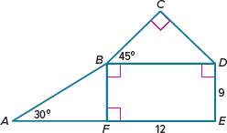
Exit Ticket
Find the missing side lengths on the figure.

