Slide 1
Proving Triangles Congruent: SSS, SAS
Video

Slide 2
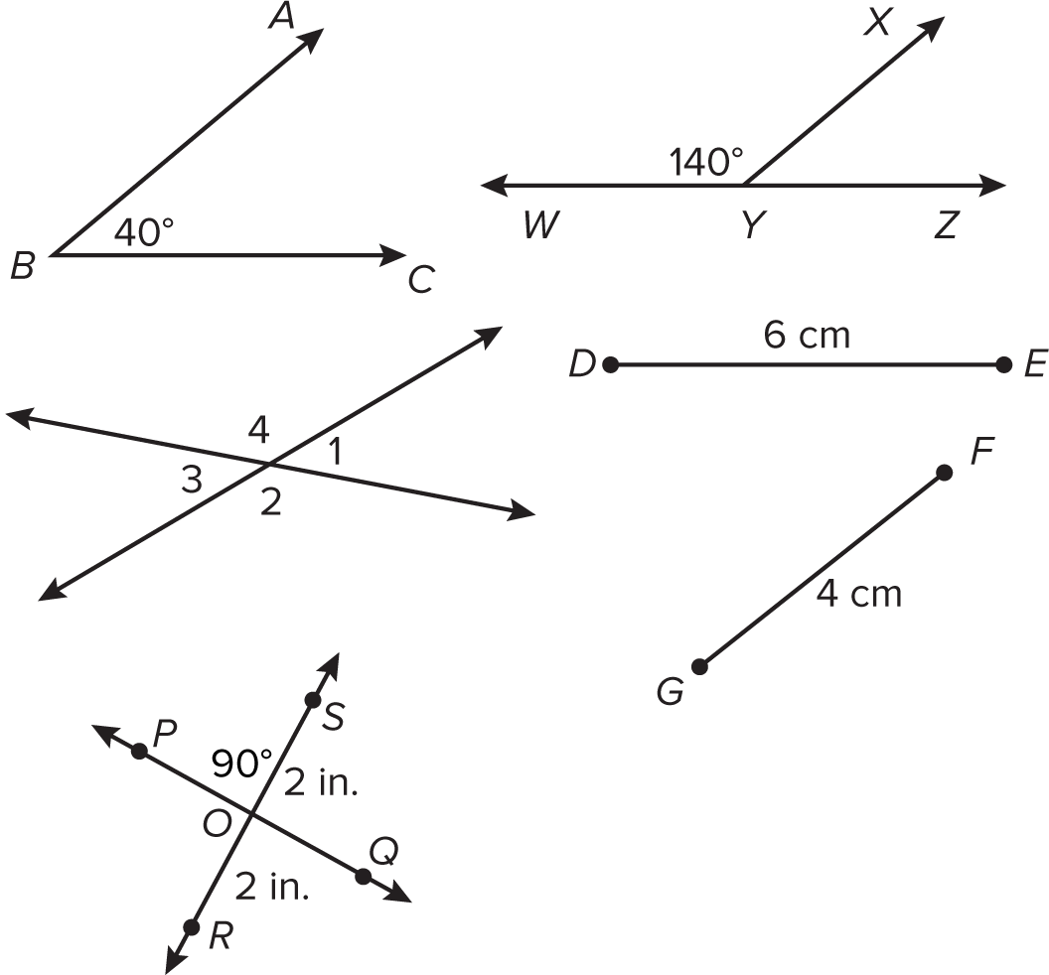
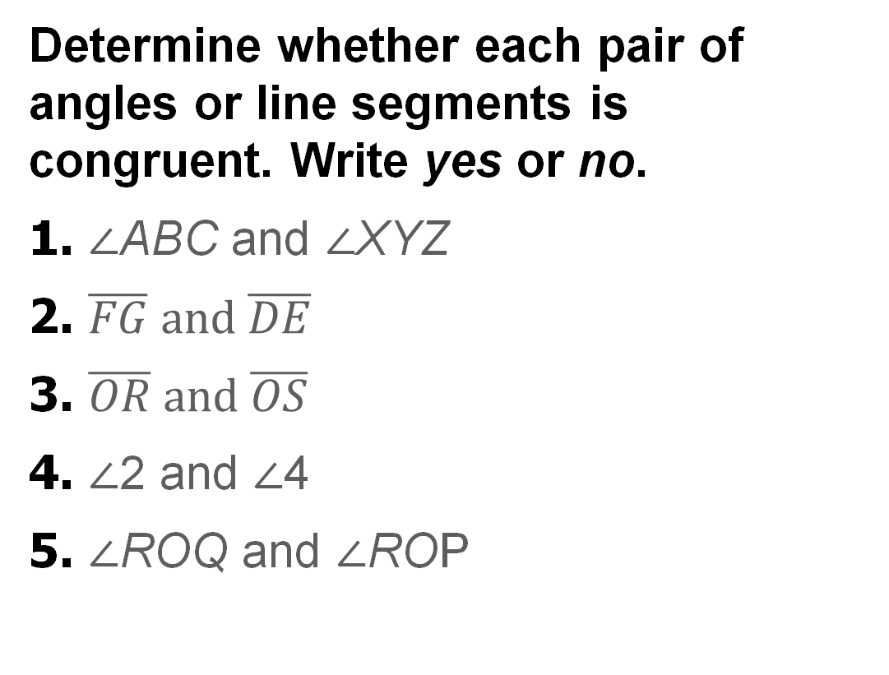
Warm Up
Determine whether each pair of angles or line segments is congruent. Write yes or no.
1. ∠ABC and ∠XYZ
2. $\overline{FG} and \overline{DE}$
3. $\overline{OR} and \overline{OS}$
4. ∠2 and ∠4
5. ∠ROQ and ∠ROP

Slide 3
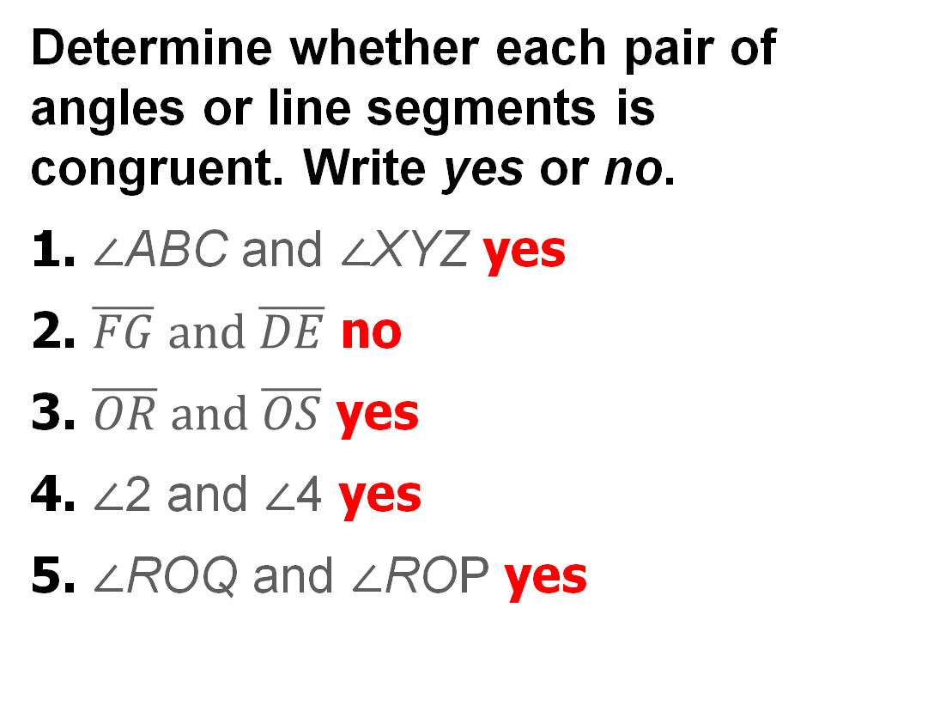
Warm Up
Determine whether each pair of angles or line segments is congruent. Write yes or no.
1. ∠ABC and ∠XYZ yes
2. $\overline{FG} and \overline{DE}$ no
3. $\overline{OR} and \overline{OS}$ yes
4. ∠2 and ∠4 yes
5. ∠ROQ and ∠ROP yes
Notes:
yes
no
yes
yes
yes

Slide 4
Florida’s B.E.S.T. Standards for Mathematics
MA.912.GR.1.2 Prove triangle congruence or similarity using Side-Side-Side, Side-Angle-Side, Angle-Side-Angle, Angle-Angle-Side, Angle-Angle and Hypotenuse-Leg.
MA.912.GR.1.3 Prove relationships and theorems about triangles. Solve mathematical and real-world problems involving postulates, relationships and theorems of triangles.
MA.912.GR.1.6 Solve mathematical and real-world problems involving congruence or similarity in two-dimensional figures.

Slide 5
Florida’s Mathematical Thinking and Reasoning Standards
MA.K12.MTR.3.1
Complete tasks with mathematical fluency.
MA.K12.MTR.5.1
Use patterns and structure to help understand and connect mathematical concepts.

Slide 6
Lesson Objectives
Content Objective
Students will use SSS and SAS to prove triangles congruent.
Language Objectives
Students use If… and When… statements to explain how triangles are or are not congruent.
To maximize linguistic and cognitive meta-awareness, students participate in MLR2: Collect and Display.

Slide 7
Learn
Proving Triangles Congruent: SSS
You can prove two triangles congruent by showing that all six pairs of corresponding parts are congruent. However, it is possible to prove two triangles congruent using fewer pairs of corresponding parts.
If two triangles have the same three side lengths, then there is a series of rigid transformations that will show the two triangles congruent. This leads to the postulate on the next slide.

Slide 8
Learn
Proving Triangles Congruent: SSS
Postulate 5.1: Side-Side-Side (SSS) Congruence
If three sides of one triangle are congruent to three sides of a second triangle, then the triangles are congruent.

Slide 9
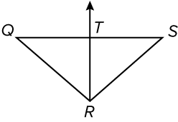
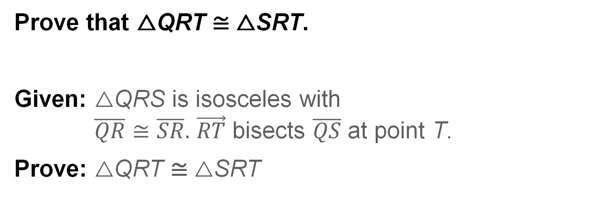
Example 1
Use SSS to Prove Triangles Congruent
Prove that △QRT ≅ △SRT.
Given: △QRS is isosceles with
$\overline{QR}≅\overline{SR}.$ $\vec{RT}$ bisects $\overline{QS}$ at point T.
Prove: △QRT ≅ △SRT

Slide 10
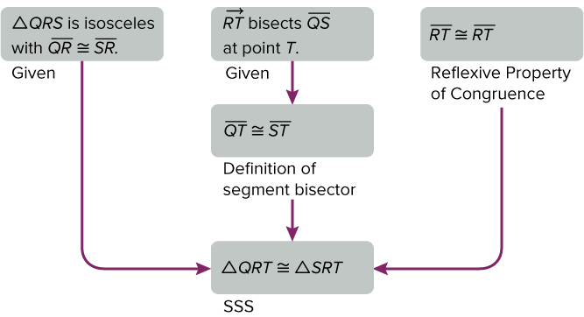
Example 1
Use SSS to Prove Triangles Congruent
Proof:

Slide 11
Example 1
Use SSS to Prove Triangles Congruent
Talk About It!
What properties of flow proofs make it a reliable method for proving triangles congruent?

Slide 12
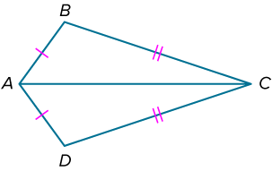
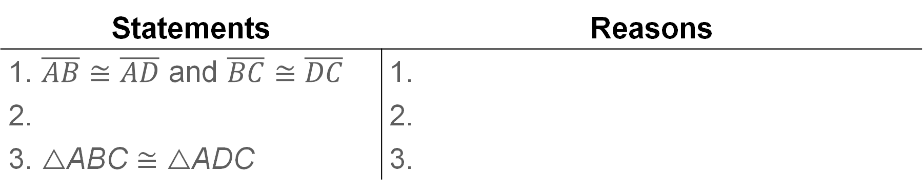
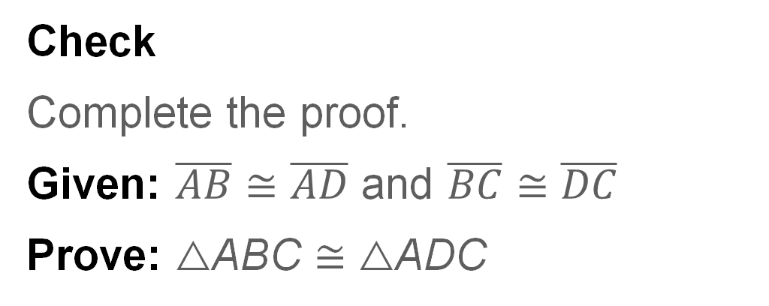
Example 1
Use SSS to Prove Triangles Congruent
Check
Complete the proof.
Given: $\overline{AB}≅\overline{AD}$ and $\overline{BC}≅\overline{DC}$
Prove: △ABC ≅ △ADC
Statements | Reasons
1. $\overline{AB}≅\overline{AD}$ and $\overline{BC}≅\overline{DC}$ | 1.
2. | 2.
3. △ABC ≅ △ADC | 3.

Slide 13
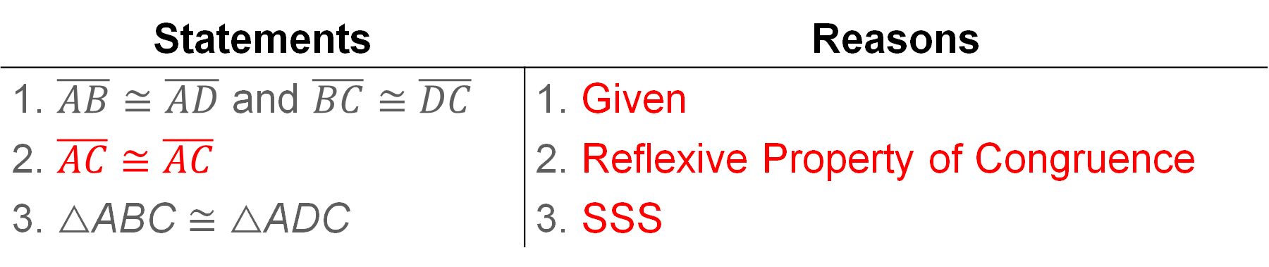

Example 1
Use SSS to Prove Triangles Congruent
Check
Complete the proof.
Given: $\overline{AB}≅\overline{AD}$ and $\overline{BC}≅\overline{DC}$
Prove: △ABC ≅ △ADC
Statements | Reasons
1. $\overline{AB}≅\overline{AD}$ and $\overline{BC}≅\overline{DC}$ | 1. Given
2. $\overline{AC}≅\overline{AC}$ | 2. Reflexive Property of Congruence
3. △ABC ≅ △ADC | 3. SSS
Notes:
Statements
2. $\overline{AC}≅\overline{AC}$
Reasons
1. Given
2. Reflexive Property of Congruence
3. SSS

Slide 14
Example 2
Use SSS on the Coordinate Plane
Triangle JKL has vertices J(2, 5), K(1, 1), and L(5, 2). Triangle QNP has vertices Q(−4, 4), N(−3, 0), and P(−7, 1). Is △JKL ≅ △QNP?
Part A Graph the triangles.
Part B Make a conjecture.
Part C Support your conjecture.

Slide 15
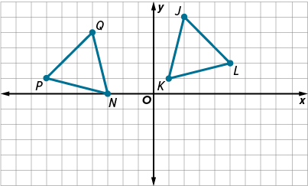
Example 2
Use SSS on the Coordinate Plane
Part A Graph the triangles.

Slide 16
Example 2
Use SSS on the Coordinate Plane
Part B Make a conjecture.
Use your graph to make a conjecture as to whether the triangles are congruent. Explain your reasoning.
From the graph, it appears that the triangles have the same shape and size, so we can conjecture that they are congruent.

Slide 17
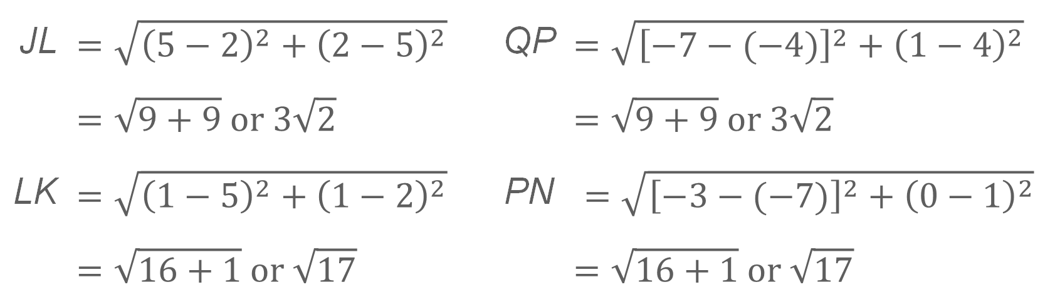
Example 2
Use SSS on the Coordinate Plane
Part C Support your conjecture.
Use the Distance Formula to show that all corresponding sides have the same measure.
JL | $$=\sqrt{{\left(5−2\right)}^{2}+{\left(2−5\right)}^{2}}$$ | QP | $$=\sqrt{{\left[−7−(−4)\right]}^{2}+{\left(1−4\right)}^{2}}$$
 | $$=\sqrt{9+9} or 3\sqrt{2}$$ |  | $$=\sqrt{9+9} or 3\sqrt{2}$$
LK | $$=\sqrt{{\left(1−5\right)}^{2}+{\left(1−2\right)}^{2}}$$ | PN | $$=\sqrt{{\left[−3−(−7)\right]}^{2}+{\left(0−1\right)}^{2}}$$
 | $$=\sqrt{16+1} or \sqrt{17}$$ |  | $$=\sqrt{16+1} or \sqrt{17}$$
(continued on the next slide)

Slide 18
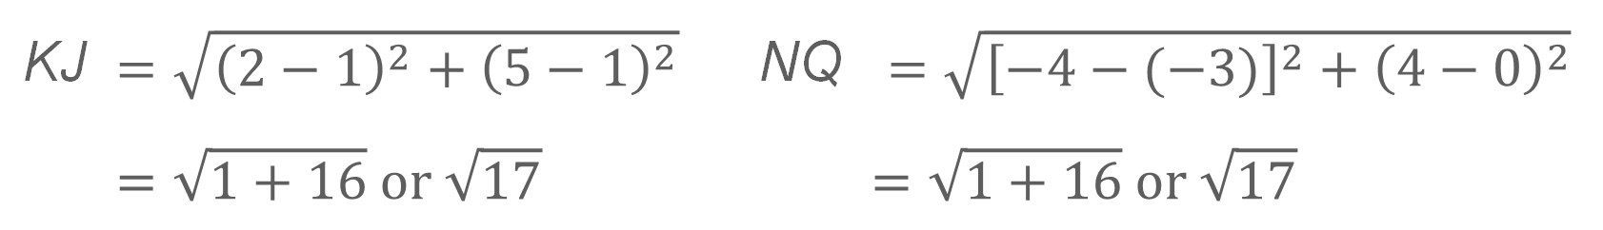
Example 2
Use SSS on the Coordinate Plane
KJ | $$=\sqrt{{\left(2−1\right)}^{2}+{\left(5−1\right)}^{2}}$$ | NQ | $$=\sqrt{{\left[−4−(−3)\right]}^{2}+{\left(4−0\right)}^{2}}$$
 | $$=\sqrt{1+16} or \sqrt{17}$$ |  | $$=\sqrt{1+16} or \sqrt{17}$$
JL = QP, LK = PN, and KJ = NQ. By the definition of congruent segments, all corresponding segments are congruent. Therefore, △JKL ≅ △QNP by SSS.

Slide 19
Example 2
Use SSS on the Coordinate Plane
Check
Triangle ABC has vertices A(1, 1), B(0, 3), and C(2, 5). Triangle EFG has vertices E(1, −1), F(2, −5), and G(4, −4). Is △ABC ≅ △EFG?
Part A
Graph △ABC and △EFG on the same coordinate plane.
Part B
Find the side lengths of each triangle.

Slide 20
Example 2
Use SSS on the Coordinate Plane
Part C
Is triangle ABC congruent to triangle EFG? Justify your argument.
A. No; AC ≠ FG, so SSS congruence is not met.
B. No; BC ≠ FG, so SSS congruence is not met.
C. Yes; all corresponding sides have the same measure, so SSS congruence is met.
D. Yes; all corresponding sides have the same measure, so by the definition of congruent figures, △ABC ≅ △EFG.

Slide 21
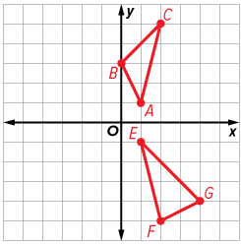
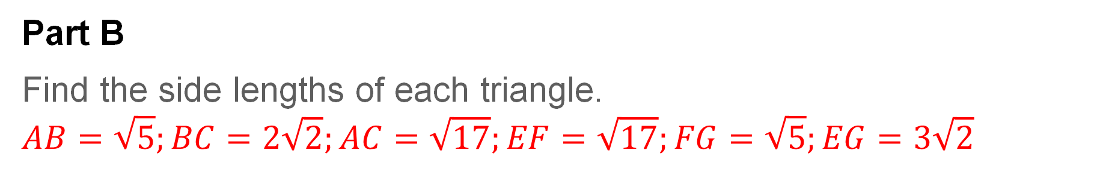
Example 2
Use SSS on the Coordinate Plane
Part A
Graph △ABC and △EFG on the same coordinate plane.
Part B
Find the side lengths of each triangle.
$$AB=\sqrt{5};BC=2\sqrt{2};AC=\sqrt{17};EF=\sqrt{17};FG=\sqrt{5};EG=3\sqrt{2}$$
Notes:
Part B
$$AB=\sqrt{5};BC=2\sqrt{2};AC=\sqrt{17};EF=\sqrt{17};FG=\sqrt{5};EG=3\sqrt{2}$$

Slide 22
Example 2
Use SSS on the Coordinate Plane
Part C
Is triangle ABC congruent to triangle EFG? Justify your argument.
A. No; AC ≠ FG, so SSS congruence is not met.
B. No; BC ≠ FG, so SSS congruence is not met.
C. Yes; all corresponding sides have the same measure, so SSS congruence is met.
D. Yes; all corresponding sides have the same measure, so by the definition of congruent figures, △ABC ≅ △EFG.
B
Notes:
B

Slide 23
Learn
Proving Triangles Congruent: SAS
The interior angle formed by two adjacent sides of a triangle is called an included angle.
If two triangles are formed using the same side lengths and included angle measure, then there is a series of rigid transformations that will show that the two triangles are congruent. This leads to the postulate on the next slide.

Slide 24
Learn
Proving Triangles Congruent: SAS
Postulate 5.2: Side-Angle-Side (SAS) Congruence
If two sides and the included angle of one triangle are congruent to two sides and the included angle of a second triangle, then the triangles are congruent.

Slide 25
Learn
Proving Triangles Congruent: SAS
Think About It!
Both legs of one right triangle are congruent to the legs of another right triangle. Are the triangles congruent? Justify your argument.

Slide 26
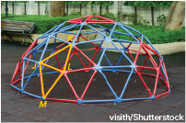
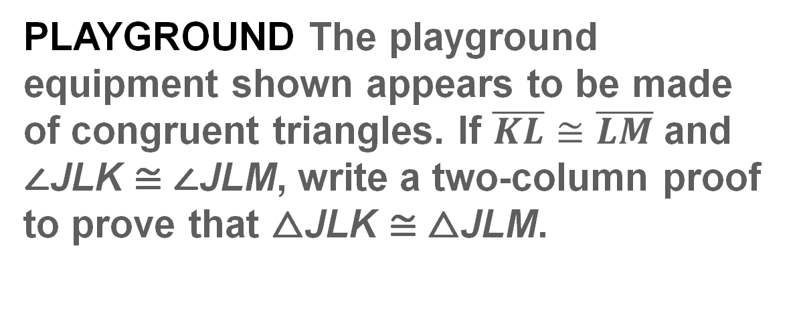
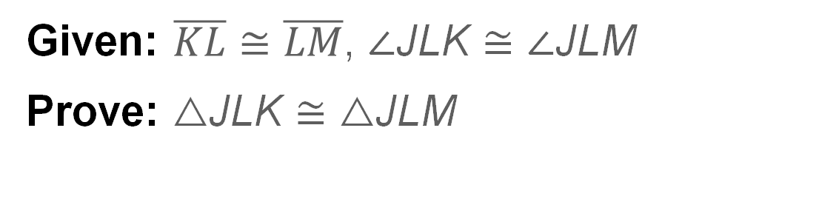
Example 3
Use SAS to Prove Triangles Congruent
PLAYGROUND The playground equipment shown appears to be made of congruent triangles. If $\overline{KL}≅\overline{LM}$ and ∠JLK ≅ ∠JLM, write a two-column proof to prove that △JLK ≅ △JLM.
Given: $\overline{KL}≅\overline{LM}$, ∠JLK ≅ ∠JLM
Prove: △JLK ≅ △JLM

Slide 27
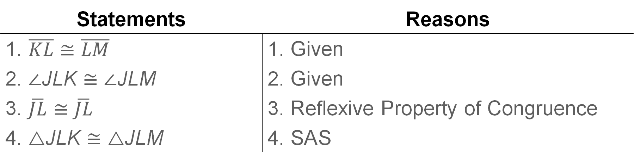
Example 3
Use SAS to Prove Triangles Congruent
Proof:
Statements | Reasons
1. $\overline{KL}≅\overline{LM}$ | 1. Given
2. ∠JLK ≅ ∠JLM | 2. Given
3. $\overline{JL}≅\overline{JL}$ | 3. Reflexive Property of Congruence
4. △JLK ≅ △JLM | 4. SAS

Slide 28
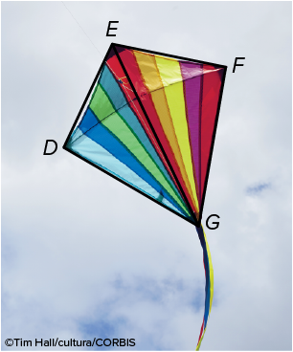
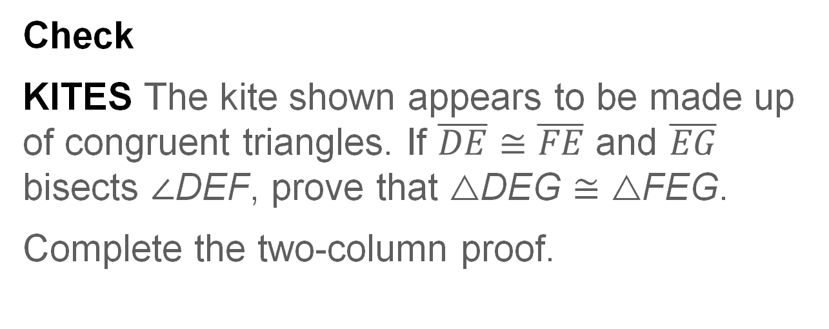

Example 3
Use SAS to Prove Triangles Congruent
Check
KITES The kite shown appears to be made up of congruent triangles. If $\overline{DE}≅\overline{FE}$ and $\overline{EG}$ bisects ∠DEF, prove that △DEG ≅ △FEG.
Complete the two-column proof.
Given: $\overline{DE}≅\overline{FE},$ $\overline{EG}$ bisects ∠DEF.
Prove: △DEG ≅ △FEG

Slide 29
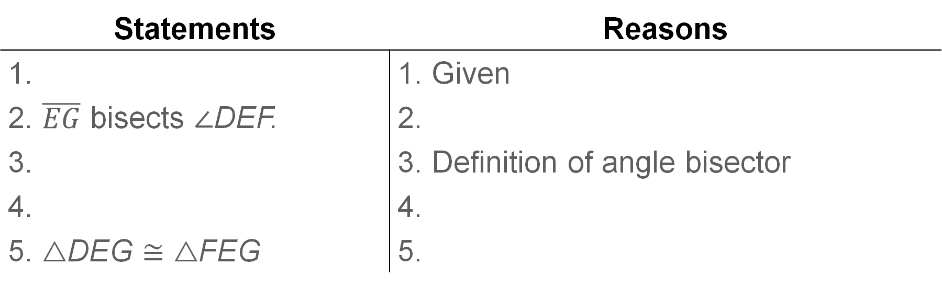
Example 3
Use SAS to Prove Triangles Congruent
Proof:
Statements | Reasons
1. | 1. Given
2. $\overline{EG}$ bisects ∠DEF. | 2.
3. | 3. Definition of angle bisector
4. | 4.
5. △DEG ≅ △FEG | 5.

Slide 30
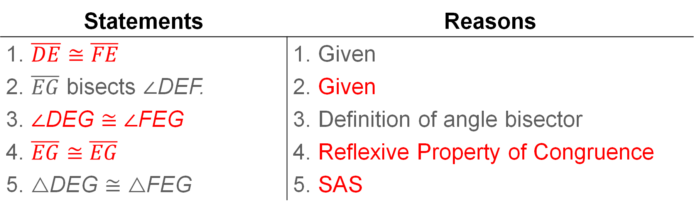
Example 3
Use SAS to Prove Triangles Congruent
Proof:
Statements | Reasons
1. $\overline{DE}≅\overline{FE}$ | 1. Given
2. $\overline{EG}$ bisects ∠DEF. | 2. Given
3. ∠DEG ≅ ∠FEG | 3. Definition of angle bisector
4. $\overline{EG}≅\overline{EG}$ | 4. Reflexive Property of Congruence
5. △DEG ≅ △FEG | 5. SAS
Notes:
Statements
1. $\overline{DE}≅\overline{FE}$
3. ∠DEG ≅ ∠FEG
4. $\overline{EG}≅\overline{EG}$
Reasons
2. Given
4. Reflexive Property of Congruence
5. SAS

Slide 31
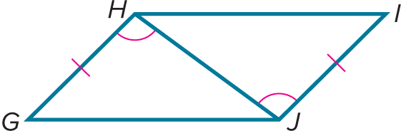
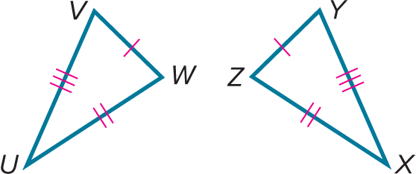
Exit Ticket
Which congruence criterion would you use to prove the two triangles congruent?
1.
2.

Slide 32
Exit Ticket
Which congruence criterion would you use to prove the two triangles congruent?
1.
2.
SAS
SSS
Notes:
SAS
SSS

